Slide 1
Marine Corps Leadership Development (MCLD)
Future
Time Management and Goal Setting
Notes:
This class will address some of the most important habits one must develop to be successful: goal setting and time & task management.

Slide 2
Functional Areas of Leadership Development
Continual Assessment of:
Fidelity:
Fighter:
Fitness:
Family:
Finances:
Future: Goal Setting and Time Management
Notes:
2

Slide 3
Why concern ourselves with Goal Setting and Time Management?
Interact on a personal level with Marines.
Systematically identify principles and translate them into a plan of action.
To better organize our own lives, use time at work and at home more wisely, and assist our Marines to do the same thing.
Discuss and practice some of the popular techniques of leadership, goal setting and time management
Notes:
Time Management and Goal setting skills are of course valuable for any person.
Ultimately, this portion is just a way to facilitate engaged leadership and organically create mentoring relationships.
By setting goals and asking our Marines to do the same we force ourselves to prioritize: which starts with identifying the basics of what is important to us. These are real life skills that take time and practice to master. We are providing a real life skill that improves readiness, and helps Marines for the rest of their lives.
Start to explore how the business world approaches things. There is a lot Marine officers can learn, about leadership and management from the business world as we begin to think about higher levels of leadership skills.

Slide 4
Principles Count
Big Advantage: Exploit it
Core Values
The best way to confront current and future challenges is to reinforce the basics of Marine Corps Values and leadership principles.
Our core values are where we start any mission, and any guidance on leading Marines.
Brilliance in the Basics: Leaders Role to reinforce.
Do we need to reinforce the basics??
Notes:
The USMC is at a great advantage when we start with principles. Unlike businesses or even other services, who must apply significant rigor to establish common values and principles within their organization. In the Marine Corps, we do not have that problem. Marines are already well trained in core values. These are our bedrock principles, and provide leaders a tremendous advantage when we are guiding our Marines. We all have common heritage in this sense.
- There are no shortcuts to success here. Everything we do falls in line under our core values. What that means there are unfortunately no quick fixes to success. We have to work hard to succeed. But we have the foundational principles to serve as an anchor point as we go forward.

Slide 5
Behavioral Health Statistics
There are consequences associated with young Marines and idle, unstructured time:
56% Binge Drink
15% considered heavy drinkers
Drug use low but misuse of prescription drugs an issue (About 20% of prescription drug users)
31% chew tobacco
How to counter this?
22% report high anxiety
13% report depression
25% victims of abuse in lifetime
1 in 5 females report unwanted sexual contact
22% report low commitment to the Marine Corps.
9% report feeling detached from the Marine Corps.
Notes:
Some numbers from the latest DoD/Tricare survey. Setting a good time management/goal setting program will certainly not alleviate all or even any of these challenges, but if we are to adopt a holistic approach to developing quality citizens, these numbers should be discussed. Additionally, giving people daily goals may alleviate some of the stressors and negative results associated with Marine life. This is the message to those who say, we know our Marines and we are good leaders. Harmful behaviors are occurring.

Slide 6
Goal Setting
Does setting goals help us?
Assists in Engaged Leadership
Encourages personal accountability
Motivation for better time management
How?
Define Values
Define the goals/mission
Prioritize the basics: Core Values and competencies: PME, PT, Training, Family Readiness
Make a plan for how to reach it
Assess and adjust regularly
Notes:
Goal Setting:
Why do we set goals? We do that to empower ourselves to have control over our own circumstances and give us control to effect what happens in our lives.
Before we start setting specific goals, it is important to define ourselves first. That is why principles and USMC values are so vital to going forward. We as USMC leaders have a great advantage here. The institution defines the values for the Marines, and we as leaders simply must assist Marines in living out those common values.
When setting goals, it is important that all the basics are covered and reinforced. This requires constant goal setting on the basics of military and personal readiness. Daily PT, Reading, a monthly savings plan, a weekend spent with the family etc…. These are the investments that do not show immediate pay off, but are investments into long term personal happiness and professional growth.

Slide 7
Goal Setting
Marine Corps Leadership Development recommends the SMART method of setting Goals
Treat our Goals as we would mission statements with a proper IOT at the end.
OIF II and 1MARDIV
Specific
Measurable
Attainable
Relevant
Time-based
Notes:
During OIF I, due to the tempo of the movement to Baghdad, a shortfall was identified that missions were being executed without leaders issuing 5-paragraph orders. In response, 1st MarDiv Commander General Mattis, prior to returning to Anbar Province for OIF II stressed that no movement, patrol or action of any sort will take place without leaders issuing a proper 5-paragraph order. This is the type of rigor we can be attaching to our personal goal setting plans.

Slide 8
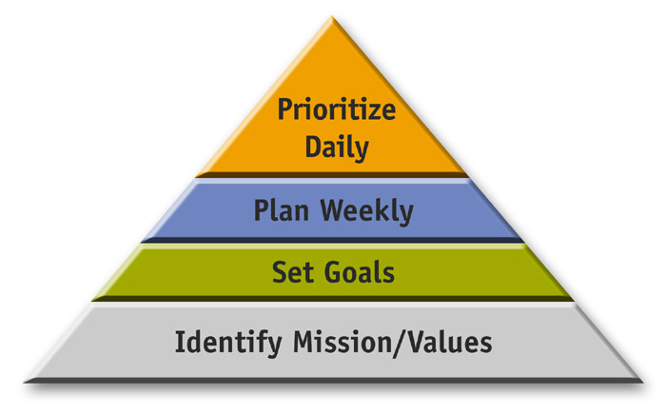
Productivity
Process

Slide 9
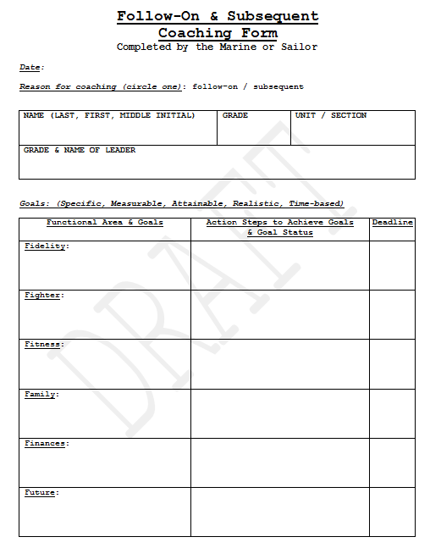

Slide 10
Assessing Progress
Regular coaching/counseling sessions
Once Marines create SMART goals, engaged leadership becomes easier and more focused.
Are the goals balanced and centered
Marines have control: Leaders facilitate and assist.
Adjust, reinforce, and/or continue with existing goals.
Requires leaders to get familiar with all the existing programs of the USMC. Marine Corps Leadership Development assists with this.
Developing Subordinates
Future assessment worksheet
Notes:
Assessing Progress is where Marine Corps Leadership Development comes together. This is where small unit leaders really get to know and understand their Marines. By using the Follow-On & Subsequent Coaching Form regularly leaders reinforce their own progress. This is Developing Subordinates. As leaders we evaluate and are evaluated based on this.
The Future Assessment Worksheet is another resource the Marine Corps Leadership Development has on the website for leaders and Marines alike to use during regular evaluations and assessments. This is simply a tool, that assists in the continuous process of developing our Marines.

Slide 11
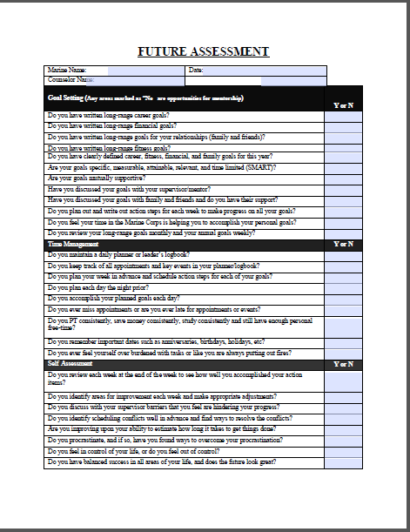

Slide 12
Why Manage Your Time?
“Determine never to be idle. No person will have occasion to complain of the want of time who never loses any. It is wonderful how much can be done if we are always doing.” Thomas Jefferson
“The cumulative value of investing small moments over long periods is considerable.”
Col Erdelatz
“It is amazing what a person can accomplish if they are not overly busy watching television.”

Slide 13
Now that we have SMART Goals, now what?
We create goals, but execution is the hard part:
Time Management
Many methods used to assist in Time Management:
Popular techniques to identify priorities and manage time wisely.
Notes:
Now that we have a great plan, some education on managing time and planning the day is warranted:

Slide 14
Time Management
Answer "yes" or "no" to each question:
I frequently need to respond to crisis or put out fires.
I have little time for actually planning ahead and sorting out priorities.
When I leave work “on time,” I feel guilty or anxious because of what has been left undone.
I have trouble devoting time and energy I would like to family and/or friends.
Even when I’m “off duty,” I find it difficult to quit thinking about what is happening at work.
I often find myself caught up in busy work or trivial issues.
I don’t have sufficient time to devote to activities that build my professional reputation.
Just keeping my head above water is about all I can hope for.
I have trouble finding a time system that works well for me.
It’s often the same few problems or people that take up a large chunk of time.
Notes:
Read through these questions, and think to yourself about some of these.
Responding "yes" to even or two of these statements may indicate difficulties. Make some time now and plan ahead.
Goal setting is a powerful process for thinking about your ideal future, and for motivating yourself to turn this vision of the future into reality

Slide 15
Time Management
A set of common sense skills that help you use your time productively and learn to:
Prioritize: Determine which things you do are important (lead to goal accomplishment) and which can be delayed or dropped
Use your time in the most effective way possible
Control distractions that waste time
Lessen stress by giving yourself more time to relax

Slide 16
Time Management Matrix
Urgent/Important Not Urgent/Important
Mission Essential Basics: PME, PT
Urgent/Not Important: Not Important/
Non-priority E-Mails Not Urgent: PS3, TV
Meetings
Q I
Q II
Q III
Q IV
Notes:
The Time Management Matrix is in 4 Quadrants. We must balance these quadrants, limiting time in the bottom half and placing a higher value on the top two. Urgent/Important Tasks must be completed, however Not Urgent important tasks maintain our foundation to do great things when the time is right.
Which is most important: Think COIN, we learned this and we can apply these tactical lessons learned to planning and managing our lives. In the COIN fight is it wise to shoot the enemy if it will cause collateral damage? No, so of course we think long term, we invest in protecting the population, and we do it, day after day. This is thinking long term, investing in mission accomplishment. We define the mission in the six area of our life, and prioritize with the long term in mind.

Slide 17
Avoid Procrastination
Procrastination is putting things off until they are unavoidable
Common pitfalls into procrastination:
Over Planning – Implementation is delayed
Perfectionism – Usually not required or cost effective
Boredom – Self-discipline is needed
Hostility – to task or person giving the task
"The Deadline High" – meeting a tight deadline and the adrenaline rush can be addictive
Quadrant III and IV
Time Management Worksheet

Slide 18
Future and Time Management
Two Years of Research Simply Put: Organize Priorities and manage time accordingly.
Work smarter, not harder
Think Foundational Goals in the six functional areas of Leadership Development.
Prioritize in each area.
Make a weekly plan: Make a daily plan.
Plan According to foundational goals and Principles, not putting out fires. Quadrant II vs III
Notes:
Future deals with goal setting for the other functional areas and managing your time to assist you in reaching those goals.
Time Management encompasses a wide scope of activities, and these include planning, setting goals, delegation, analysis of time spent, monitoring, organizing, scheduling, and prioritizing.
Time management refers not only to work activities, but also encompasses personal activities as well.
A time management system is a designed combination of processes, tools and techniques."

Slide 19
Time Management Worksheet
Date Time | Mon | Tue | Wed | Thurs | Fri | Sat | Sun
05-06
06-07
07-08
08-09
09-10
10-11
11-12 | -----1115------ |  | -----1115------ |  | -----1115------
12-13 | -----1230------ |  | -----1230------ |  | -----1230------
13-14 | -----1345------ |  | -----1345------ |  | -----1345------
14-15
15-16
16-17
17-18
18-19
19-20
20-21
21-22
22-23
23-24
Notes:
This is simply an example of how weekly goals can be translated into daily efforts. Marines can certainly use smart phones, computers, personal binders etc. for this. This form can be printed off and taped/stapled into a Marines notebook, and can easily be used for small unit inspections.

Slide 20
Leadership Techniques
The Bottom Line
Vision
Helps Marine visualize their own goals
Challenge
Support
If leaders can get the vision and motivation right, the Marines will figure this out. They may only need some assistance and oversight. This is engaged leadership and developing subordinates.
Notes:
By guiding the coaching process and employing the core leadership development skills in this way, the leader provides the subordinates with the vision, challenge and support, helping them visualize their goals, challenging them to take the necessary action to achieve them, and supporting them throughout the process of doing so.
20

Slide 21
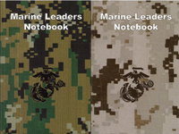
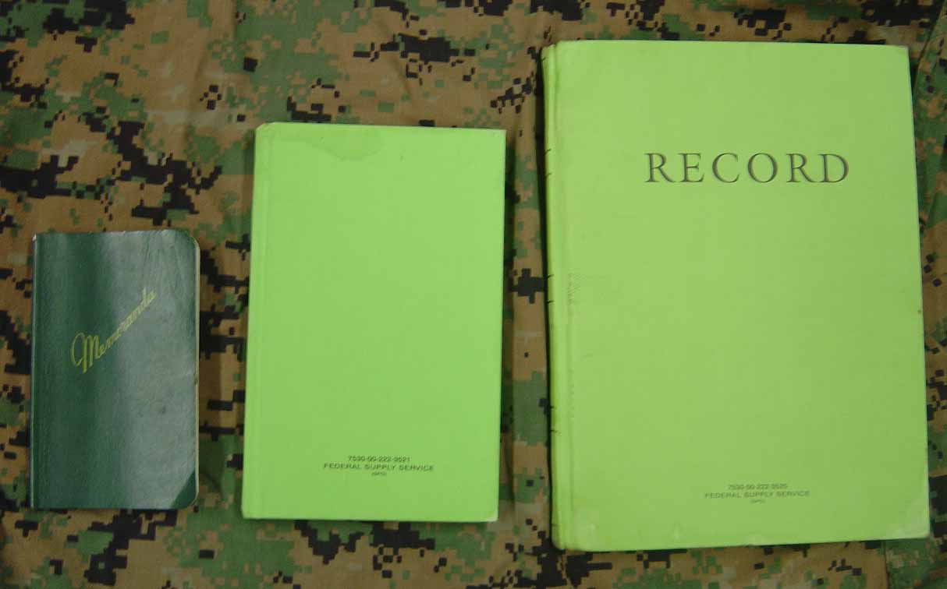
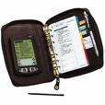
Leader’s Logbook
Notes:
Why a leaders logbook:
Affordable: standard green memo book: 7530-00-222-3521 ~ $2.70 thru servmart/ Marine Leaders Notebook through Behavioral health free to download or free in hardcopy (when in stock)
Deployable- size cargo pocket
Flexible - many variations use one that fits your unit’s needs
Transferable: pages can be transcribed or replaced
Teachable: train the trainer on how to build/ use a standard covey type Marine daily planner
Durable: hard cover or electronic can be used/stored in multiple ways
Replaceable: replacements through various civilian outlets/ servmart /download

Slide 22
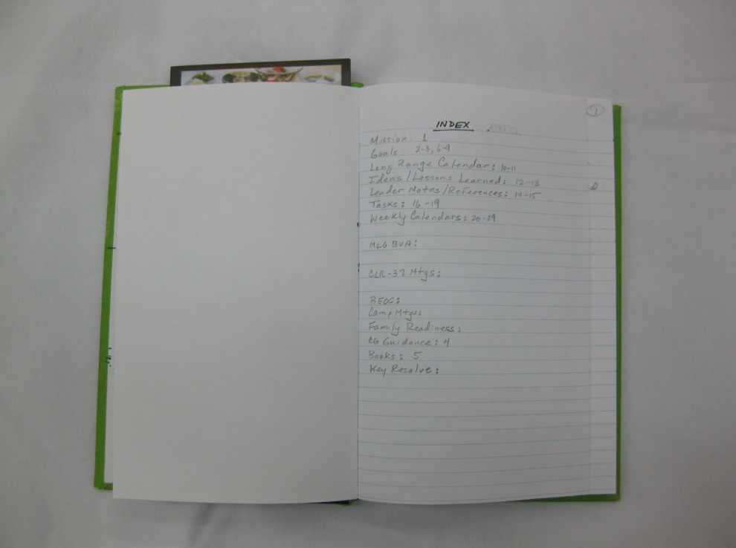
Cargo Pocket Leader’s Logbook Examples
Example of Index Method
Green Memo book 5.5x8 NSN 7530-00-222-3521
https://www.gsaadvantage.gov/advantage/catalog/product_detail.do?gsin=11000006302737
Notes:
LEADER’S LOGBOOK INSTRUCTIONS TEMPLATE
SETUP:
Copy this page and reduce it to 60% Then Glue the reduced copy inside the front cover of book 7530-00-222-3521
Name and POC info on first page inside the front cover.
First 2-3 lined pages for your index. Title “Index” at the top.
The First page after the Index is page 1. Number first 30 or 40 Pages in the upper right corners.
Use Page 1 to write your Mission Statement
Pages 2 -7 are for your functional area goals (Fidelity, Fighter, Fitness, Family, Finances, Future) Specific Measurable, Attainable, Relevant, and Time-based)
Page 8 and 9. Following your Mission Statement and Goals at the front of the book, create your Long Range Planning Calendar. Do this by drawing a line down the middle of each page. That gives you four columns across the double page. On the top line write the months above each column Jan, Feb, Mar, Apr. Overdraw the 9th and 10th lines. In the small spaces you have made write the months May, Jun, Jul, and Aug. Overdraw lines 18 and 19 and write the months Sep, Oct, Nov, and Dec.
Page 10 Ideas
Page 11 Lessons Learned
Page 12 Leader Notes
Page 13 References
Page 14-17 Tasks. Set this up with columns to track your tasks across a double page. For example: Done, Task, Date, Assigned to, Due, Priority, Due to, Notes. You may want to use page 14-15 to track tasks assigned to you and 16-17 for tasks you assign to others.
Page 18-19 “Week-at-a-Glance” Overdraw the first and 19th Lines. Separate the left page and the right page into 4 columns each by drawing a line down the center of each page and then lines about an inch to the left and right of the center lines. Label the columns on page 18 Mon, Tues, Wed, Thur. Label the columns on page 19 Fri, Sat, Sun, Goals. On the last column only (goals) overdraw lines 5,10,15,23. That divides your goals column into 6 boxes. Label them Fight, Fit, $, Fam, Fid, Fut.
Use pages 20-21 to make a copy of what you just made on page 18-19. Note that when you line your bookmark up on your Week at a glance" pages you can enter appointments on the appropriate line for the hour of day.
Under the schedule area of each day you write your tasks for that day.
Continue making "Week at a glance" pages for a month or two. The next page after that will start your notes. You don't need to make all your pages at once. Do that at opportune times such as when you are waiting for a meeting to start.
Use the last three pages for your POCs and label the pages from back to front “A-I, J-Q, and R-Z” respectively.
From back to front after the POCs, create monthly calendar sheets using two facing pages, either creating blocks or using a line for each day of the month (1-15 on the left side and 16-31 on the right).
Add unit specific pages or any other page that support your mission. Either write in or glue to the page
DAILY: (Plan each day for 5 minutes the night prior)
Prioritize tasks for the day (A, B, C, 1, 2, 3, etc.)
Record all significant events, using tags for different topic areas for easy reference later.
At the end of the day, review your notes and index important information. For example, you may have an index topic for counseling sessions where you will list all of the pages that have notes on those sessions. The index line may look something like this: Counseling: 10, 13, 14, 22, 35…
Circle page numbers after they have been properly indexed to keep track of what has been recorded.
Review the day and see what you can do better tomorrow. – add to fidelity goals.
WEEKLY: (15-20 minutes over the weekend before you start the next week)
Transfer events from your monthly calendar to your week-at-a-glance.
Pick a least one goal for each functional area to accomplish during the week and schedule it.
Schedule other tasks that you must accomplish around your goals and events that are already scheduled.
Review the week with your Mentor/team.
At the end of the week, pick one thing that you need to do better and include that in your Fidelity goal for the next week.
MONTHLY:
Review your functional areas and goals, and schedule action steps on your monthly calendar.
Record significant dates, deadlines, scheduled events, etc. on your monthly calendar.
Review the upcoming month with your supervisor/ counselor/mentor

Slide 23
Sample Leader’s Logbook
Index – for future reference
Mission
Tasks assigned to you and assigned to others
Goals Long term, short term, action steps
Calendars: Hourly, Daily, Weekly, Monthly, Annual Planning Calendar
Points of contact
Notes from Meetings, phone calls
Ideas and lessons learned

Slide 24
LEADER’S LOGBOOK BOOKMARK
0500 | CHECK SIX
0600 | 1: FIDELITY
0700 | -24/7
0800 | -DEPENDABLE
0900 | 2: FIGHTER
1000 | -ROADMAP
1100 | -MCC SKILLS
1200 | -LEADER
1300 | 3: FITNESS
1400 | -MIND
1500 | -BODY
1600 | -SPIRIT
1700 | -SOCIAL
1800 | 4: FAMILY
1900 | -SUPPORT
2000 | -TIME
2100 | -COMM
2200 | 5: FINANCES
FIDELITY | -PAY
FIGHTER | -DEBT
FITNESS | -SAVINGS
FAMILY | 6: FUTURE
FINANCES | -GOALS
FUTURE | -CALENDAR
Notes:
LEADER’S LOGBOOK BOOKMARK
(Copy this page and cut out the bookmarks. Glue them back to back and laminate it. Use this tool for your week-at-a-glance pages to plan and schedule your week.)

Slide 25
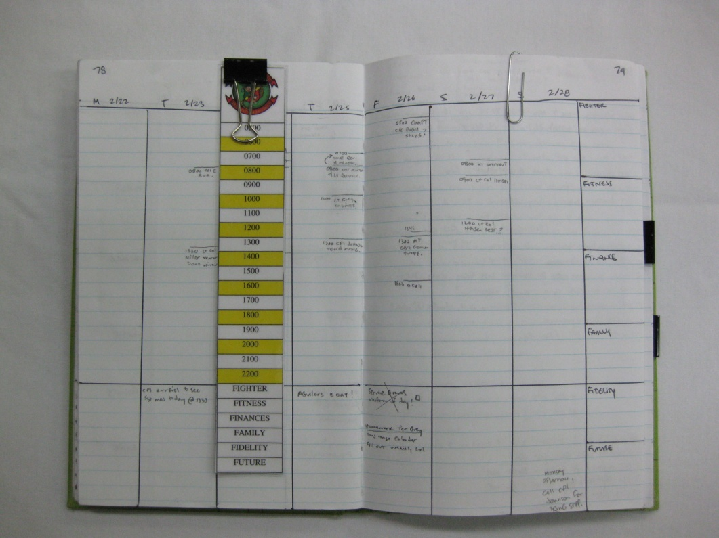
Leader’s Notebook
Example of Weekly Planner

Slide 26
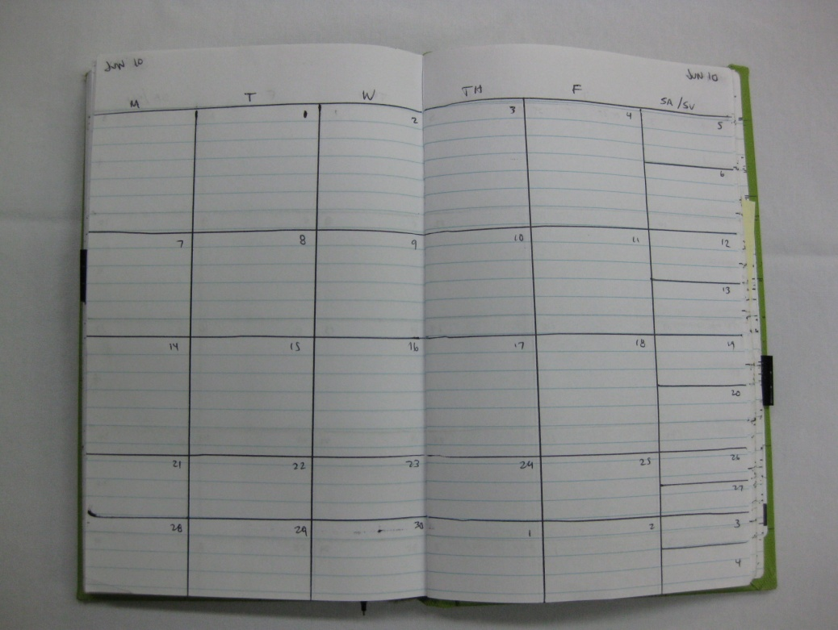
Leader’s Notebook
Example of Monthly Planner

Slide 27
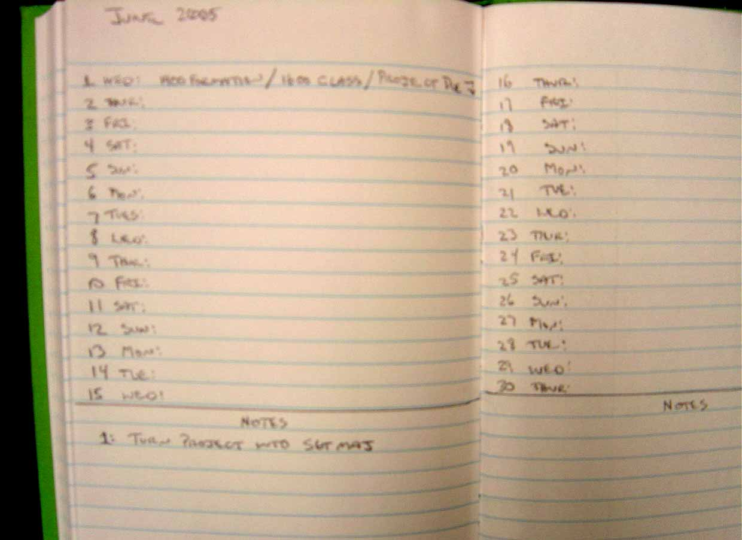
Leader’s Notebook
Example of notes pages

Slide 28
Mission and Goals
SMART Goals: Specific, Measurable, Achievable, Relevant, Time-based
Become a better leader to my Marines
Get to better know my Marines by conducting relevant coaching and counseling.
Improve general Marine knowledge:
Read rank relevant books in the CMC List:
Read 60 min. per day from the CMC List over the next month IOT invest in knowledge and general proficiency.
Notes:
The SMART Goals provide clear mission statements for ourselves and our Marines. What does a Marine want to accomplish? Simply break that down into a SMART goal with a clear mission type order: i.e…..

Slide 29
Steps for Making Effective Time Management Decisions
C - Compare activities (are some less important?)
H - How will your choice affect you later? (consequences)
O - Order your priorities
I - Inscribe (write) scheduling decisions in your planner or calendar
C - Carry out the plan you have made
E - Enjoy being in control of your time

Slide 30
Develop a Plan
Prioritize your tasks.
Record tasks.
Plan each day.
Use waiting time.
Evaluate
Notes:
Record: tasks / deadlines in appropriate day/hour blocks in an organizer/ MS Outlook or leader’s notebook.
Consider your time to be used and make every attempt to get the most out of every day and build on your successes.
Keep leaders notebook or organizer IOT jot down the task, things to do or notes to yourself.
Record all regularly scheduled personal activities - meetings and PT.
Record any special activities you need to do or want to do on a regular basis (College Courses).
Schedule a review time immediately after your classes and study time
Plan: Planning your day can help you accomplish more and feel more in control.
Write a to-do list, putting the most important tasks at the top.
Keep a schedule of your daily activities to minimize conflicts and last-minute rushes.
Plan your day each morning or the night before and set priorities for yourself.
Maintain and develop a list of specific things to be done each day, set your priorities and the get the most important ones done as soon in the day as you can. Evaluate your progress at the end of the day briefly.
Look ahead in your month and try and anticipate what is going to happen so you can better schedule your time.
Prioritize:
Take the time you need to do a quality job. Doing work right the first time may take more time upfront, but errors usually result in time spent making corrections, which takes more time overall.
Time-consuming but relatively unimportant tasks can consume a lot of your day.
Prioritizing tasks will ensure that you spend your time and energy on those that are truly important to you and your section.
Break large, time-consuming tasks into smaller tasks. Work on them until you get them all done.
Limit distractions. Block out time on your calendar for big projects. During that time, close your door and turn off your phone and email.
Take a break when needed. Too much stress can derail your attempts at getting organized. When you need a break, take one. Take a walk. Do some quick stretches at your workstation.
Use waiting time to review notes, MOS skills or PME reading. Taker a book off the CPRL with you to medical/dental appointments, etc.
Evaluate:
Examine and revise your goals on a monthly basis and be sure to include progress towards those goals on a daily basis.
Examine your old habits and search for ways to change or eliminate them.
Post reminders in your quarters or office about your goals.
Keep those long term goals in mind.
When you catch yourself procrastinating-ask yourself, "What am I avoiding?"
Catch yourself when you are involved in unproductive projects and stop as soon as you can.

Slide 31
Sight Alignment/Sight Picture
Values
The Target
The Clear Front Sight Post:
The Rear Sight:
Dope Adjustments:
Goals
Actions
Notes:
Another way to frame goal setting :
Think of your goals in terms of Marksmanship. . . the purpose and plan for life must be very clear….
Your long term goal is the Target: The Six Functional Areas of Leadership Development
Short term goals sight picture and alignment
Front Sight Tip: What you are doing each week
Rear Sight: The values that frame your actions (Honor, Courage, commitment, etc)
Dope Adjustment: Adjusting values to principles (know yourself, your Marines, your enemy, be proficient, etc.)
31

Slide 32
Sight Alignment/Sight Picture
Your leader is the range coach
Writing it Down
Assess Progress
Values
Goals
Actions
Notes:
In regular counseling sessions- you and your leader (the Range Coach) will evaluate:
What is your target? (is it in the black – center mass or off the berm?)
Spotting the rounds: Is the Marine on target?
Does the Marine see the clear tip of the front sight post? (Do short term weekly goals support the long term?)
How’s trigger squeeze? (Is the Marine making a good decision?)
Dope Adjustments: ( Adjusting values to align with principles)
A good coach can make adjustments before rounds down range (before poor life decisions affect the Marine)
Writing it Down- think of the Coaching/ Counseling Form or Leadership Development Notebook as the Data book you use on the range
Write goals on the Follow-On & Subsequent Coaching Form/ or in your Leadership Development Notebook
Benefits:
Forces clarity
Enables focus
Forces prioritization
Enables self-awareness
Holds you accountable
Empowers others to assist
Action Steps
For each of your six goals
Determine the next step towards the goal
What can you do in the next week?
Assess Progress
Follow-on & Subsequent counseling sessions
Dope adjustments as needed

Slide 33
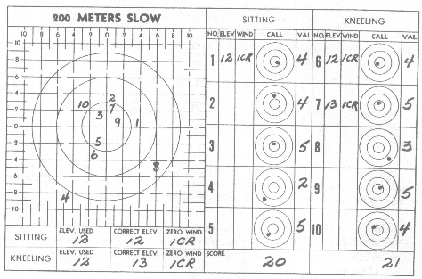
Productivity

Slide 34
GUIDING PRINCIPLE
Marines maintain six functional areas of excellence (FAE):
Check Six – Areas of Continued Assessment Competence/Leadership
Fidelity: Core Values 24/7
Fighter: MOS/Common Skills
Fitness: Mental, Emotional, Physical, Spiritual (MEPS)
Family and Friends: Support, Comm, Growth
Finances: Pay, Budgeting, Savings, Debt
Future Planning: Goals, Key Events, Requirements
Notes:
Principle 12 defines six areas.
34

