Slide 1
The Profession of Arms
Scott Hamm, sgtmaj (ret)

Slide 2
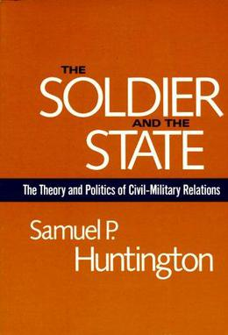
Profession defined
Professional vs. Member of a Profession
Samuel Huntington, 1957,The Soldier and the State
  Expertise
  Responsibility
  “Corporateness” (Self policing and Education/Advancement)
“…display specialized knowledge in the management of violence, maintains a monopoly on education and advancement in their field, and have an overarching responsibility to the society they serve and thus do not 'compete' in the open market. The military profession requires comprehensive study and training, and thus expertise, of an intellectual set of skills: organizing of forces, planning of activities, and executing and directing activities.”

Slide 3
Profession defined
Professions are identifiable vocations whose members’ discretionary practice is warranted by society in expectation of reliable and effective application of some specialized knowledge or skill, mastery of which requires continuous study and practice. Professions are work-related groups of practitioners, who develop a sense of corporate identity and demonstrate a sense of collective responsibility for the quality of the service delivered and the reputation of their practice.
Organizations motivate by salary, benefits, etc.
Professions use intrinsic factors
  Pursuit of expert knowledge
  Camaraderie
  Membership in a revered, honorable occupation

Slide 4
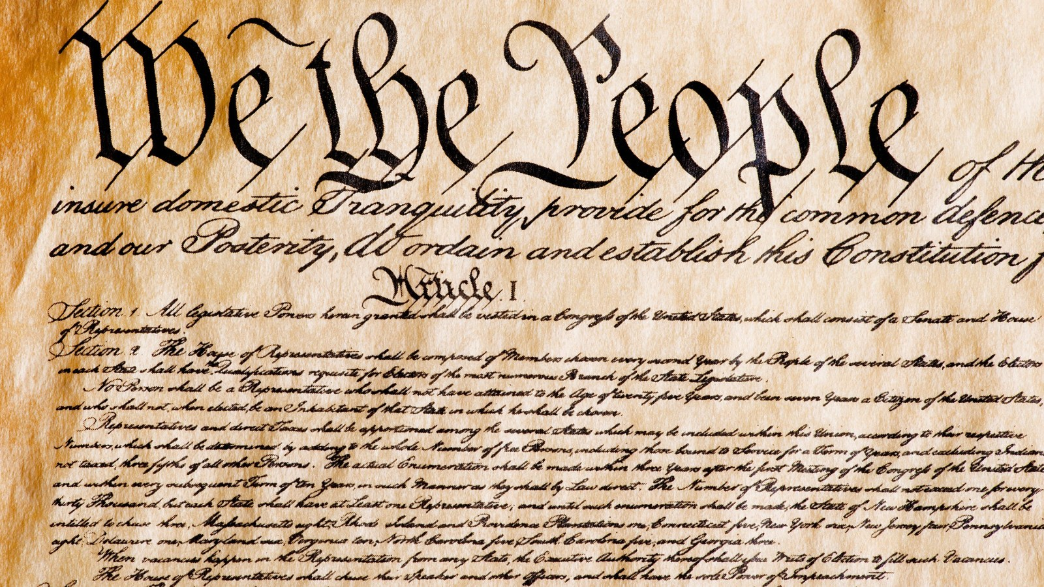
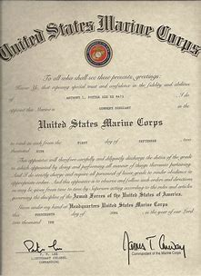
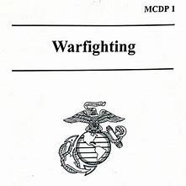
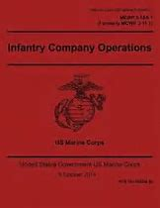
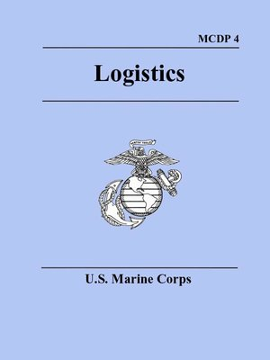
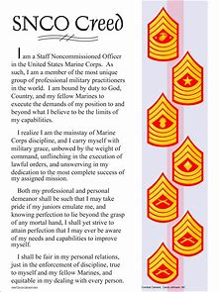
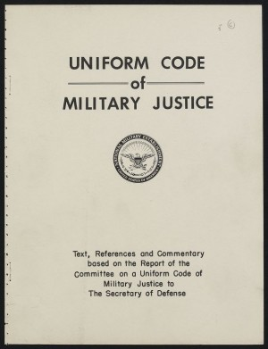
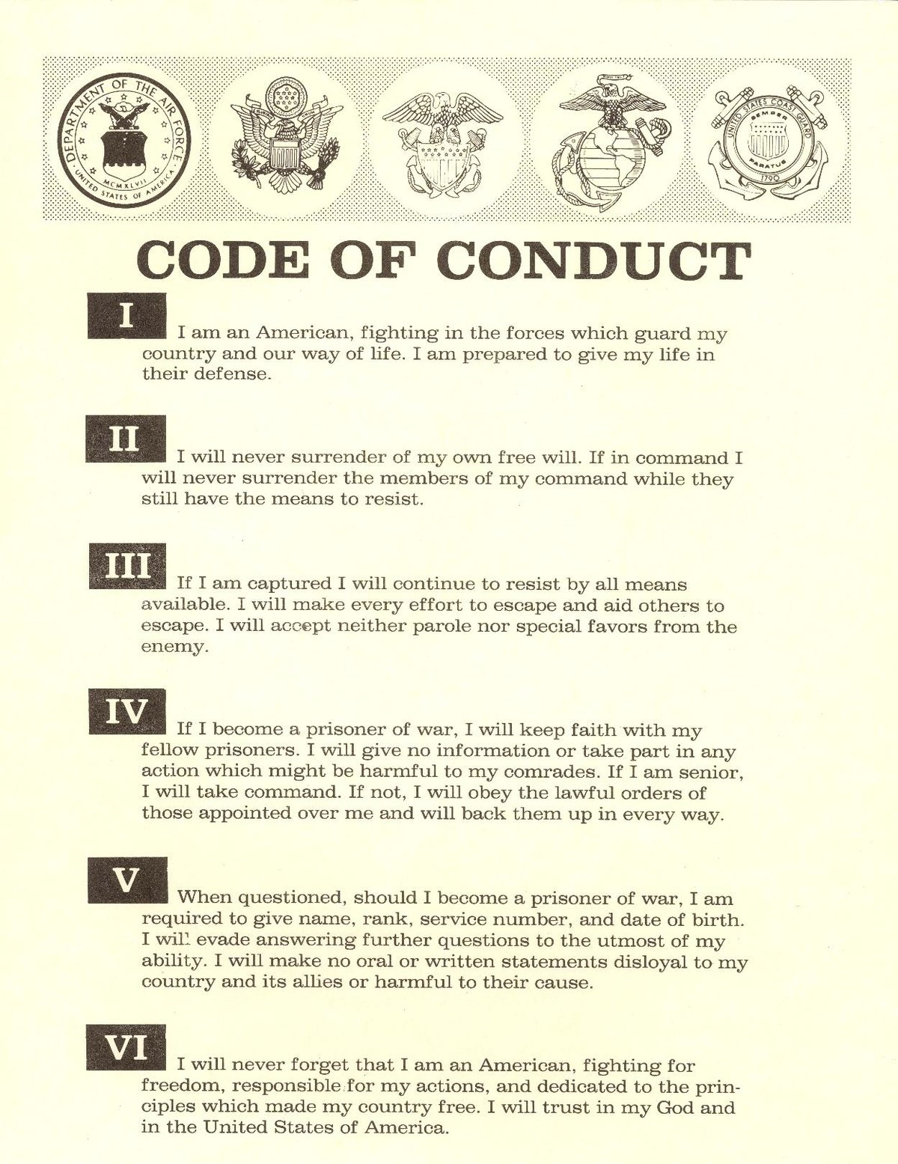
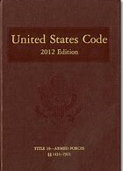
Profession of Arms
A vocation comprised of experts in the ethical application of combat power, serving under civilian authority, entrusted to defend the Constitution and the rights, interests and lives of the American people.
Foundations of our profession
  U.S. Constitution, Title 10 of the U. S. Code
  Oath of Office, Promotion Warrant
  UCMJ
  Doctrine
  Code of Conduct
  NCO/SNCO Creed
  Core Values
  Institutional/Unit Culture & History

Slide 5
Professionalism
A professional understands concepts and procedures, and more importantly, the time and place to use them
  Attrition vs. maneuver
  Recognitional decision-making vs. deliberate planning (MCPP)
Being a professional makes your advice and recommendations relevant
Learn from your peers, subordinates, and leaders
  Camaraderie, shared understanding, commander’s intent
The importance of critical thought
  Question “that’s the way we’ve always done it”
  Understand concepts and procedures that are combat proven and necessary
  Study of history and doctrine provides context and relevance

Slide 6
The Importance of Studying Our Profession’s History
Name this amphibious landing:
  80 ships embarked with troops, fire support assets, logistics
  Observation of enemy defenses shows their occupation of high ground with excellent ability to place fires onto initial landing beaches
  Landing force moves to alternate landing beaches—enemy sends mobile forces to meet them
  Landing craft have to disembark in deeper water than desired—assault elements have to fight from the water, under enemy fire
  Landing force fire support ships take up station to provide flanking enfilade fire on the enemy at the landing beach
  Assault elements fight ashore—the commander commits afloat reserve forces at the critical moment and repels the enemy; achieves a beachhead

Slide 7
Julius Caesar’s first invasion of Britain in 55 B.C.
What are some of the lessons to learn?
  Importance of reconnaissance (had alternate landing beaches)
  Planning for unexpected obstacles (disembarking early – mental toughness)
  What signaled to Caesar it was time to commit the reserve?
  Tempo/Momentum

Slide 8
The Importance of Studying Our Profession’s Doctrine
“A centralized system theoretically needs only one competent person, the senior commander, who is the sole authority. A decentralized system requires leaders at all levels to demonstrate sound and timely judgment.”
“It is obvious that we cannot allow decentralized initiative without some means of providing unity, or focus, to the various efforts…We seek unity not principally through imposed control, but through harmonious initiative and lateral coordination within the context provided by guidance from above.”
  MCDP 1- Warfighting
How do we understand “commander’s intent”? How do we explain it and use it?

Slide 9
Combat Experience vs Professional Expertise
The combat experience we have gained is extremely valuable to us as professionals
Do not confuse combat experience with professional competence; tactical and technical proficiency
  ER doctor performing open heart surgery
Military Technical Expertise
  Across the range of military operations
  Tactical, Operational, Strategic levels
Human Development Expertise
  Training
  Education
  Professional Development
Moral – Ethical Expertise
  Instilling of values
  Adherence to law, especially in combat
Political – Cultural Expertise
  Cultural understanding: others, but also our own
  Political interaction and understanding

Slide 10
Commander – Senior Enlisted Interaction
Command selection
Lieutenant Colonel Commands
  New to command, but significant MOS credibility
  New to level of authority (reward, punishment, etc.)
  Mentor and develop officers and enlisted
Colonel Commands
  New to commanding through commanders
  New to working directly for a general officer

Slide 11
Questions ?
Scott Hamm
Davis Defense Group
703-432-5699
540-623-6106

