Slide 1
http://www.youtube.com/watch?feature=player_detailpage&v=1pD7RI_p1ns

Slide 2
Marines and Ethical Behavior
Notes:
‹#›
Hugh Thompson is an American Hero. He is one of very few individuals who was willing to risk his life in order to stop GIs’ unethical behavior at My Lai. This presentation is dedicated to Hugh Thompson as he is the example that we want to follow when it comes to doing the right thing for the right reasons. In March 1968 CWO Thompson and his crew, Glean Andreotta and Larry Colburn were flying above My Lai while they realized that what was happening on the ground was a horrible war crime: the killing of women, children and old men by the GIs of Charlie Company. CWO Thompson landed the helicopter and saved as many lives as he could even if this meant confronting fellow American soldiers who were responsible for immoral acts. As soon as he returned back to base, he reported what he saw immediately. His report was met with mistrust. It took years for the Army to recognize Hugh Thompson’s valor. It was only in 1998 that he and his crew (Glen Andreotta was killed in action in Vietnam a few weeks after My Lai took place) were recognized for their valor with the Army Soldier Medal. Hugh Thompson spent much of his life speaking to military audiences about leadership. You will hear more about Hugh Thompson during this presentation and the film.
Instructor a recent interview with Hugh Thompson is available at http://www.youtube.com/watch?v=hkFa2lSNAGc

Slide 3
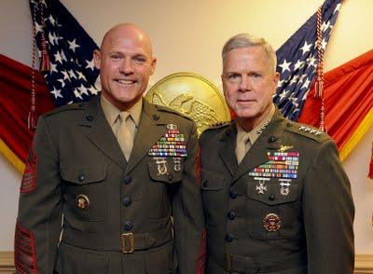
CMC & SGTMAJ Video

Slide 4
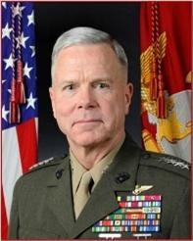
Whether fighting at sea or ashore, Marines have been guided by honor, courage and commitment. These core values have been the compass for every Marine’s service throughout our rich history. Superior leadership, hard training, and a willingness to sacrifice have forged our Corps into one of the most capable fighting forces the world has ever known. Our Marine Corps has remained true to these values for 235 years … and so it will during my service as your Commandant.
General James Amos, Commandant of the Marine Corps
Gen. Amos

Slide 5
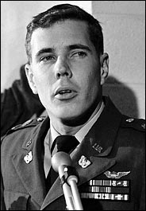
Dedicated to the Memory of
CWO Hugh Thompson
1943 - 2006

Slide 6
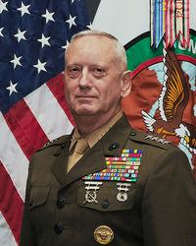
Demonstrate to the world there is “No Better Friend. No Worse Enemy” than a U.S. Marine.
You are part of the most feared and trusted force. Engage your brain before you engage your weapon.
Gen. Mattis

Slide 7
Ethics
Honor, courage and commitment
Ethics: eth·ics plural noun
1. ( used with a singular or plural verb ) a system of moral principles: the ethics of a culture.
2. the rules of conduct recognized in respect to a particular class of human actions or a particular group, culture, etc.: medical ethics; Christian ethics.
3. moral principles, as of an individual: His ethics forbade betrayal of a confidence.
4. ( usually used with a singular verb ) that branch of philosophy dealing with values relating to human conduct, with respect to the rightness and wrongness of certain actions and to the goodness and badness of the motives and ends of such actions.

Slide 8
Leading Marines
Being a Marine is a state of mind.
Ethical behavior is action taken specifically in observance of a defined standard of conduct.
For Marines, ethics are the standards of our corps. As a result, the individual is obligated to apply judgment to a given set of circumstances.
Judgment and therefore choice, is at the center of ethical conduct. Every Marine, regardless of grade, has this responsibility.

Slide 9
How do we make decisions in a simple or simplified moral field?
‹#›

Slide 10
Every day we make ethical decisions in response to inputs society gives us.
Often we do not even have to think about the ethical dimension of our actions.
How long does it take us to decide to stop at a red traffic light?
How long does it take us to help a child who is the victim of a car accident?
How long does it take us to give back the cashier the money he/she has given us in excess?

Slide 11

Our society is a strong provider of inputs and points of reference for morally sound behavior.

Slide 12
When I make a moral decision what should I be aware of:
Who I am;
Where I am;
Whom I am with;
What my responsibilities are.

Slide 13
How long would it take you to help a young woman being brutally attacked?

Slide 14
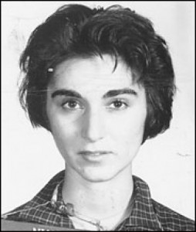
The Murder of Kitty Genovese in New York.
1935 - 1964

Slide 15

Darley and Batson 1973
Good Samaritans at Princeton Theological Seminary

Slide 16
What would you do?

Slide 17
Would you steal, cheat or lie?

Slide 18
Is it acceptable to steal?
Is it acceptable to steal food?
Is it acceptable to steal food if you are hungry?
Is it acceptable to steal food if you are starving?
Is it acceptable to steal food if someone you are caring for is starving (your children; your parents)?

Slide 19
Is it acceptable to torture?
Is it acceptable to torture an EPW/detainee who might be responsible for the killing of several Marines?
Is it acceptable to torture the insurgent who might give us good intelligence?
Is it acceptable to torture the insurgent who might know where they held a Marine that was taken prisoner yesterday?
Is it acceptable to torture the member of a kidnapping group who has kidnapped your son, and might know where your son is being held?

Slide 20
At what point does something unethical become acceptable? And why?
Emotions can cause us to abandon rational thought and shift our moral judgment from long-term absolutes to short-term pragmatic “solutions”.
Marines do not do that!
How dangerous is this shift from rational thought to emotional “solutions” for the ethical leader and his/her Marines?

Slide 21
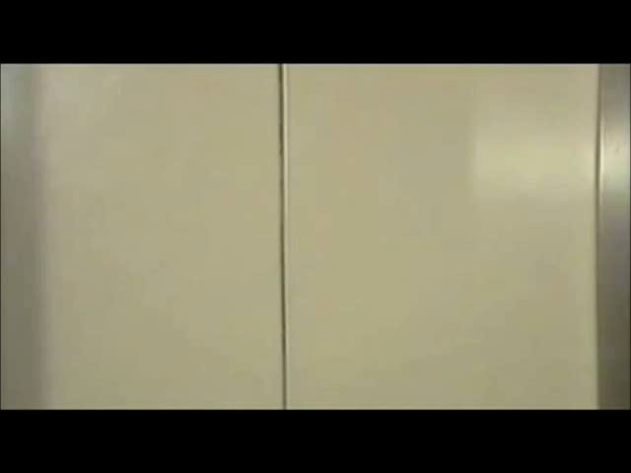

Slide 22
Ethical decision making… the impact of where we are!
Were the university students who participated in the SPE a group of wild individuals?
How long did it take for their moral compass to be compromised by the situation they were placed in?
What should Marines and Sailors learn from the Stanford Prison Experiment?

Slide 23
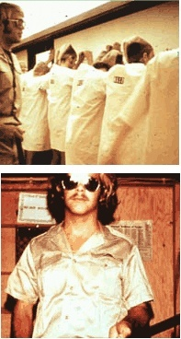
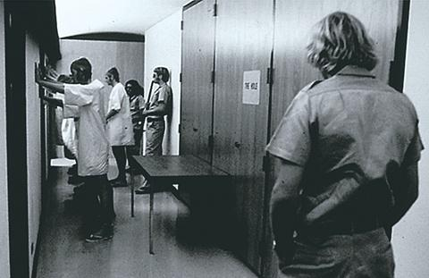
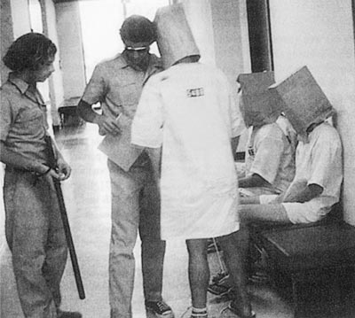
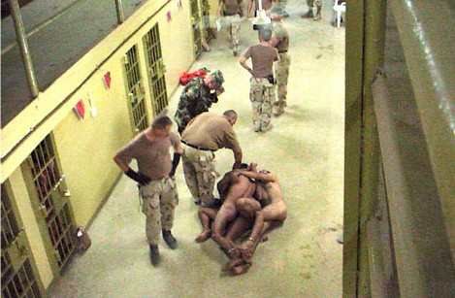
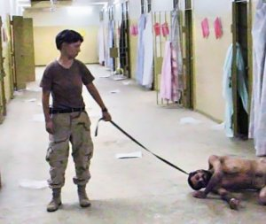
From the SPE to… Abu Ghraib

Slide 24
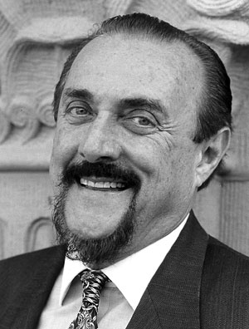
“Good people can be induced, seduced, and initiated into behaving in evil ways.”
“They can also be led to act in irrational, stupid, self-destructive, antisocial and mindless ways when they are immersed in ‘total situations’ that impact human nature.”
Prof. Zimbardo
http://www.usna.edu/ethics/publications.htm#Zimbardo

Slide 25
Ethical decision making… the impact of who we are with!
How do we make decision when you are in a group?

Slide 26


Slide 27
Conformity Can Be A Negative Side Of Cohesion.

Slide 28
Cohesion vs Conformity
Cohesion can turn negative if the core values of the individuals and the unit are significantly eroded.
In a crisis or highly stressful situation such as combat, soldiers will choose loyalty to their close friends over obligation to a higher organization.
‹#›

Slide 29
Obedience and Moral Courage. Should Marines behave like the subjects of Professor Milgram experiment?

Slide 30


Slide 31
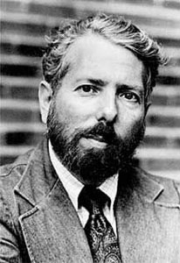
Milgram: a large number of individuals were able to execute an immoral order because they could convince themselves that they were not responsible for it.
A Marine and Sailor is always responsible for his action.
Prof. Milgram

Slide 32

An individuals’ easiest “mistake”
“creating the myth of invulnerability to situational forces, we set ourselves up for a fall by not being sufficiently vigilant to situational forces.”

Slide 33
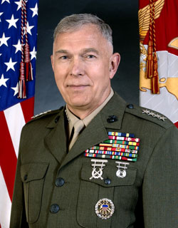
Marines must have an “ethical muscle memory” to make instinctive decisions when rounds are impacting nearby, it’s 120 degrees, and your buddy is bleeding.
An ethical mindset frames the problem – then it takes the moral and physical courage of a Marine to do the right thing.
Gen. Conway
Notes:
‹#›
Understanding ourselves and those around us, and understanding the situation, are keys to ensuring that we don’t fall victim to situational forces. We should avoid believing that we and our Marines will never engage in certain behaviors. Such beliefs and mistaken sense of invincibility will ensure failure. The most effective way to succeed is to guard against the possibility that we might indeed engage in an unethical behavior and make sure that it does not happen.

Slide 34
Situation: Iraq, 2009: Al Anbar Provence (Post Transition to ISF). You are the Leader of all Police Transition Teams (PTTs) in Al Anbar. While returning to their FOB one of your teams is hit by a complex ambush in Fallujah, Corpsman is severely injured. During the ambush IP’s stand by idly while your team receives SAF. The team makes it back to the FOB without further incident.
Mission: Train and mentor Iraqi Police
WHAT DO YOU DO?

Slide 35
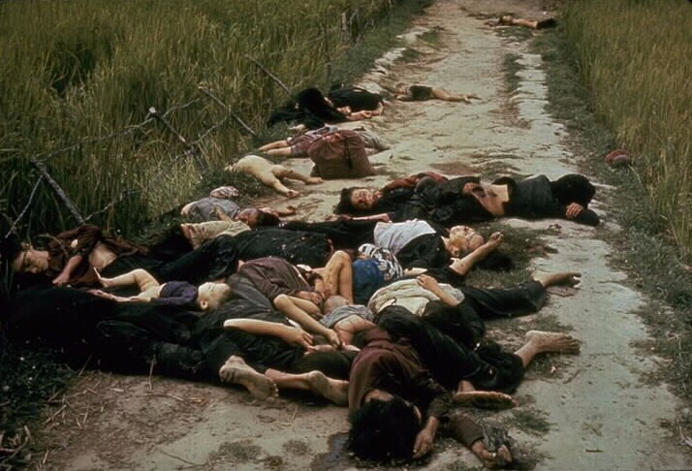
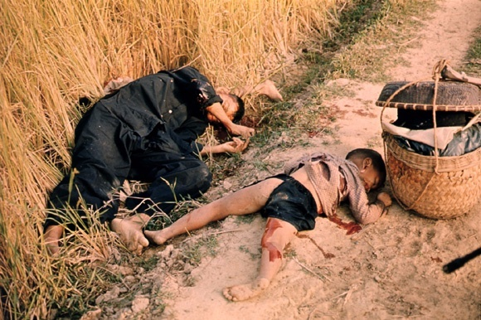
What Happened at My Lai
December 1967 Charlie Company deploys.
December 1967 – March 1968 Operations against VC 48th Local Force Bn
March 14, 1968 SGT George Cox killed by booby trap
March 16, 1968 Assault on Son My Village
More than 400 civilians were killed
Crimes included group acts of murder, rape, sodomy, maiming and assault

Slide 36
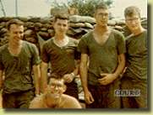
C Company: A Company of Ordinary Americans
Average age: between 18 and 22.
87 % of the NCOs were high school graduates (20 % above the Army norm)
70 % of the non-NCOs were high school graduates; nineteen had some college credits
Average cross section of American youth typically assigned to Army combat units in Vietnam.

Slide 37
