Slide 1
Marine Corps University
Academic Year 2024 Command Brief
MAY 2024
Approved for public release

Slide 2
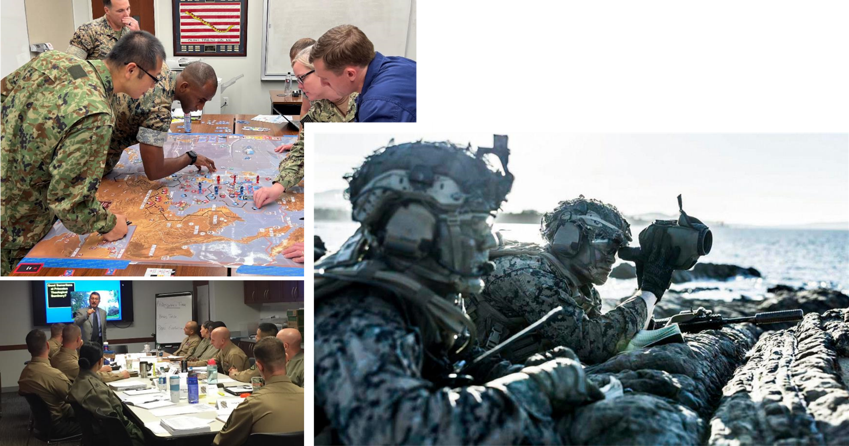
Mission
Marine Corps University/Education Command educates Marines to prevail in combat.
WHO WE ARE

Slide 3
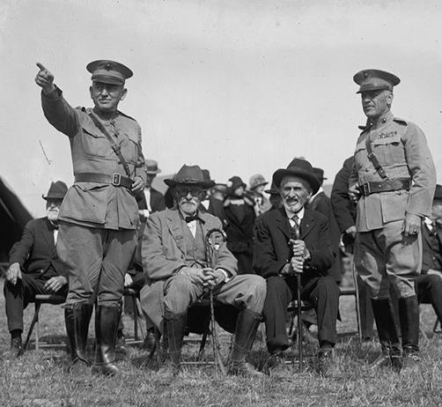
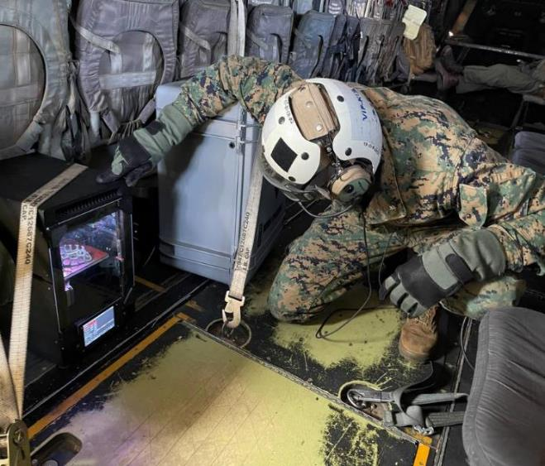
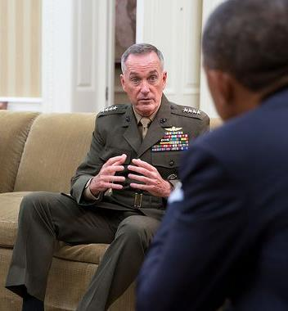
Our Values
Heritage
Innovation
Decisiveness
Upholding our legacy as an elite fighting force, we preserve and present the history of the United States Marine Corps to our successors and the public.​
We educate Marines to be pioneers and lifelong learners of critical thinking, collaboration, initiative, and leadership.
Highly disciplined in planning, decision-making, and execution, we develop Marines to deliver timely, relevant, and compelling solutions to complex problems.
WHO WE ARE
Generals Lejeune and Williams study the Civil War with Antietam veterans.
LtCol Radigan prints a medical cast aboard an MV-22 Osprey from Medium Tiltrotor Squadron 164.
General Dunford briefs the
President of the United States.

Slide 4
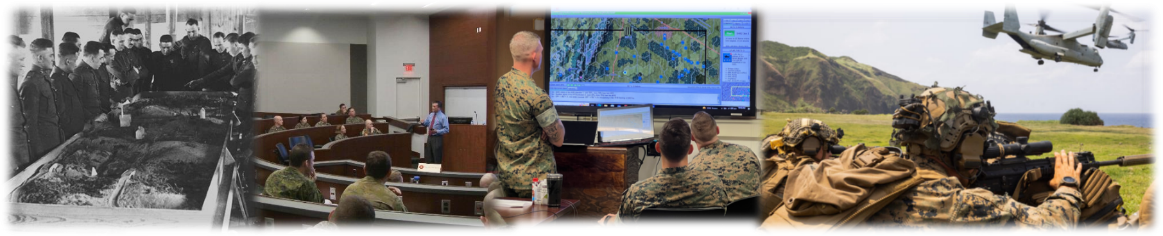
Vision
Be the premier institution where warfighters explore history’s lessons, integrate novel technology, and emerge as the most capable, sought-after leaders in the ever-evolving landscape of conflict. We are dedicated to fostering a culture of continuous professional military education, strategic thinking, and excellence, equipping our graduates to face future challenges with resilience and to lead with unwavering honor, courage, and commitment.
WHO WE ARE

Slide 5
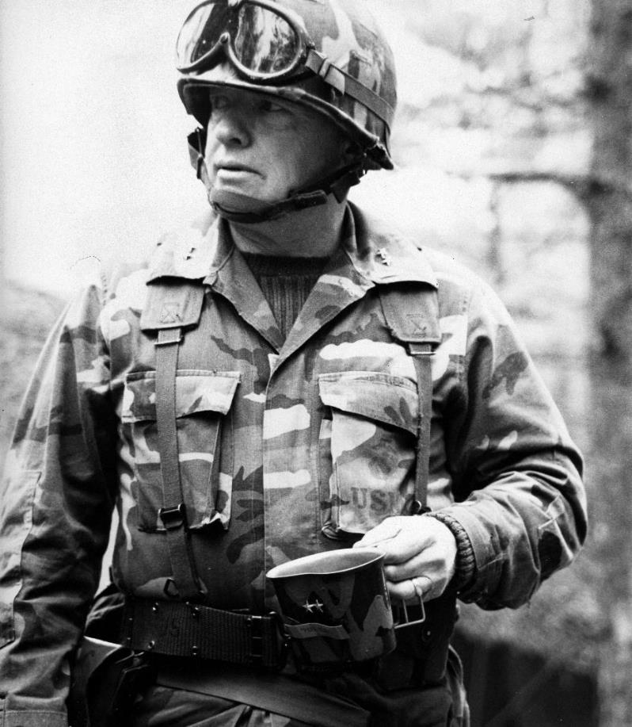
GEN ALFRED M. GRAY
Founded in 1989 by General Alfred M. Gray, MCU builds on a legacy dating back to World War I, emphasizing education for Marine leaders.
With a focus on maneuver warfare and adaptability, MCU remains committed to developing critical thinking, creativity, and military judgment in leaders to meet future challenges in the ever-evolving operating environment.
General Gray's vision and commitment to education continue to shape MCU's mission.
WHO WE ARE

Slide 6
Organization
Executive Admin
Support Specialist
President, MCU
CG, EDCOM
Board of Visitors
Aide-de-Camp
SJA
Sergeant Major
Chief of Staff
Marine Corps University Foundation
Protocol Officer
Marine Corps Heritage Foundation
Chaplain
Senior Service Representatives at Joint and Service Schools
Staff Secretary
Marine Corps Uniform Board
Safety
Marine Corps Association & Foundation
Marine Corps University
Provost/
Vice President for
Academic Affairs
Vice President for
Business Affairs
Vice President for Operations and Plans
Comptroller
Vice President for
Distance Learning
Director
College
of Distance Education and Training (CDET)
CDET Regional Directors
Director
Marine Corps
War College
Director
School of Advanced Warfighting
Director
Command and Staff College
Director
Expeditionary Warfare School
Director
College of Enlisted
Military Education
Director Marine Corps Senior Enlisted Academy
Director
Marine Corps University Press
Director
Marine Corps History Division
Director
National Museum of the Marine Corps
Director
Lejeune Leadership Institute
Directors
SNCO Academies

Slide 7
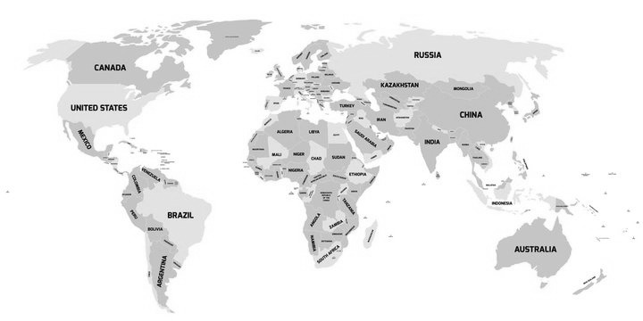

Global Coverage
Camp Pendleton
29 Palms
Miramar
Quantico
Marine Corps University
Camp Lejeune
Ft Worth
Okinawa
Hawaii

Slide 8
PME Community Snapshot
Officer PME Students Enrolled
MCWAR (Resident) | 31
CSC (Resident) | 199
CSC (Distance) | 1,064
CSC (Blended) | 64
SAW (Resident) | 26
EWS (Resident) | 242
EWS (Distance) | 1,790
EWS (Blended) | 268
RSSC/SPC (Resident) | 33
Foreign PME (Resident) | 25
TOTAL | 3,742
Enlisted PME Students Enrolled
Leading Marines Prerequisite (Distance) | 27,925
Corporals Course Prerequisite (Distance) | 19,763
Sergeants School Prerequisite (Distance) | 6,803
Sergeants School Seminar (Distance) | 1,018
Sergeants School (Resident) | 3,835
Career School Prerequisite (Distance) | 2,899
Career School Seminar (Distance) | 1,114
Career School (Resident) | 1,975
Advanced School Prerequisite (Distance) | 1,794
Advanced School Seminar (Distance) | 682
Advanced School (Resident) | 1,360
First Sergeants School (Resident) | 300
Senior Enlisted Blended Seminar Program | 1,050
Cornerstone / Slated Enlisted Leader Orientation Course | 140 / 50
TOTAL | 70,708
Marine Corps University
MCU Faculty
Civilian Faculty | 28
Military Faculty | 206
CDET Faculty | 325
TOTAL | 559

Slide 9






Officer PME Continuum
General
Officer
Executive
Education Program
Col
Cornerstone
CMC’s
Commanders
Program
Foreign-Fellowships
Marine Corps
War College
Joint-Sister Service Foreign-Fellowships
LtCol
Marine Corps University
School of Advanced
Warfighting
SAMS-SAASS-MAWS
Rank
Maj
Command & Staff
College
Sister Service
Foreign
Fellowships
Capt
Expeditionary Warfare
School
Sister Service Schools
Olmsted Scholars
Fellowships
Lt
MOS
School
MOS
School
Basic Officer
School
US Naval Academy
Officer Candidates
School
5
10
15
20+
Years of Service

Slide 10
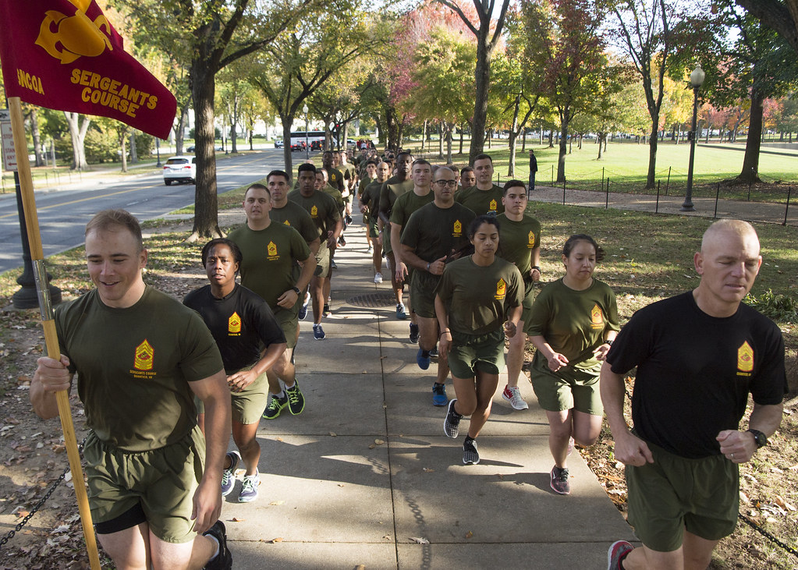
Resident Officer PME Demographics
 | USMC | USMCR | USA | USAF | USN | USSF | USCG | IMS | CIV | TOTAL
MCWAR | 11 | 0 | 4 | 4 | 2 | 1 | 1 | 5 | 3 | 31
CSC | 92 | 5 | 19 | 17 | 17 | 2 | 1 | 32 | 14 | 199
SAW | 18 | 0 | 2 | 1 | 0 | 1 | 1 | 3 | 0 | 26
EWS | 180 | 4 | 21 | 16 | 0 | 0 | 0 | 21 | 0 | 242
 | 284 | 11 | 47 | 42 | 10 | 4 | 5 | 60 | 20 | 498
Marine Corps University
Civilian Students:
MCWAR: DoS (2), DIA,
CSC: DoS (6), DIA, NGIA (2), DC/I (3), DHS, USAID, MARCORSYSCOM.
International Military Students (IMS):
Argentina, Australia, Bahrain, Brazil, Canada, Colombia, Czech Republic, France, Georgia, Greece, India, Indonesia, Italy, Japan, Jordan, Korea, Malaysia, Mexico, Morocco, Nepal, Netherlands, New Zealand, Norway, Philippines, Romania, Singapore, Taiwan, Thailand, United Arab Emirates, United Kingdom.
This Photo by Unknown author is licensed under CC BY.

Slide 11




Enlisted PME Continuum
Knowledge & Critical Thinking
Safeguard and Lead the Institution
Cornerstone and SELOC
Influencing
Command Climate
Communication
First Sergeants School
Developing
Subordinate leaders
Advanced School
Leadership
& Professional
Ethics
Leadership Progression
College of Enlisted Military Education
Leading
Subordinate leaders
Warfighting
Career School
Leading
Marines
Cmd Seminars/
Sergeants School
Enlisted Education Continuum
Ethical Follower
RTR/SOI/MOS School/
Cmd Seminars
Skills
The Enlisted College and Marine Corps Senior Enlisted Academy support the transition from skills-oriented following to knowledge-based leading

Slide 12

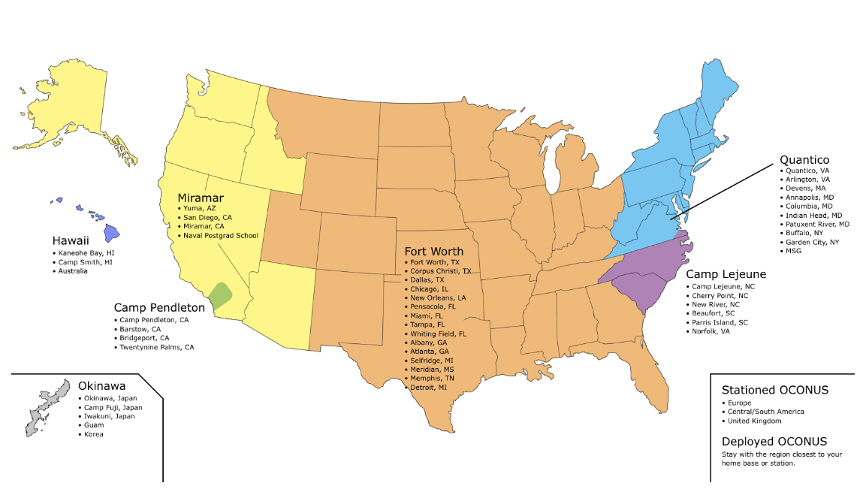
Distance PME Areas of Responsibility
College of Distance Education
Okinawa | Hawaii | Miramar | Camp Pendleton | Ft Worth | Quantico | Camp Lejeune

Slide 13
Marine Corps History Division
Collects, preserves, and presents historical information to inform decision-making, conduct research, and write Marine Corps history.
Archives
Holdings estimated 20M pages, >4M photographs, 30K maps.
Field Historians
Histories
95% of records declassified - available to all researchers
>2M digitized record pages and photographs (90% of all Command Chronologies)
Reserve Individual Mobilization Augmentees
HD’s “forward presence” with MEFs and operating units
Collect “real time” records and oral histories, contribute written products
research and write official operational and institutional history
Multi-volume series; commemoratives, monographs, battle studies, etc.
WWII “Red” Books, Vietnam Series, Quantico: Crossroads of the Marine Corp
Marine Corps University
Produce definitive history projects on OIF and OEF
Digitize and develop remote accessibility of archival collection
Develop and execute collection plan for OIF, OEF, and current operations
Priorities

Slide 14
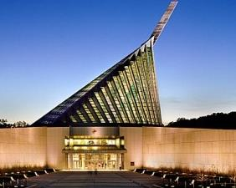
National Museum of the Marine Corps
Mission: Preserving our past, influencing the present, inspiring the future
Background:
Opened to the public 10 Nov 2006, additional galleries opened in 2010
Marine Corps Heritage Foundation raised funds to construct building; GS staff operate Museum
Accredited by American Alliance of Museums (AAM) in 2012; reaccredited in 2022
Final Phase construction began in 2015; Gallery 13 & 14 (post-Vietnam history) to open by 2025
Children’s Gallery, Combat Art Gallery, Art Studio with Artist in Residence
Marine Corps University
Extra Important Information:
Each year: ~500,000 visitors; 50,000+ students on site; 8,300+ distance learning students; 250,000 fans/followers on six social media platforms; 22,500+ web site visitors/month; 20+ regular PME programs and growing​
Professional curatorial, exhibits, collections, visitor services, education, public affairs, facilities, fiscal, and admin staff (58 GS billets); Marine detachment (9); 300+ volunteers; security, maintenance, housekeeping, other contractors; 20+ special assistants; two teachers in residence; 10 summer interns

Slide 15
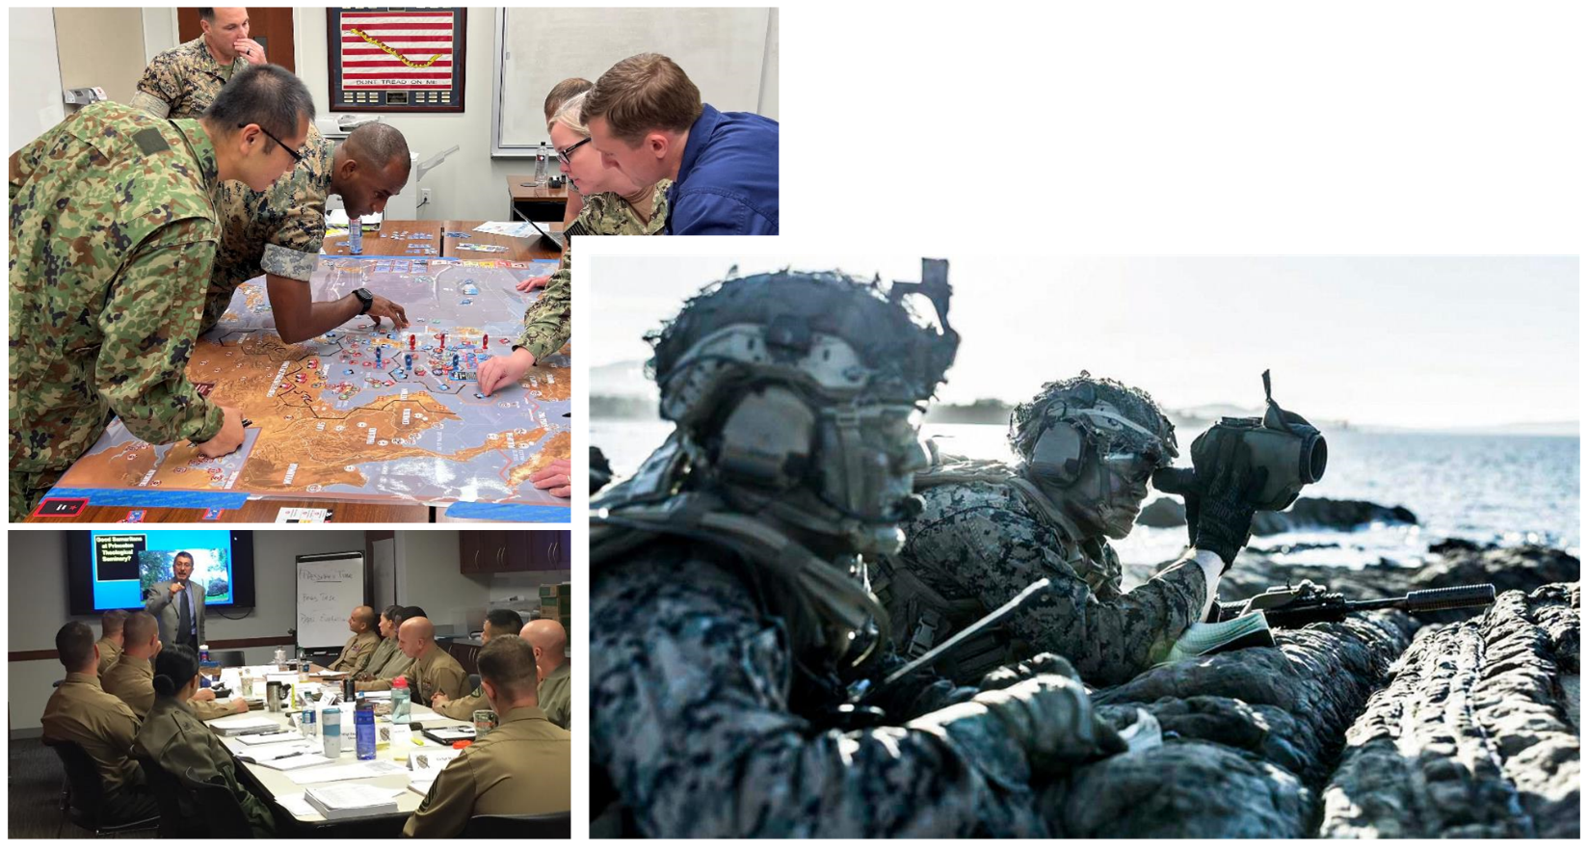
Questions

