Slide 1

Marine Corps University
AY22-23 Command Brief
8 September 2022
Approved for public release: distribution unlimited
Notes:
Final Version 20220908 (1630)

Slide 2
Vision & Mission Statements
Vision Statement
  Advance the legacy of Marine Corps warfighting excellence through a forward-thinking military academic institution that delivers world class education to develop professional leaders.
Mission Statement
MCU/EDCOM develops and delivers Professional Military Education and training through resident and distance learning programs, while also preserving and presenting the history of the Marine Corps, in order to prepare leaders to meet current and future security challenges and inform the public of the service’s role in national defense.
Notes:
Vision Statement: in Sept 2019 CG EDCOM directed revert to version previously approved by PPC.
Mission Statement: approved by CG EDCOM in June 2017; formal change request in staffing.

Slide 3
MCU Organization
Executive Admin
Support Specialist
President, MCU
CG, EDCOM
Board of Visitors
Aide-de-Camp
SJA
Sergeant Major
Chief of Staff
Marine Corps University Foundation
Protocol Officer
Marine Corps Heritage Foundation
Chaplain
Senior Service Representatives at
Joint and Service Schools
Staff Secretary
Marine Corps Uniform Board
Safety
Marine Corps Association & Foundation
Provost/
Vice President for
Academic Affairs
Vice President for
Business Affairs
Vice President for
Operations and Plans
Comptroller
Vice President for
Distance Learning
Director
College
of Distance
Education and Training (CDET)
CDET Regional Directors
Director
Marine Corps
War College
Director
School of Advanced Warfighting
Director
Command and Staff College
Director
Expeditionary Warfare School
Director
College of Enlisted
Military Education
Director Marine Corps Senior Enlisted Academy
Director
Marine Corps University Press
Director
Marine Corps History Division
Director
National Museum of the Marine Corps
Director
Lejeune Leadership Institute
Directors
SNCO Academies

Slide 4
The Community We Serve
Officer PME |  | Enlisted PME
MCWAR (Resident) | 31 | Leading Marines Prerequisite (Distance) | 26,187
CSC (Resident) | 197 | Corporals Course Prerequisite (Distance) | 16,501
CSC (Distance) | 1,337 | Sergeants School Prerequisite (Distance) | 4,431
CSC (Blended) | 62 | Sergeants School Seminar (Distance) | 1,660
SAW (Resident) | 26 | Sergeants School (Resident) | 5,145
EWS (Resident) | 224 | Career School Prerequisite (Distance) | 2,486
EWS (Distance) | 1,863 | Career School Seminar (Distance) | 1,378
EWS (Blended) | 234 | Career School (Resident) | 2,175
RSSC/SPC (Resident) | 33 | Advanced School Prerequisite (Distance) | 1,374
Foreign PME (Resident) | 25 | Advanced School Seminar (Distance) | 764
TOTAL | 4032 | Advanced School (Resident) | 1,480
Civilian Faculty | 28 | First Sergeants School (Resident) | 192
Military Faculty | 206 | Senior Enlisted Blended Seminar Program | 1050
CDET Faculty | 348 | Cornerstone / Senior Enlisted Leader Orientation Course | 140 / 50
TOTAL | 582 | TOTAL | 65,013
Notes:
Grand Total: 69,627

Slide 5
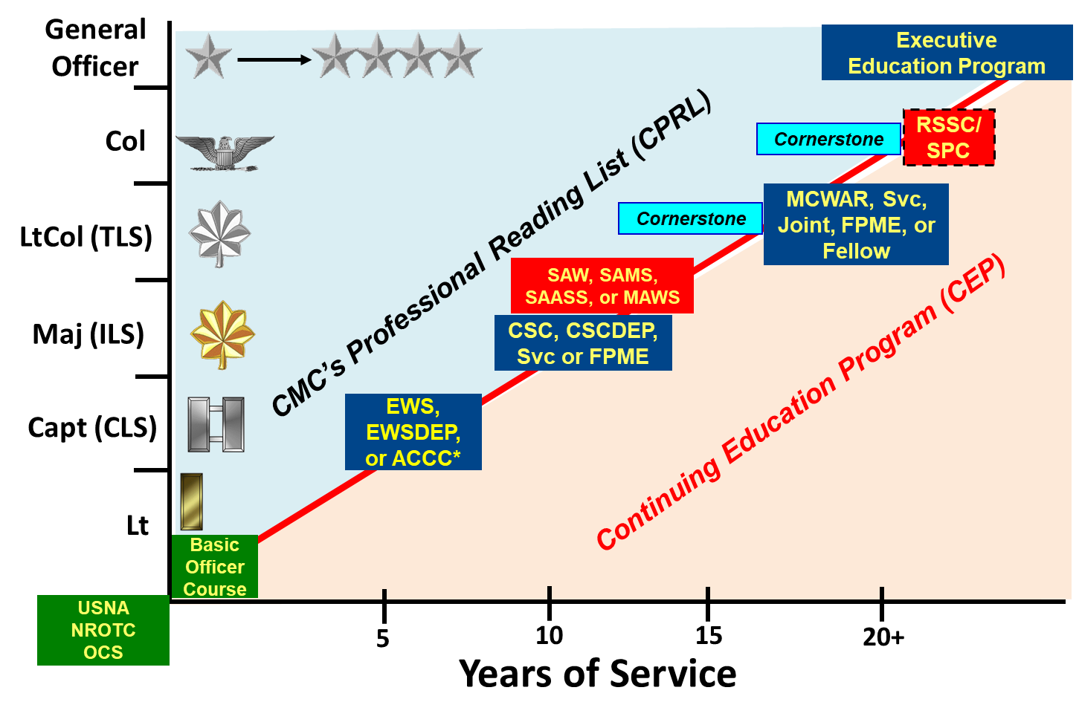
Officer PME Continuum
Notes:
Suggested new slide for Officer PME Continuum

Slide 6

AY21-22 Resident OPME Demographics
 | USMC | USMCR | USA | USAF | USN | USCG | IMS | CIV | TOTAL
MCWAR | 10 | 1 | 4 | 4 | 2 | 1 | 4 | 5 | 31
CSC | 93 | 7 | 20 | 20 | 8 | 2 | 32 | 15 | 197
SAW | 19 | 0 | 1 | 2 | 0 | 2 | 2 | 0 | 26
EWS | 162 | 3 | 22 | 16 | 0 | 0 | 21 | 0 | 224
 | 284 | 11 | 47 | 42 | 10 | 5 | 59 | 20 | 478
Civilian Students:
MCWAR: DoS (2), DIA, NGIA, DHS
CSC: DoS (6), DIA, NGIA (2), DC/I (3), DHS, USAID, MARCORSYSCOM.
International Military Students (IMS):
Argentina, Australia, Brazil, Canada, Chile, Colombia, Czech Republic, France, Georgia, Germany, Greece,India, Indonesia, Italy, Japan, Jordan, Korea, Malaysia, Maldives, Mexico, Morocco, Netherlands, New Zealand, Norway, Philippines, Romania, Singapore, Spain, Taiwan, Thailand, United Arab Emirates, United Kingdom.

Slide 7
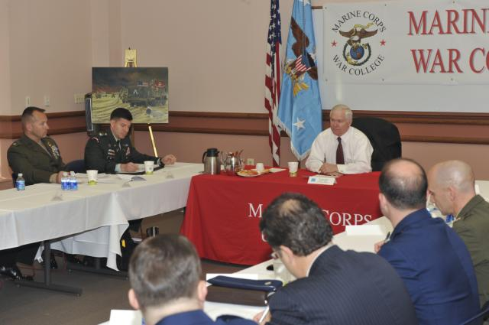
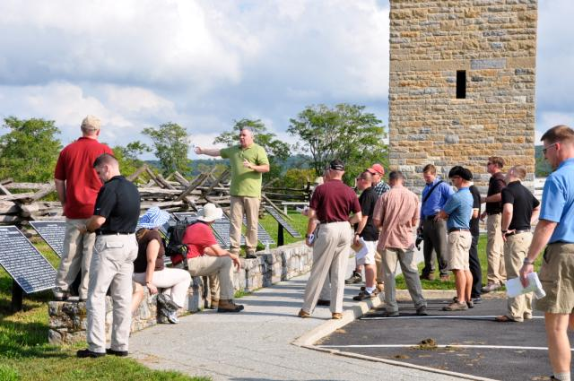
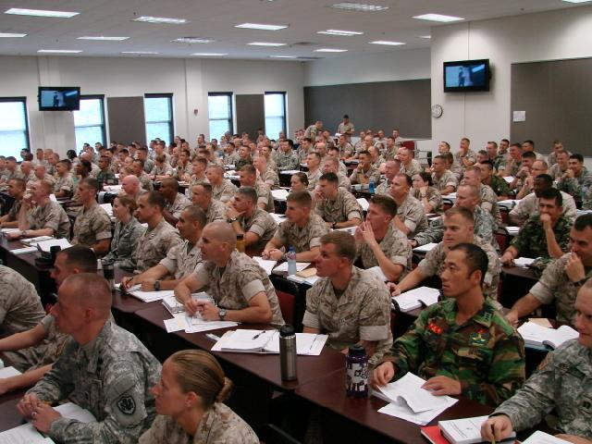
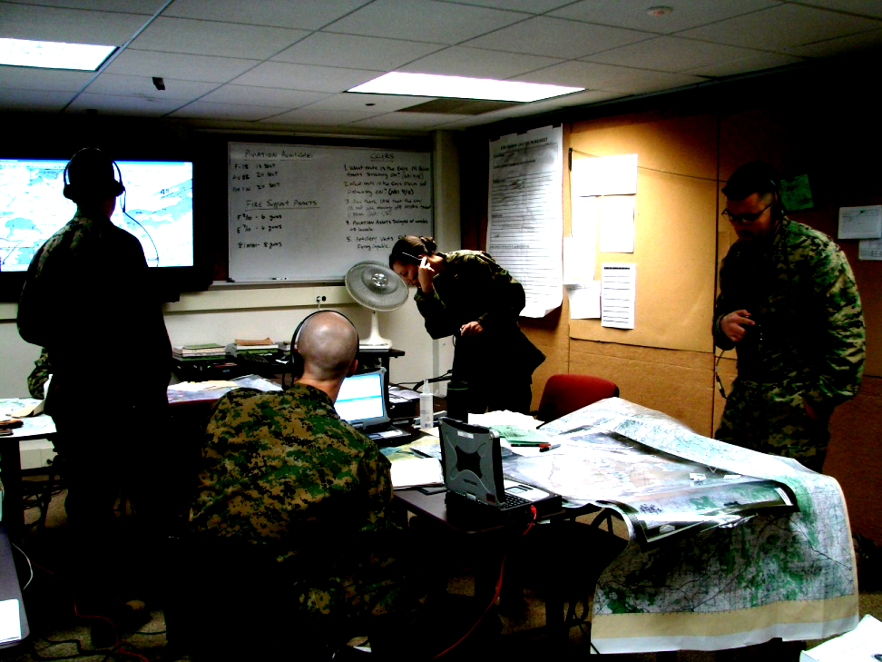
Educational Methodologies
Seminar
Staff Ride
Face-to-Face
Online
Wargame/PE
Lecture

Slide 8
MCWAR Academic Calendar (AY22-23)
Aug
Sep
Oct
Nov
Dec
Jan
Feb
Mar
Apr
May
Jun
Blocks
Foundations
Advanced Studies
Hol
iday
B
reak
Program
Diplomacy
& Statecraft
Warfighting
& Economics
Major
Curricula
Events
Joint
Warfare
Leadership
& Ethics
National
Security
Graduation
Overnight
Field
Studies
Philly Staff Study
G’burg
Staff Ride
OCONUS
CONUS
Trips
Supporting Events
Marine Corps University Symposium(s)
President’s Lecture Series
Krulak Center Events
Marine Corps Birthday Ball

Slide 9
SAW Curriculum Design (AY22-23)
Three Concurrent Courses
7100: Operational Art
Start
18th Century
19th Century
20th Century to Present
  Program Outcomes:
  Create solutions to complex problems and apply operational art in an uncertain geostrategic security environment.
  Apply knowledge of the operational level of war, the art of command, and ethical behavior in warfighting.
  Quickly and critically evaluate a situation, determine the essence of a problem, fashion a suitable response, and concisely communicate the conclusion in oral, written, and visual forms.
  Apply the competence, confidences, character, and creativity required to plan, lead, and command at high-level service, joint, and combined headquarters.
  Create, design, plan, and implement adaptive concepts to meet current and future challenges.
Starting Conditions
Emergence of Modern War
Seven Years War
French-Indian War
Theory:
Clausewitz, Jomini,
Mahan, & Corbett
WWI
France & Mid-East
Dissolving Empires: Korea & Vietnam
Post-Cold War:
Iraq & Afghanistan
Great Power
Conflict
American Revolution
& Napoleon
Total War:
WWII ETO & Pacific
NDS
Campaign analysis focused on planning and command.
Alternate solutions with historical examples.
Theory & Doctrine in the historic context.
7200: Operational Planning
NMS
VEO, Iran
Italy (Historical)
China
China
Conceptual Planning Critical Thinking
Red Team
Functional Planning MEF Ops
Strategic Direction
Global Integration
Competition
CCMD Campaign
Plans
Maritime
Campaigns
CCMD Contingency Plans
JSCP
Provides depth, understanding and appreciation of Service and Joint planning processes.
Design campaign plans against trans-regional, all-domain, all-functional military problems across the competition to conflict continuum.
CPG
7300: Changing Character of Conflict (3C)
Future War Project
JPMEI
What is Military Power?
China Case Study
What is Military Innovation?
Russia Case Study
What is Competition?
What are Battle Networks?
Cyber, Space Case Studies
What is the Character of Irregular Threats?
Insurgency, Terrorism Case Studies
Study contemporary great power competition and conflict to develop campaign plans.
Explore how modern militaries generate power, respond to change, and create response options.
Generate planning products from an adversary perspective.
Jun
Dec
Jun
SAW Themes
Great Power Competition; Nature and Character of War; Political Aim; National and Military Culture; Leadership and Command; Learning and Adaptation; Operational Environment; Resourcing Military Forces;
Single Battle Concept; Military Force Below Armed Conflict
Continual Assessment
21 Written Assignments
Fall Comprehensive Exam
7 Planning Exercises
10+ Wargames
Quarterly CCRBs
Student feedback to faculty

Slide 10

CSC Curriculum Design (AY22-23)
Fall Semester (21 Weeks)
Spring Semester (23 Weeks)
Summer Prep (6 Weeks)
Foundations (1100)
Introduce Content & Build
Conceptual Depth
Leadership in the Profession of Arms I (2100)
The Evolution of Modern War (3100)
National Security Affairs and the International System (4100)
Joint & Marine Corps Operations (5100)
Marine Corps Planning Process (6100)
Advanced Concepts & Application
Leadership in the Profession of Arms II (2200)
The Origins & Evolution of Contemporary Great Power Competition (3200)
Evolving National Security Concepts (4200)
Complex Operational Problem Solving & Design (JPP) (6200)
AY Refinement & Preparation
New Faculty Onboarding
AY Orientation / FACDEV
Electives
Capstone Exercise (PC-X)
Winter Break
Master of Military Studies (All U.S.) / Gray Scholars Program
Faculty Development
Feedback & Refinement
CCRB 1
CCRB 2
Curriculum
War Studies
Security Studies
Leadership
Warfighting
Master of Military Studies
Gray Scholars Program
Electives
Learning Facilitation Methods
Seminar
Guided Reflection
Lecture
Exercise/Prac App
Staff Ride
Extracurricular
MCU Scholars Programs
MOS Mentoring
Brown Bag Program
MCWL Wargames
President’s Lecture Series
Reading
Writing
Wargaming
Case Study
Student Discussion

Slide 11

EWS Curriculum Overview (AY22-23)
Expeditionary Warfare School educates and trains company grade officers in order to prepare them mentally, morally, and physically for billets of increased leadership responsibility across the Fleet Marine Force and the Joint Force, with emphasis on the warfighting capabilities of a Marine Air Ground Task Force operating within a complex and distributed naval expeditionary environment.
Who We Are – EWS reinforces the foundations of who we are as Marines, with specific emphasis on the Marine Corps’ ethos, values, history and Naval character, coupled with our roles and missions within the Joint Force. EWS devotes particular attention to the sacred leadership responsibilities inherent in service as commissioned officers in the Armed Forces of the United States.
How We Fight – The Marine Corps’ maneuver warfare doctrine is the lens through which we view the enduring nature and evolving character of warfare. The mental, moral, and physical underpinnings of our warfighting philosophy intentionally permeate every class, discussion, and practical exercise.
Where We Fight. . . Past, Present, and Future In keeping with the Marine Corps’ role as our Nation’s force in readiness, prepared to respond in “any clime and place,” the EWS curriculum includes a detailed study of MAGTF operations at sea, from the sea, and ashore, as well as the of the Naval expeditionary environment. The curriculum accomplishes this through case studies, preserving critical lessons from history while maintaining an eye towards the future battlefield.
August
September
October
November
December
January
February
March
April
May
Doctrine
OFEC
Planning
MAGTF Operations Ashore
MAGTF Operations Afloat
OFEC
POA
Marine Corps History
Nature and Theory of War
Marine Corps Doctrine
Critical Thinking
Effective communication
Ethical Leadership
Troop Leading Steps
Marine Corps Planning Process
Antietam Staff Ride
Fall Occupational Field Expansion Course (OFEC)
MAGTF ISR
MAGTF Logistics
MAGTF C2 / C4I
MAGTF Fires
MAGTF Aviation
Operations in the Information Environment
Offense
Defense
Marine Air Assault Task Force
Maritime Theory and Doctrine
Amphibious Operations Fundamentals
Landing Plan Development / OE&AS
Amphibious Demonstration
Global Security Environment
ANGKOR CROSS ARG/MEU PE, R2P2
Wargame
Expeditionary Fleet Orientation
Argumentative Research Paper
Commandership
Spring OFEC
Commandership
Ethical Leadership
Overland Campaign Staff Ride
Mutter Marines Symposium
Career Development
Profession of Arms
Officership
Force Fitness
Professional Communication
Military Adaptation & Innovation
Historical Studies
Global Security Environment
Future Operational Environment
Notes:
11
The EWS curriculum consists of six core courses presented over a 41 week period. This slide depicts our six core courses and Doctrine and Planning sub-courses that are shown in the order they are taught. The Military Adaptation and Innovation Course (and its 3 sub-courses of Historical Studies, Global Security Environment, and Future Warfare) is spread across the entire curriculum.
Fitness and Wellness is not a course, but we conduct the Marine Corps Physical Fitness Test and Combat Fitness Test as well as small group and school wide physical fitness and sports related event across the academic year.

Slide 12

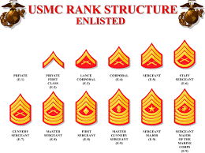


Enlisted PME Continuum
Knowledge & Critical Thinking
Safeguard and Lead the Institution
Cornerstone and SELOC
Influencing
Command Climate
Communication
Senior Enlisted Blended Seminar
Developing
Subordinate leaders
Leadership
& Professional
Ethics
Advanced School
Leadership Progression
Leading
Subordinate leaders
Warfighting
Career School
Leading
Marines
Cmd Seminars/
Sergeants School
Enlisted Education Continuum
Ethical Follower
RTR/SOI/MOS School/
Cmd Seminars
Skills
  The Enlisted College and Marine Corps Senior Enlisted Academy support the transition from skills-oriented following to knowledge-based leading
Notes:
Attending every resident PME opportunity from the ranks of lance corporal to sergeant major/master gunnery sergeant, an enlisted Marine would get 30 weeks of education.
It is designed to prepare Marines to assume the responsibilities of the next higher grade – the right information at the right time in regard to responsibility and experience.
Marines must complete both a non-resident and resident PME requirement at every grade from lance corporal through gunnery sergeant.

Slide 13
Enlisted PME Continuum (CEME)
Continuum/ Theme | LCpl Ethics Seminar | Corporals Course | Sergeants School | Career School | Advanced School
Ethical Leaders | Defining My Moral Compass Social Ills And Their Impact Embrace the Transformation | Decision Making Organizational Values Situational Ethics | Accountability For Actions Ability To Stimulate Change In Behavior | Obstacles That Affect Cohesion Mentorship Of Marines And Junior Officers | Command Climate Support Commander’s Philosophy
Professional Warfighters | Introduce warfighting concepts, MCDP-1 | Nature Of War US DOD Structure Understand the importance of the Oath and US Constitution | Theory Of War Warfighting Functions Combatant Command Structure | Operational Planning Foundations Of Joint Operations | MEF Operations National Security And National Military Strategy
Sound Decision Makers | Diverse Decision Making | Complex Decision Making Solve Problems Creatively | Communication Skills To Guide Subordinates | Formulate And Solve Open-ended Problems Use Of Commander’s Intent | Challenges Of Leadership Development Translating Policy Into Action
Endstate | Sustain the Transformation | Lead Marines | Lead Marines | Lead Subordinate Leaders | Develop Subordinate Leaders

Slide 14

Enlisted PME Continuum (MCSEA)
Continuum/ Theme | Senior Enlisted Blended Seminar | First Sergeants Course | Cornerstone | Slated Enlisted Leaders Orientation Course
Ethical Leaders | Joint And Coalition Leadership Positive Command Climate | The Unit Senior Enlisted Leader Legal Roles Situational Ethics | The Command Senior Enlisted Leader Toxic Leadership Leadership Perspectives | The Complex “Surface Area” at the General/Flag Officer Level
Professional Warfighters | MAGTF Operations In Joint Environment “Human Society” Affect In Shaping, Planning And Executing Operations | Positive command climate and culture Institutional Orders, Regulations, and Doctrine Oversee, Influence, and Develop Subordinate Staff Noncommissioned Officers | Profession of Arms How We Fight Force Design | Interplay Between Strategic, Operational and Tactical Risk. Threat Capabilities, Kill Chains, and Risks Associated with Peer-level Threats Joint Organization, Capability & Employment Consideration
Sound Decision Makers | Critical Thinking and Adaptability Skills In The Role Of Senior Enlisted Advisor | Talent Management Societal Issues Institutional Standards Unit Readiness | Art and Science of Command Organizational Behavior | Operational Time and Distance Factors and the Speed of Decision-making in Modern Naval Warfighting
Endstate | Influence Command Climate | Influence Combat Effectiveness | Safeguard the Institution | Lead the Institution

Slide 15


















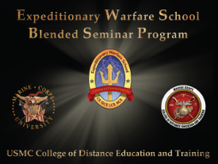
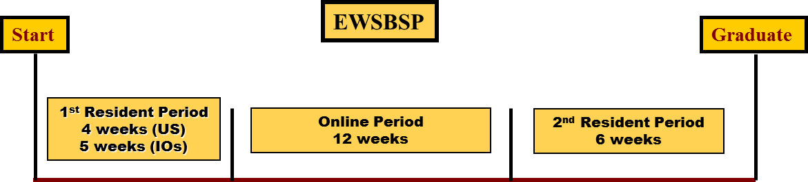

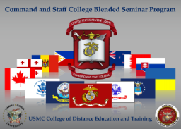
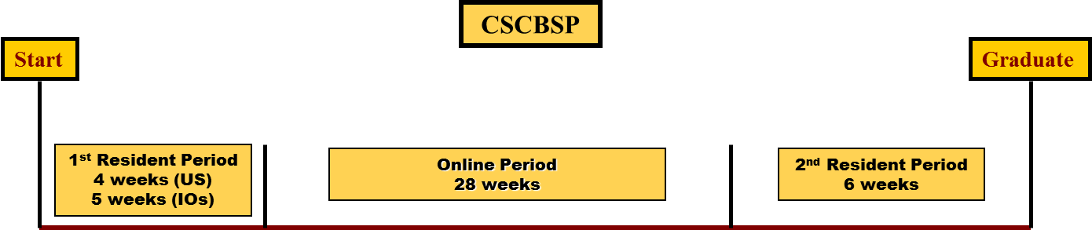


CDET Distance Education Programs
Blended Officer Seminar Programs (BSP)
Standard Nonresident Officer Seminar Programs
(onsite, online, weekend)
Delivered at Quantico, CLNC,
CPCA, & Okinawa & Hawaii (EWS only)
EWSDEP
Captain (70%)(+USMCR, LDOs, CWO-3: 100%)
2-year program/AY22 Grads = 545
Over 1,500 active students/year
EWSBSP
CSCDEP
Major (80%)+(USMCR, LDOs, CWO-4: 100%)
2-year seminar program/AY22 Grads = 565
Over 1,400 active students/year
@50% SAW, SAMS, SAAS students sourced
from CSCDEP each year
AY22: 234 Graduates (6 months)
CSCBSP
ECDEP
Program closes SNCOA seat availability gap and expands MCU reach through weekly seminars at all seven regions for Sgt – GySgt
15 week instructor facilitated onsite or online program
AY22: 62 Graduates (1 year)
Enlisted College Distance Education Program (ECDEP)
Over 50K self-study course completions/yr
- Leading Marines (E-3) IMI
- Corporals Course (E-4) IMI
Sergeants School (E-5) IMI & Seminar
Career School (E-6) IMI & Seminar
Advanced School (E-7) IMI & Seminar
Senior Enlisted Blended Seminar Program
All E8s future promotion requirement
Currently in pilot phase
Eight week DEP onsite/online then two week residence
19

Slide 16

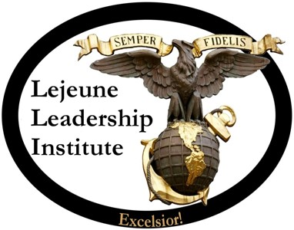



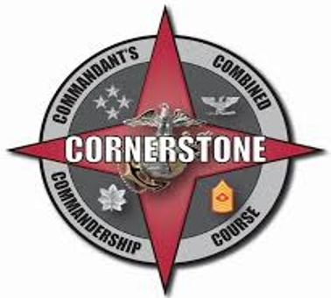
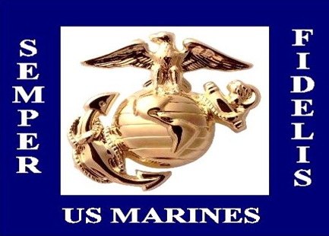
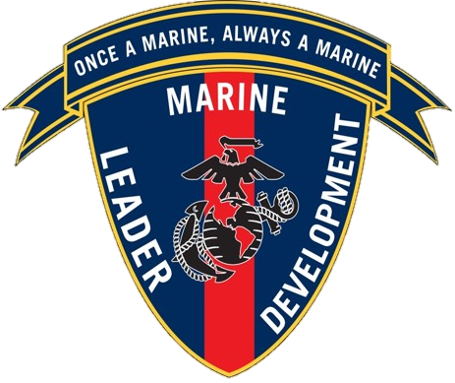
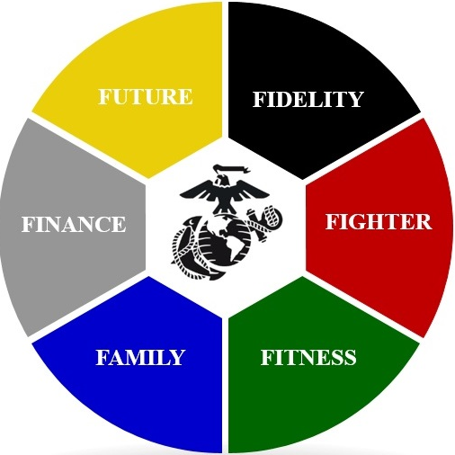
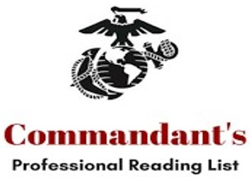
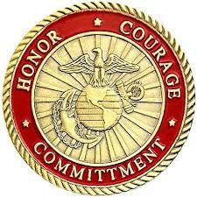
Lejeune Leadership Institute (LLI)
Mission: Develop leadership and ethics training and education for Marines and civilian Marines in order to facilitate leader development firmly rooted in the Marine Corps heritage of core values, selfless service, and warfighting excellence.
Background: Established in 2005. The LLI focus has progressively shifted from internal (MCU) support to service (Total Force) education with intra-service liaison with DoD, Joint Staff, the other Services on issues of leadership and ethics.
Executive Education Program (EEP)
GO/SES Executive Education Program (EEP)
Senior Enlisted Executive Education Program (SEEEP)
Professional Programs Branch
CMC Combined Commandership Course, “Cornerstone”
Brigadier General Select Orientation Course (BGSOC)
Senior Enlisted Leader Orientation Course (SELOC)
Marine Corps Civilian Leader Development Program (MCCLDP)
Tier 1: Online Leadership Foundations
Tier 2: Local Leadership Training Programs
Tier 3: Lejeune Leadership Institute Seminars
Tier 4: Centrally Managed Civilian Leadership Courses
Leadership Development Branch
Marine Leader Development Program (MLDP)
CMC Professional Reading Program (CPRP)
Ethics Branch
Marine Corps University Resident Colleges Ethics Training & Education
    Ethical Leader Development Workshops
Organizational Unit Leadership and Ethics MTTs
https://www.usmcu.edu/lli/

Slide 17

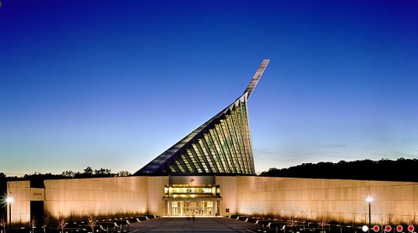
National Museum
of the Marine Corps (NMMC)
Mission: Preserving our Past, Influencing the Present, Inspiring the Future
Background:
Opened to the public 10 Nov 2006, additional galleries opened in 2010
Marine Corps Heritage Foundation raised funds to construct building; GS staff operate Museum
Accredited by American Alliance of Museums (AAM) in 2012; reaccredited in 2022
Final Phase construction began in 2015; Gallery 13 & 14 (post-Vietnam history) to open by 2025
Children’s Gallery, Combat Art Gallery, Art Studio with Artist in Residence
Each year: ~500,000 visitors; 50,000+ students on site; 8,300+ distance learning students; 250,000 fans/followers on six social media platforms; 22,500+ web site visitors/month; 20+ regular PME programs and growing
Professional curatorial, exhibits, collections, visitor services, education, public affairs, facilities, fiscal, and admin staff (58 GS billets); Marine detachment (9); 300+ volunteers; security, maintenance, housekeeping, other contractors; 20+ special assistants; two teachers in residence; 10 summer interns
Current projects & priorities:
Complete all work and open remaining Final Phase galleries to the public
Finish cataloging all collections; relocate all artifacts from old base buildings
to secure, environmentally-controlled Museum Storage Facility
Expand distance learning offerings to include PMEs; develop new PMEs
Grow social media and virtual outreach; update historical exhibits
Enhance local & regional outreach; recruit and deploy combat artists
Develop exhibits, programs, and events for USMC 250th birthday

Slide 18

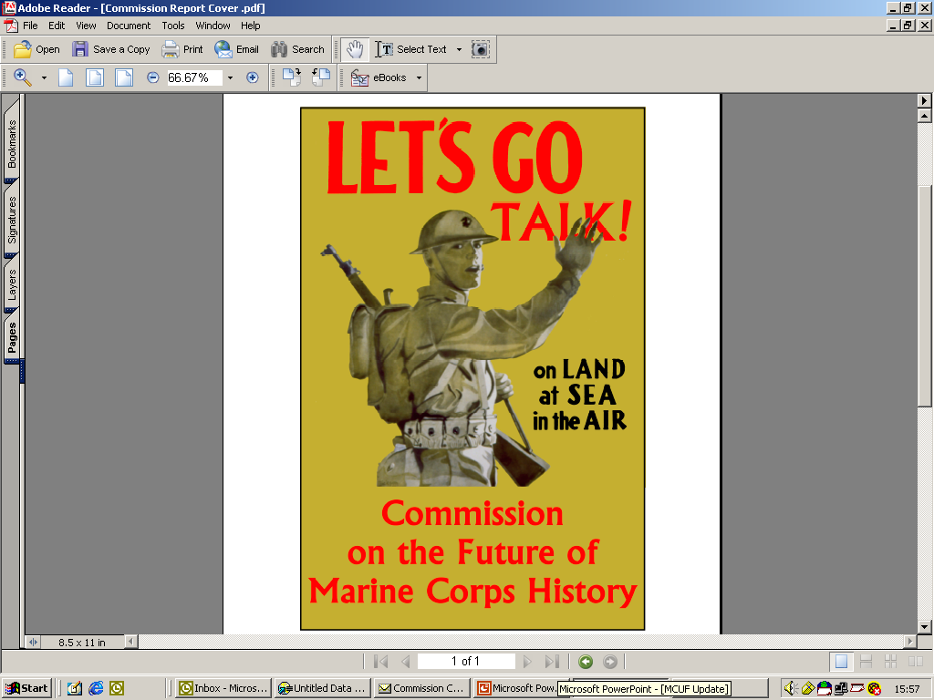
Marine Corps History Division (HD)
Collects, preserves, and presents historical information to inform decision-making, conduct research, and write Marine Corps history.
Archives - >95% of records declassified - available to all researchers
    Holdings estimated 20M pages, >4M photographs, 30K maps.
>2M digitized record pages and photographs (90% of all Command Chronologies)
Field Historians - Reserve Individual Mobilization Augmentees
HD’s “forward presence” with MEFs and operating units
Collect “real time” records and oral histories, contribute written products
Histories - research and write official operational and institutional history
Multi-volume series; commemoratives, monographs, battle studies, etc.
WWII “Red” Books, Vietnam Series, Quantico: Crossroads of the Marine Corps
Priorities
  Digitize and develop remote accessibility of archival collection
  Develop and execute collection plan for OIF, OEF, and current operations
Produce definitive history projects on OIF and OEF

Slide 19

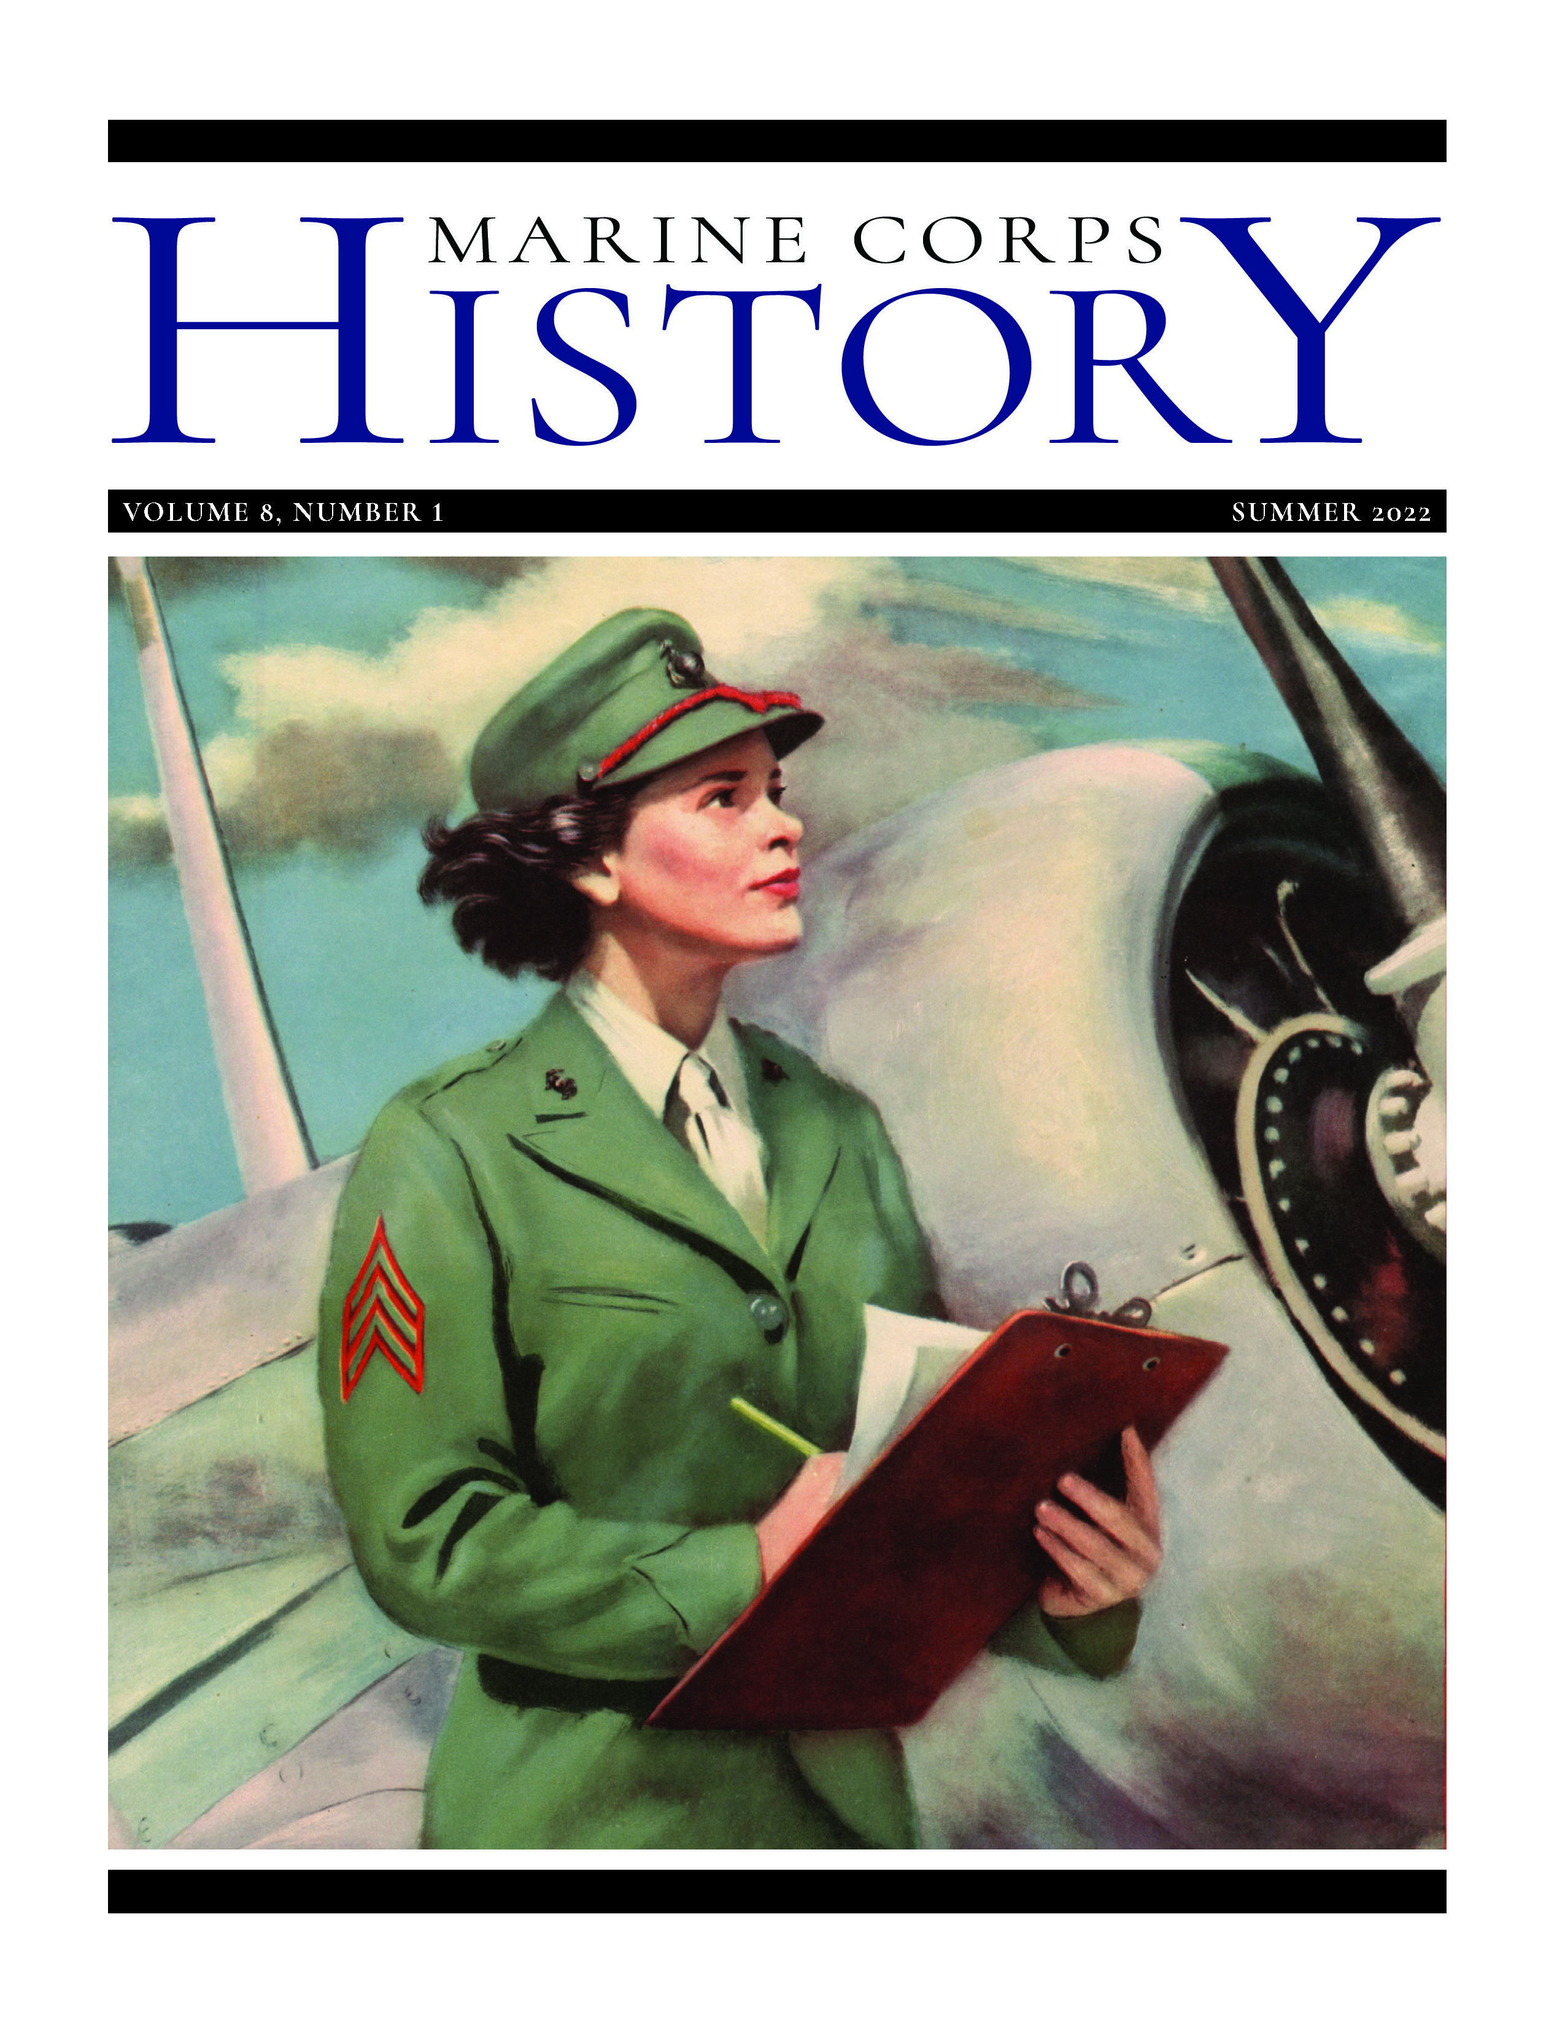
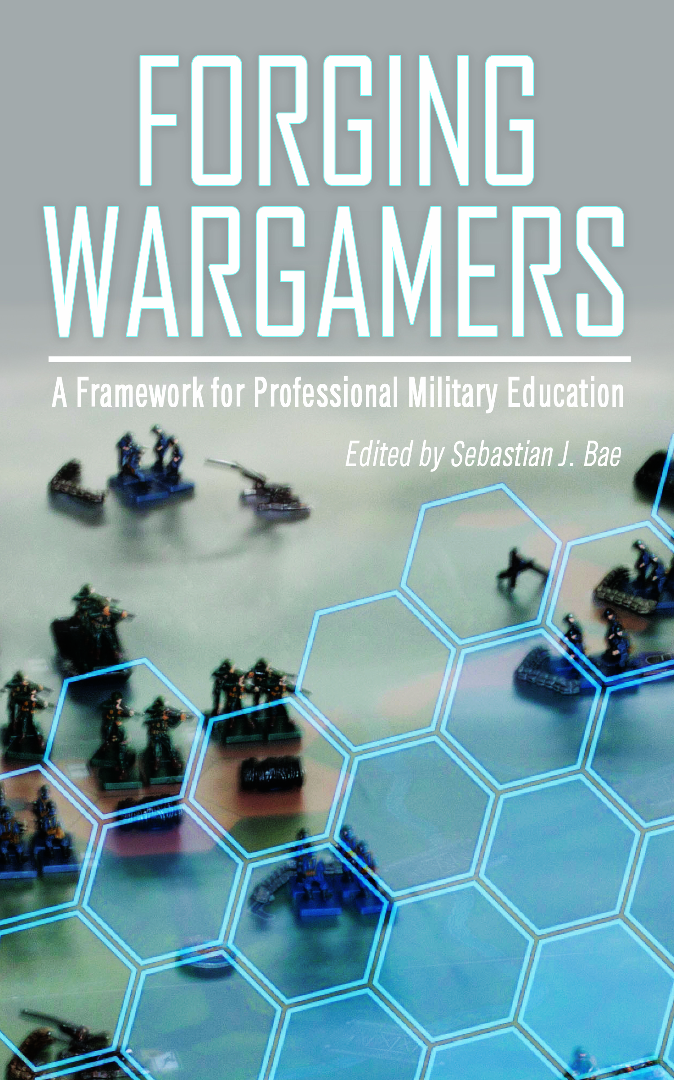
Marine Corps University Press
Mission: MCUP publishes original scholarly, peer-reviewed research (books and journals) in military history, national security, international relations, and political science realms for worldwide communities. As an open access military publisher, MCUP disseminates these products to the Joint Force, research libraries, educational institutions, and scholars at no charge. The press also serves the faculty, staff, and students by publishing on topics related to the history, culture, politics, and future of the Corps and the U.S. military.
Background:
        Fully accredited member of the Association of University Presses; Committee on Publication Ethics (forthcoming)
        Publishes four scholarly journals and 10+ scholarly monographs annually
      Content aggregated/hosted on exclusive, scholarly databases: EBSCO, ProQuest, ProjectMUSE, Scopus, Directory of Open Access Books, and ScienceOpen (forthcoming)
      Two titles on Commandant’s Professional Reading List—Journal of Advanced Military Studies and A New Conception of War—two more books in recommendation package.
      Outreach: 200-300 website visitors daily, 30,000+ pub downloads monthly, site visitors from 150+ countries/territories annually.
Annual Objectives:
Digital and print distribution of 10-15 journals and books for three imprints annually—MCUP, MCU, and History Division
Publish original, open access scholarly content that supports annual accreditation requirements, the university’s curriculum and outreach efforts, and the Service’s mission
Provide all content in multiple digital formats—html, pdf, ePUB, audio, etc.—on the MCUP platform www.usmcu.edu/mcupress

Slide 20

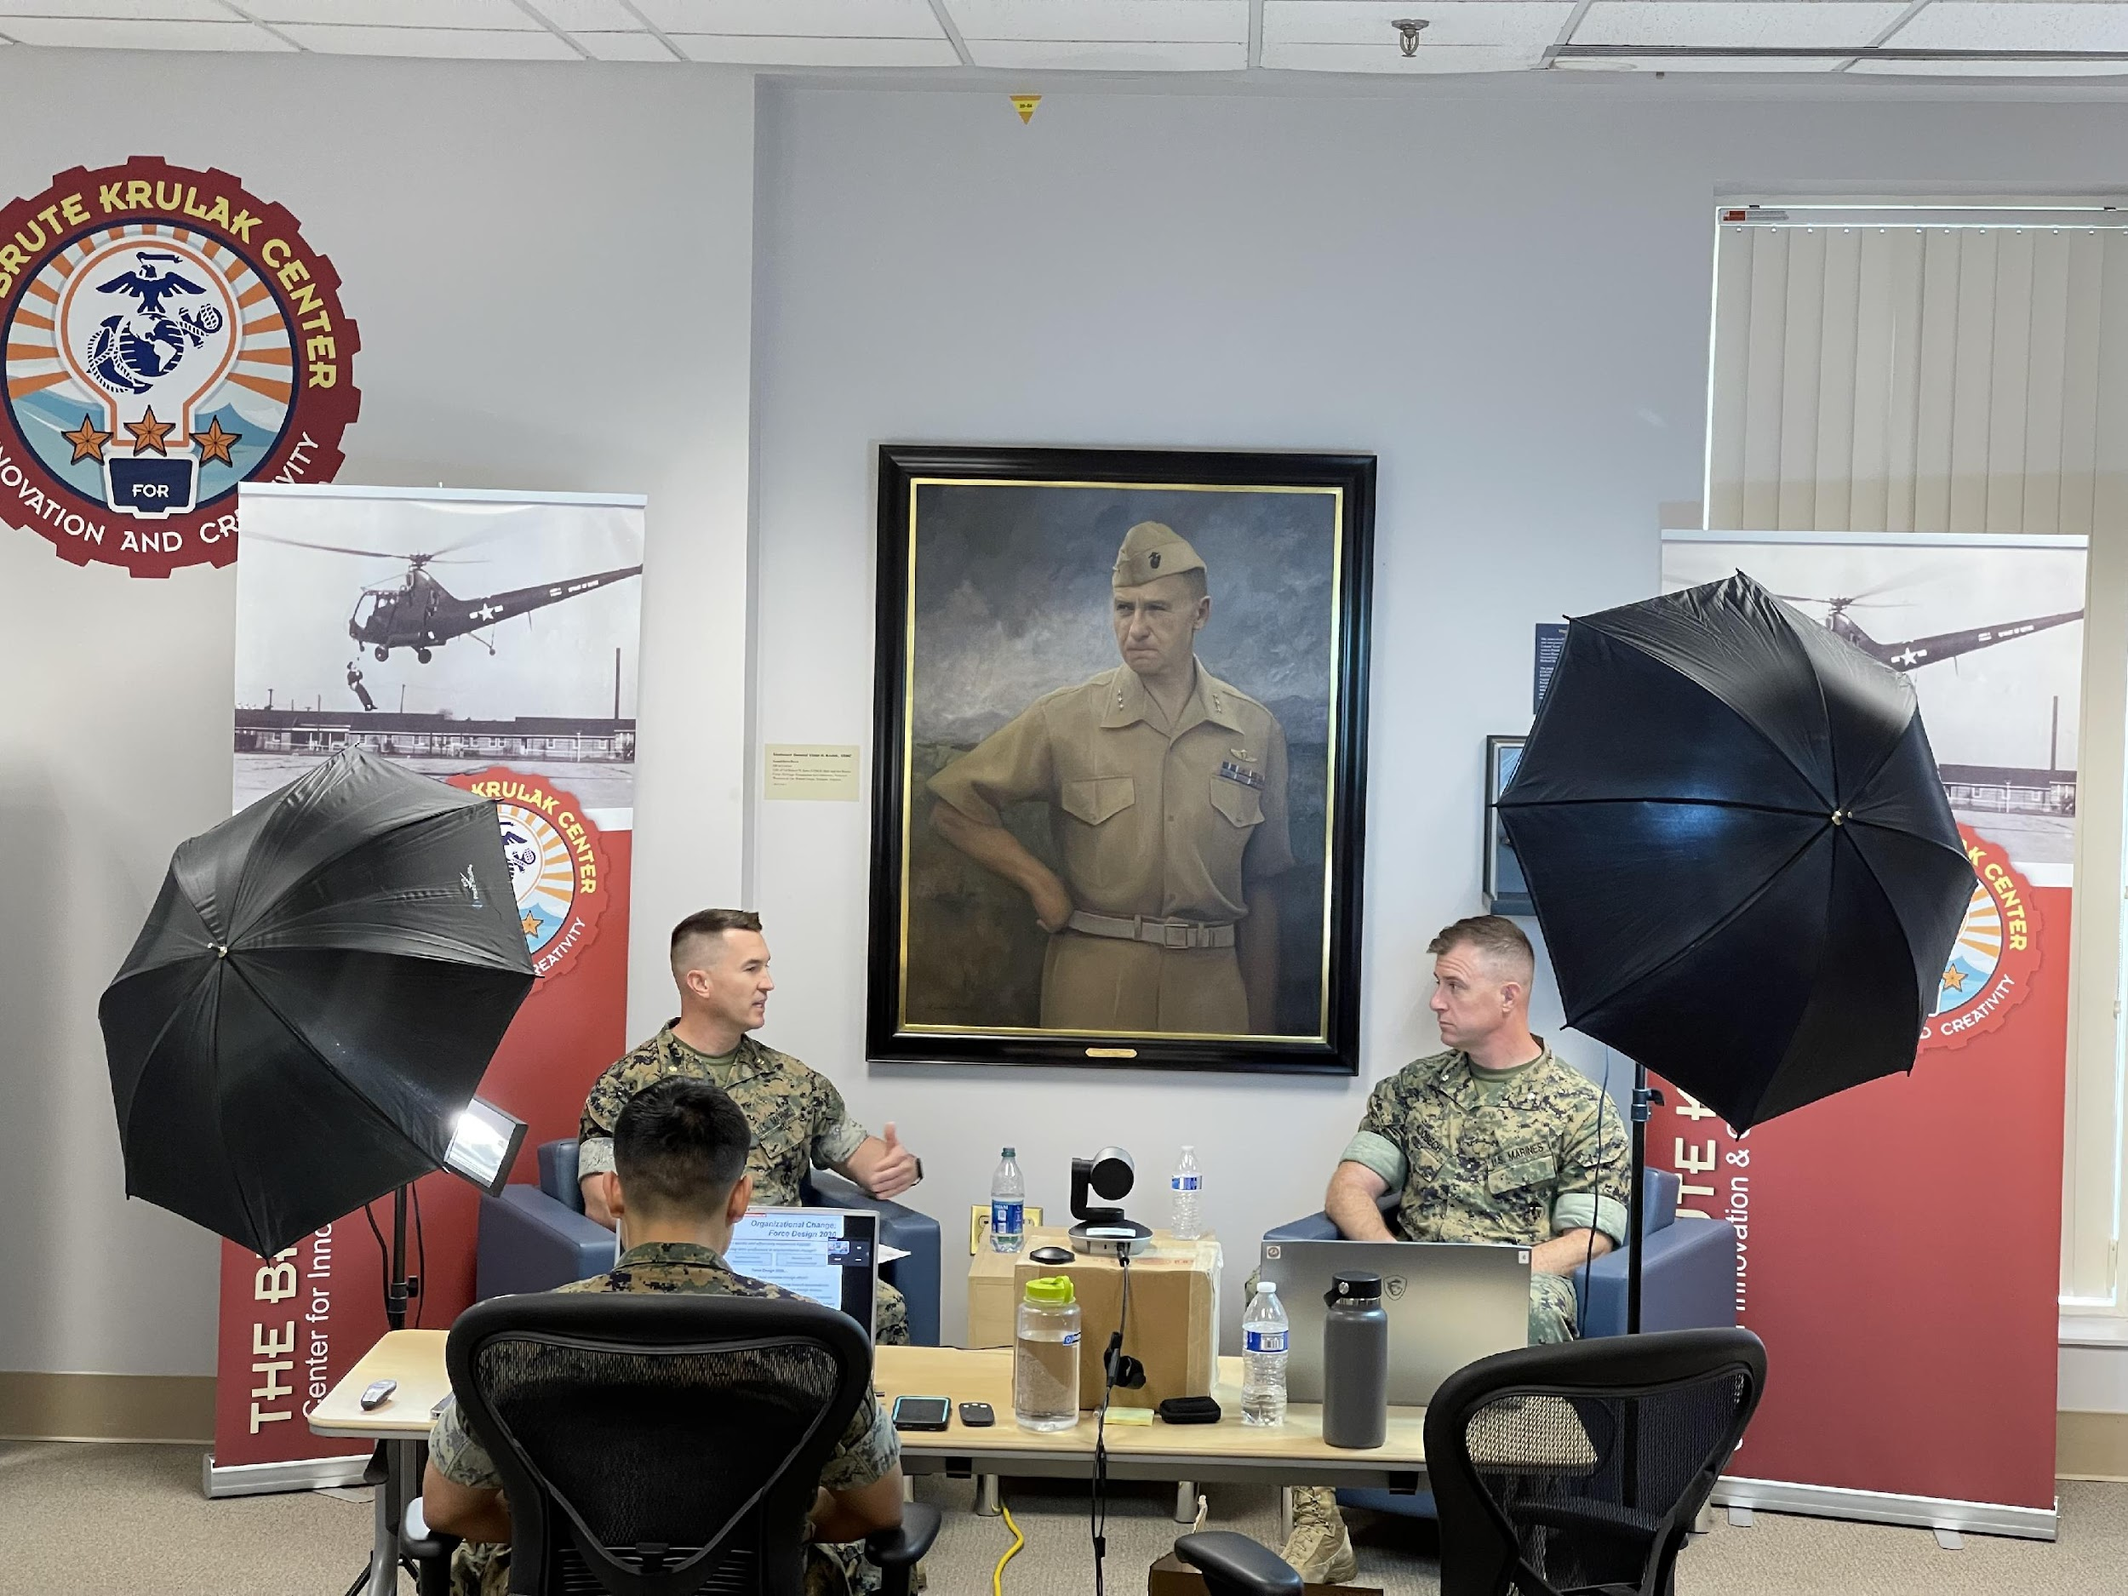
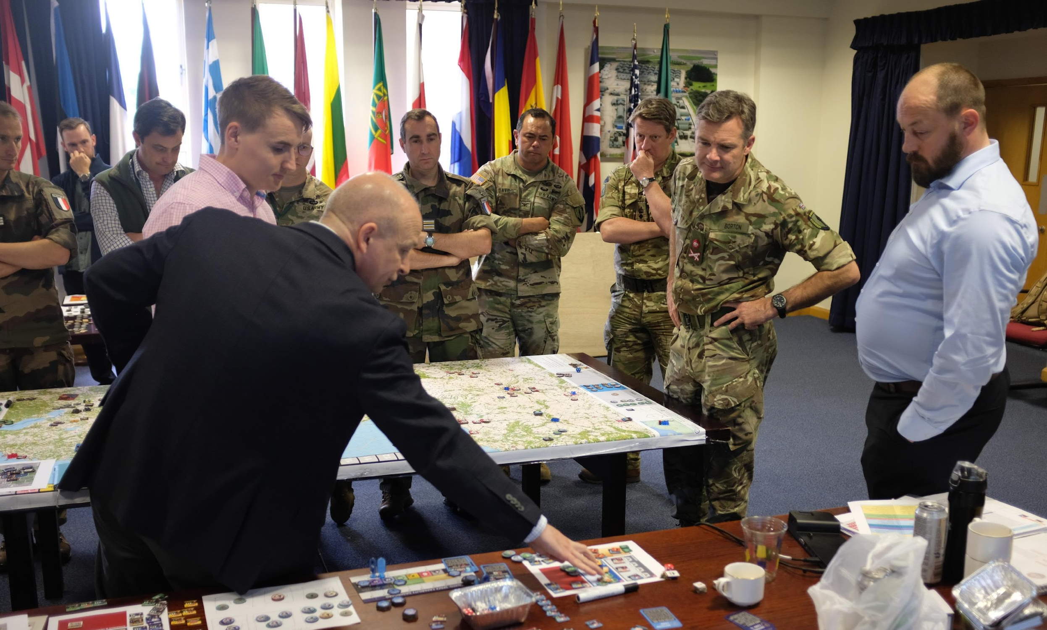

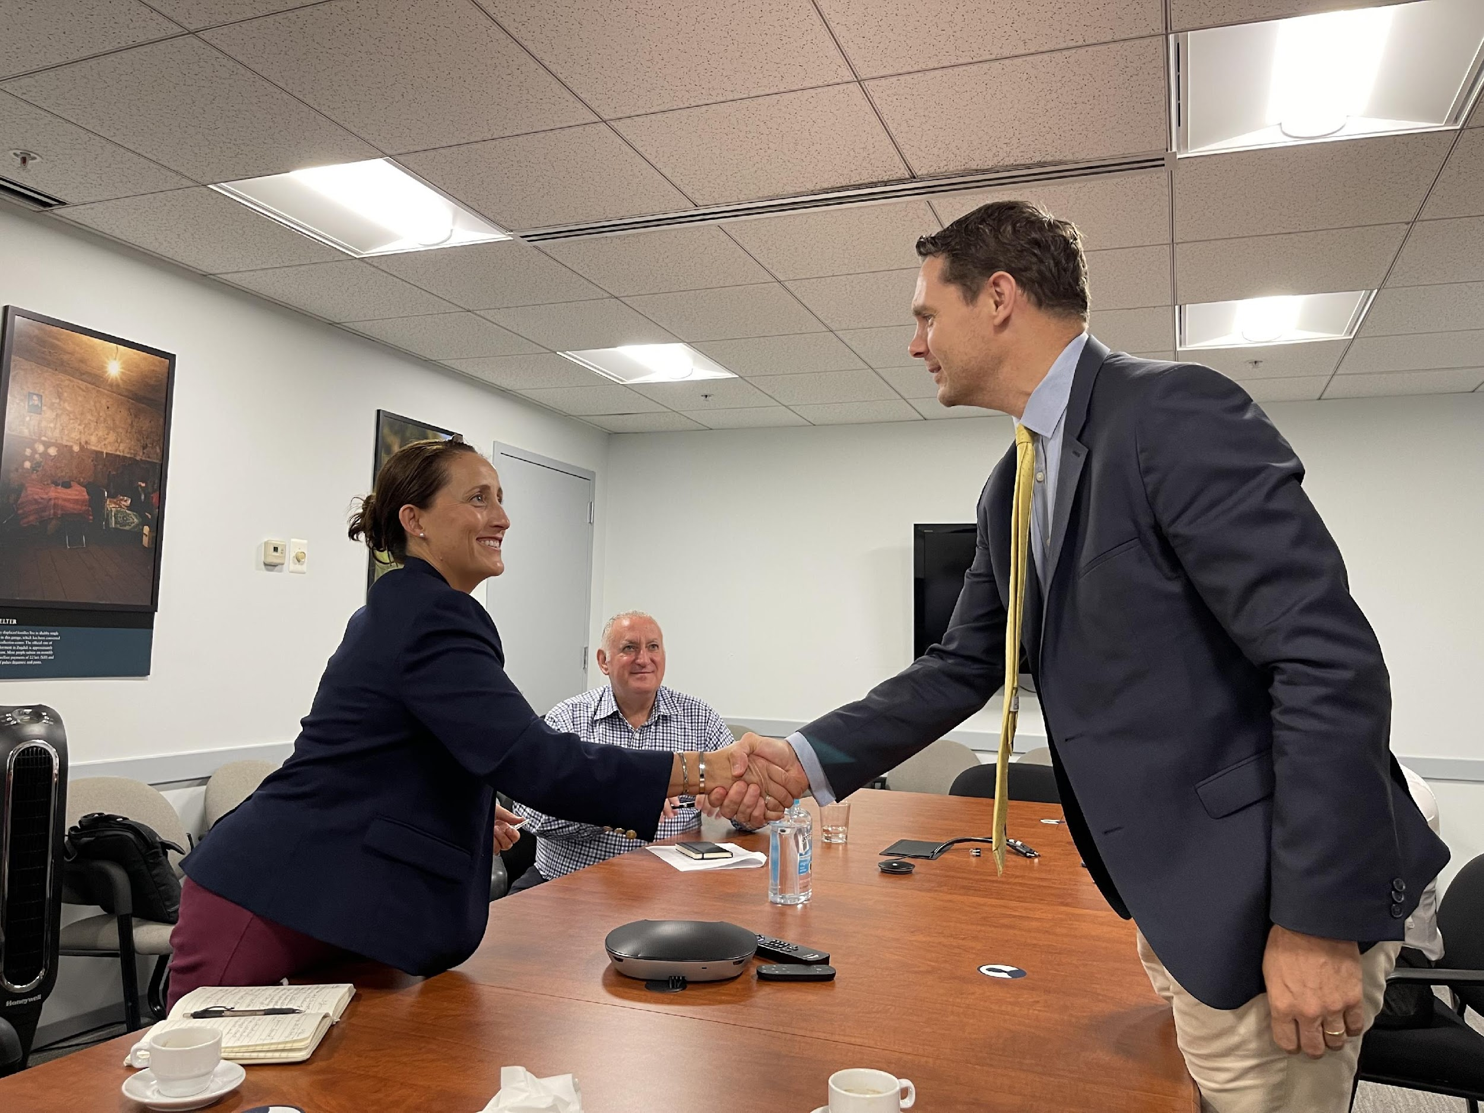
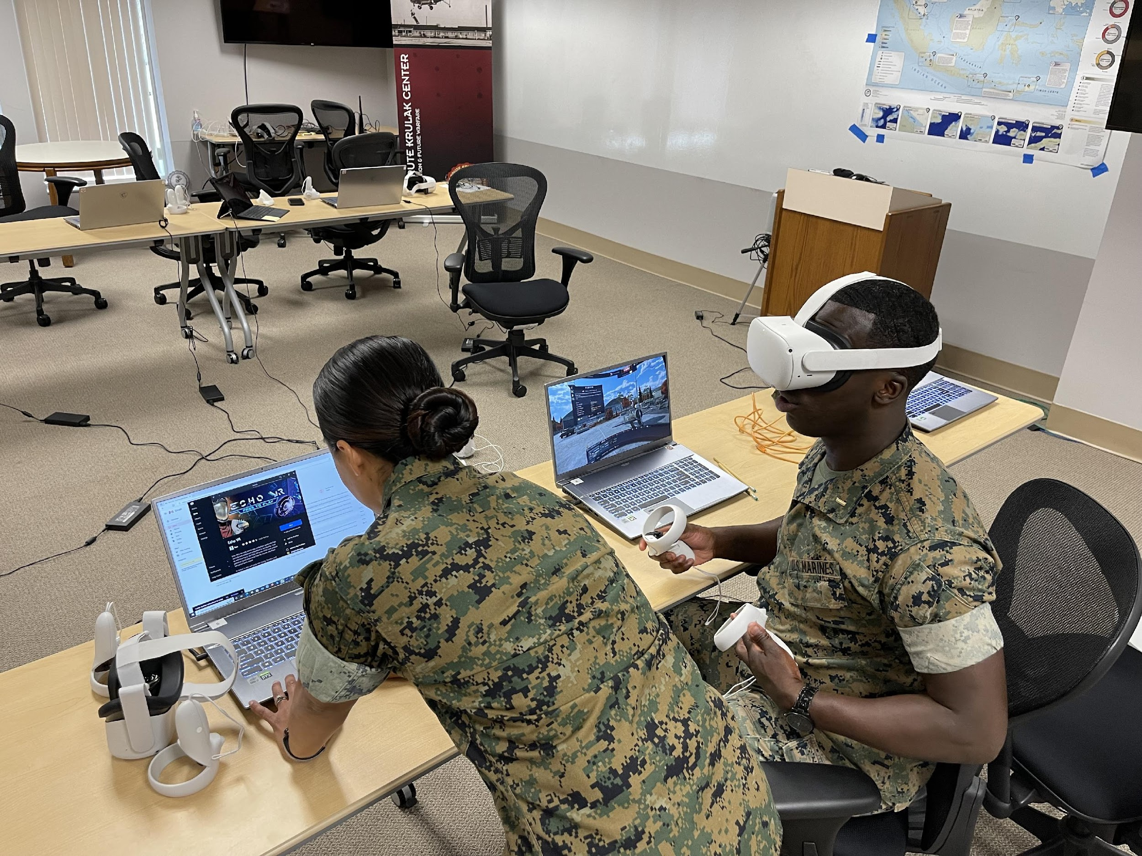
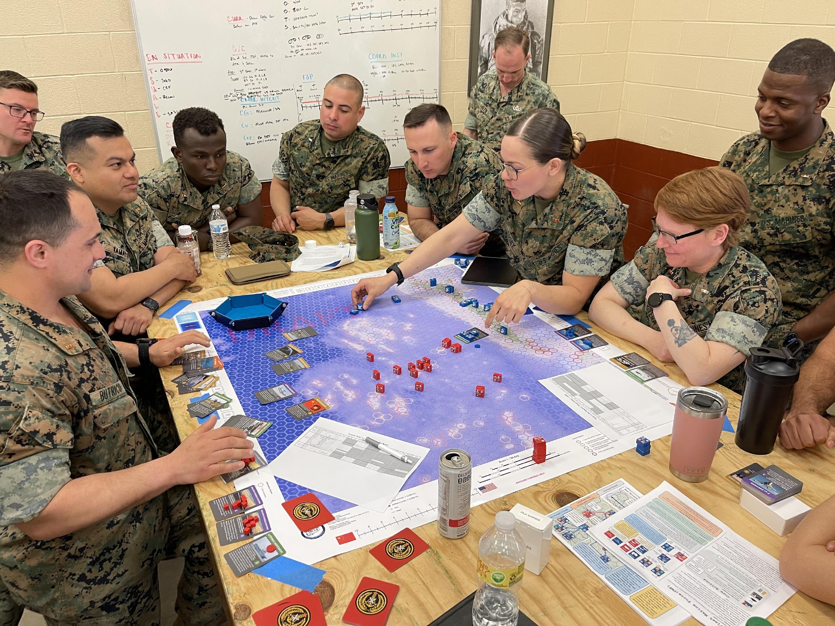
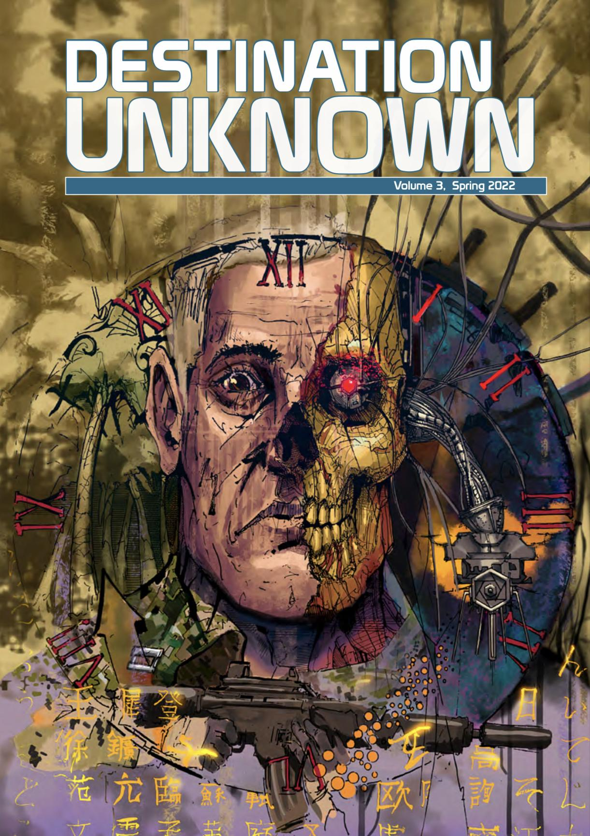
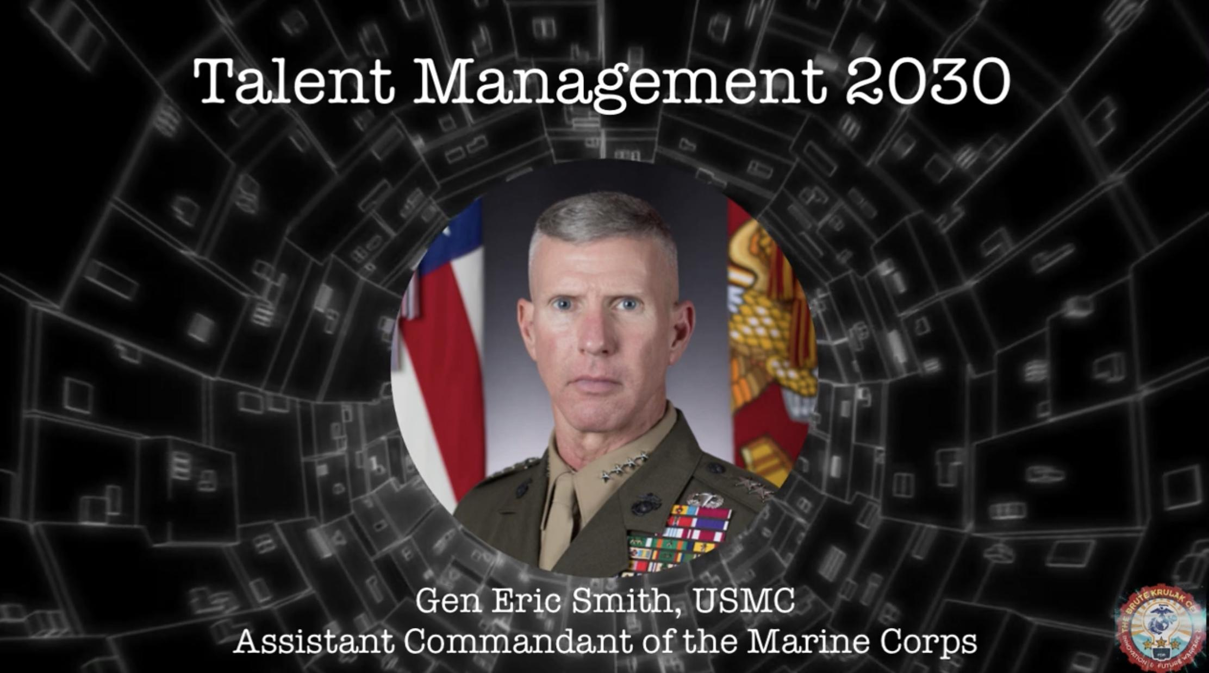
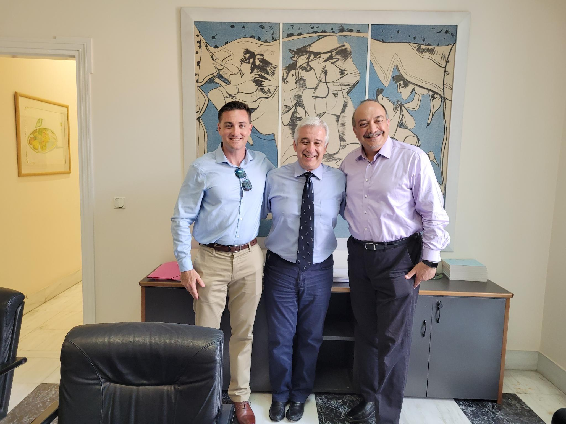
The Brute Krulak Center for
Innovation and Future Warfare
The Krulak Center supports students and faculty through an interdisciplinary approach to complex problem solving, fosters an environment that enhances our collective warfighting capability, provides wargaming capabilities to MCU and the broader Marine Corps, and facilitates and encourages novel solutions to current and future warfighting challenges in order to expand the Corps’ competitive edge and improve our warfighting effectiveness.
INSTRUCTOR SUPPORT
Faculty Development
Facilitation
Academic Initiatives
STUDENT SUPPORT
MMS Support
Classroom Instruction / Electives
Exercise Support
Innovation Summit
ADVANCED EDUCATIONAL OPPORTUNITIES
Wargaming
Scholars Programs
Speaker Series
Creative Writing
OUTREACH / COLLABORATION
Social Media
Newsletter / Website / YouTube Channel
Sister Services/Allies
All supported by Middle East Studies, Center for Regional & Security Studies, & Director of Wargaming

Slide 21
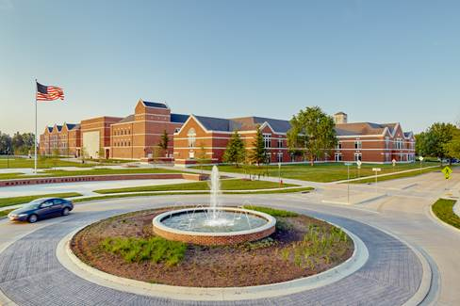
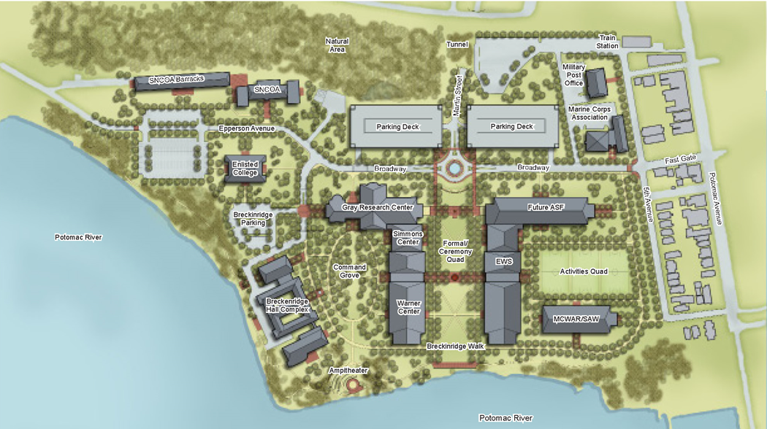
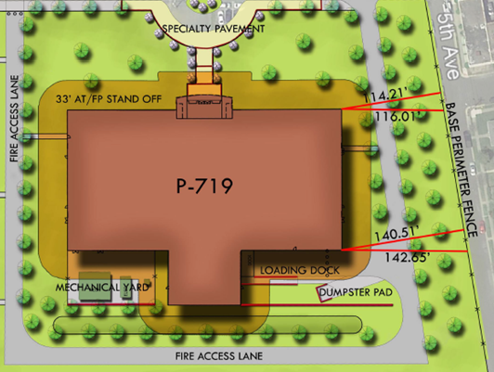
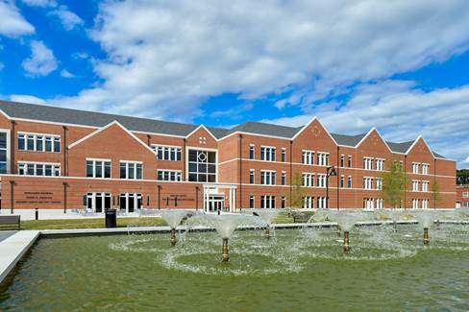
MCU Facilities Master Plan
Infrastructure
Upgrades
P-610
Wargaming Center
P-719
Enlisted College Support
Facility
P-676
EWS Academic
Facility
P-610
MCWAR, SAW and Student
Services Building
P-674
Notes:
Updated by Mr. Gentry 16-Sep-19.

Slide 22
QUESTIONS
MCU Command Brief (AY22-23)

