Slide 1
Capstone Transition Brief May 23, 2013
Purpose: Informational

Slide 2
Situation
Background: The Capstone event was established by the Veterans Employment Initiative Task Force as a verification of Career Readiness Standards (CRS) after attendance at transition readiness training (TRS).
Purpose: To evaluate service members preparedness to successfully transition from the military to the civilian sector and for validation of the CRS. If it is determined that additional assistance is needed, a warm hand-off to the appropriate partner agency will be made.

Slide 3
Mission
At 1330 on 23 May 2013, 1st Supply Battalion in collaboration with Regimental and MLG selected staff will conduct a CAPSTONE event at the Binder Chapel in order to comply with DoD and Marine directives.
Objective: Service member will demonstrate that they have met the appropriate career readiness standards to pursue following active duty as certified by the Commanding Officer. Additionally, the Command will use this opportunity to reinvigorate the “Once a Marine, always a Marine” ethos.

Slide 4
Execution
Identification of personnel (180 days out)
Quarterly requirement
56 Service Members identified to participate in ceremony.
Review of DD Form 2958
Date availability (leave or on terminal)
Rank

Slide 5
Actions to date
16 May @ 0800 review of DD Form 2958, interview w/ UTC.
17 May @ 0900 - 1030 CO reviews individual transition plan.
20 May @ 0830 - 1000 CO reviews individual transition plan.
20 May @ 1300 Remediation packages rework.
21 May @ 0900 CO re-interviews remedial transition plans.
21 May UTC submits sep package items and provide final list to S-1 & FRO.

Slide 6
Actions Cont..
CMC separation packages (S-1 via MSgt Nash).
Letter of appreciation
CMC letter
Sticker
21 May FRO sends out e-invite to service member spouses.
21 May finalize SOE For Graduation, publish FRAGO.
22 May Graduation Practice @ 0800 place Binder Chapel.

Slide 7
Ceremony
23 May Ceremony
Location: Binder Chapel (reserved)
Date (23 May @ 1330)
1325
Narrator (Cpl Hayes Ammo Company): Please take your seats the ceremony is about to begin
1330
Ceremony begins
Motivational Video (8 minutes)
Invocation (Chaplain Earl)
National Anthem
Commanding Officer Remarks (Commanding Officer)
Presentation of certificates (Co and SgtMaj)
Refreshments (FRO)

Slide 8
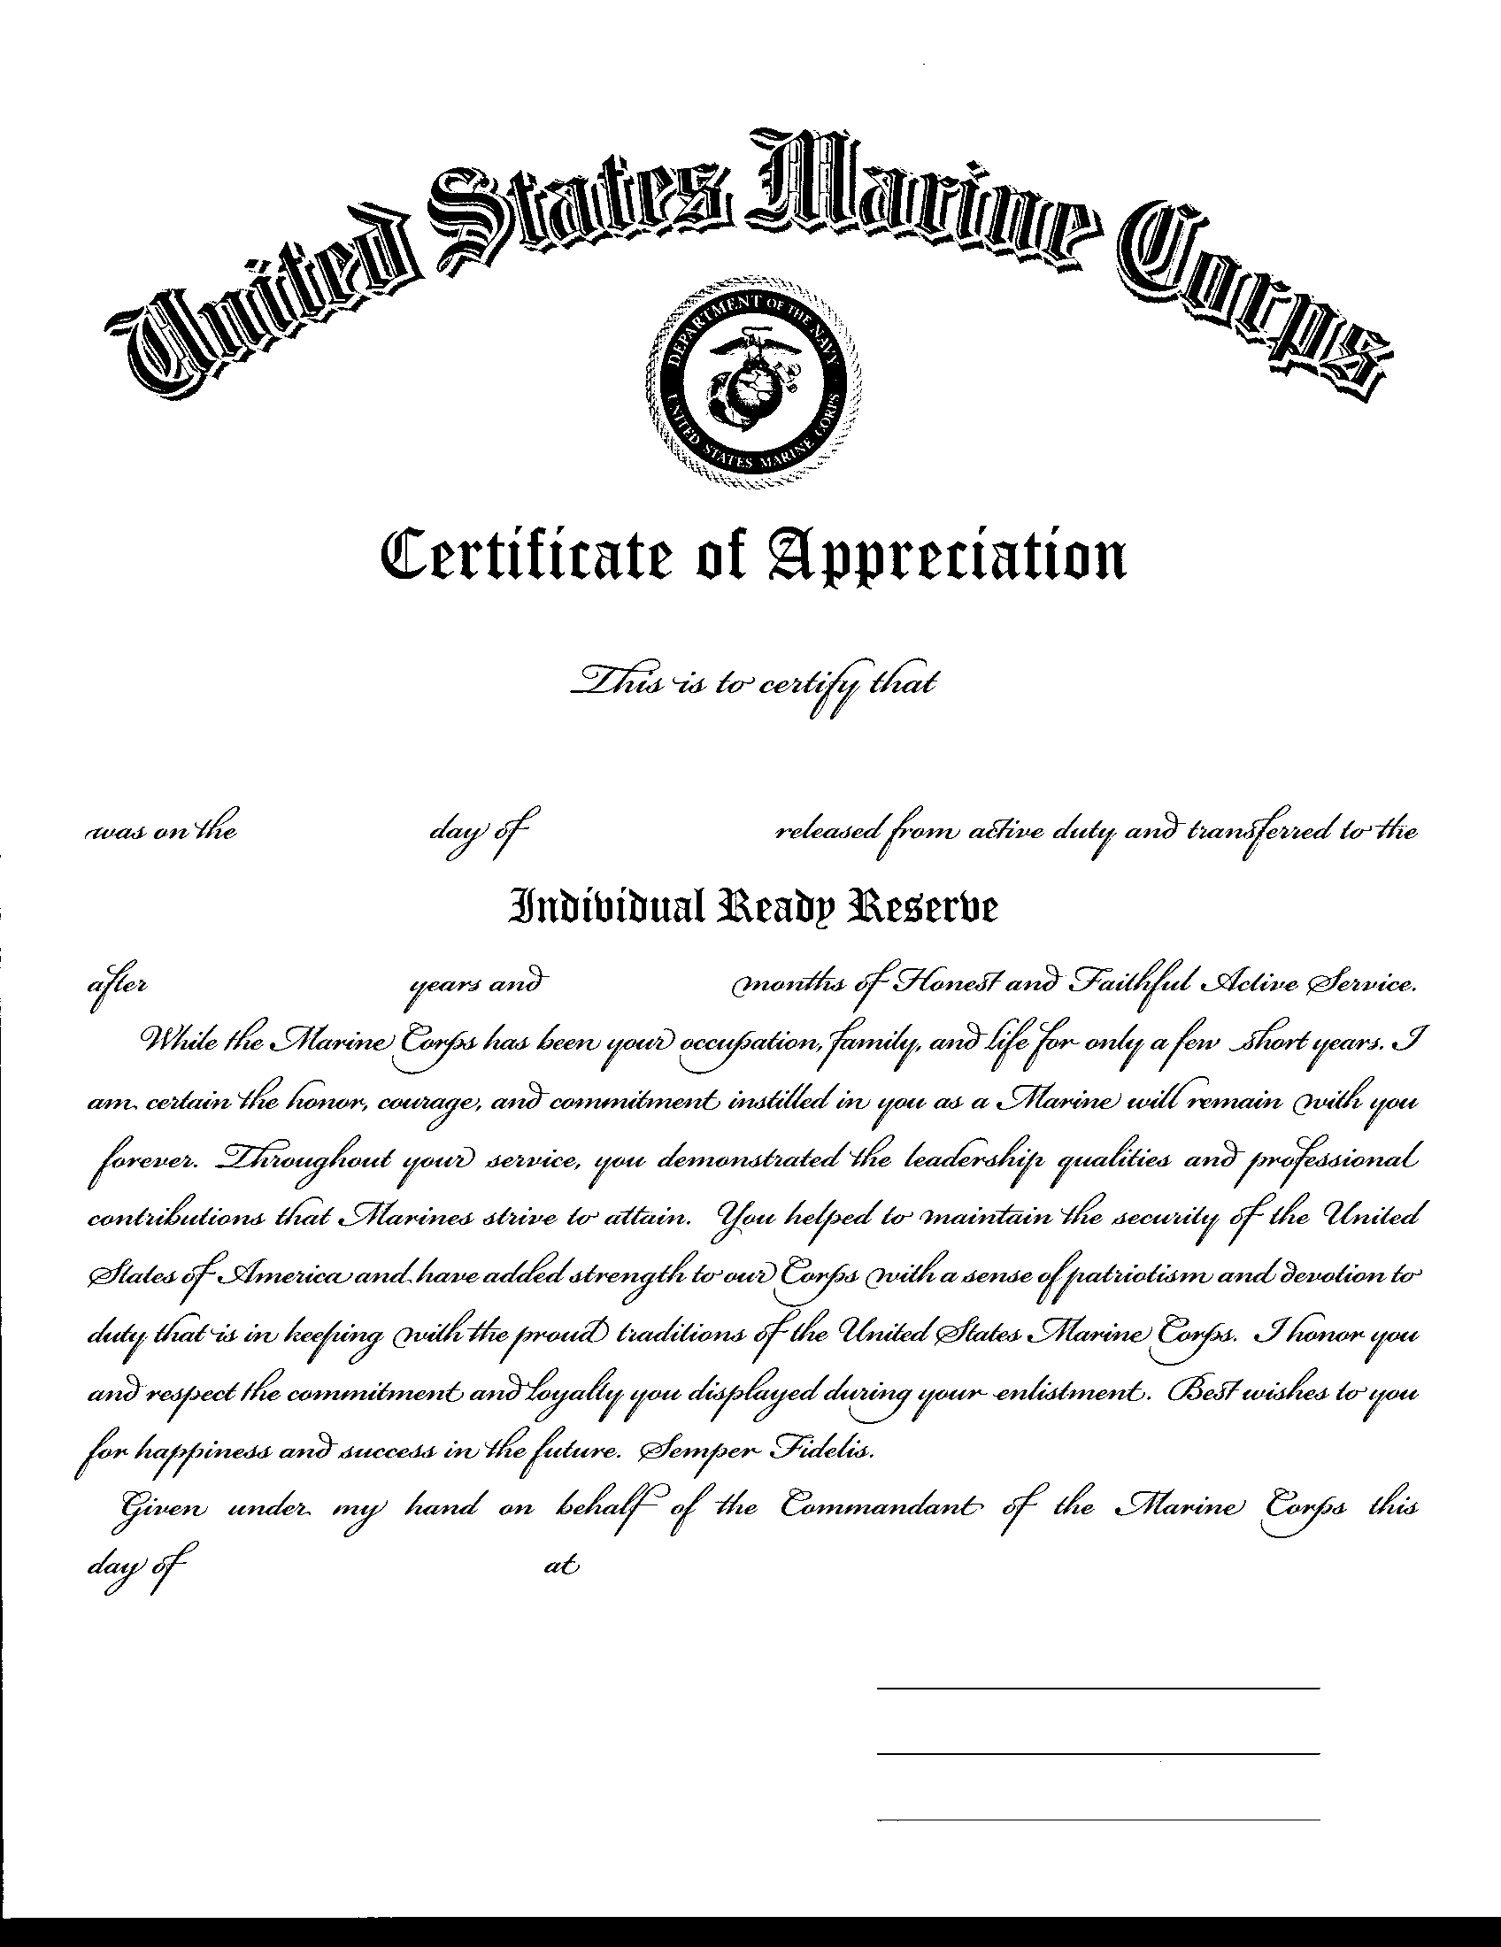
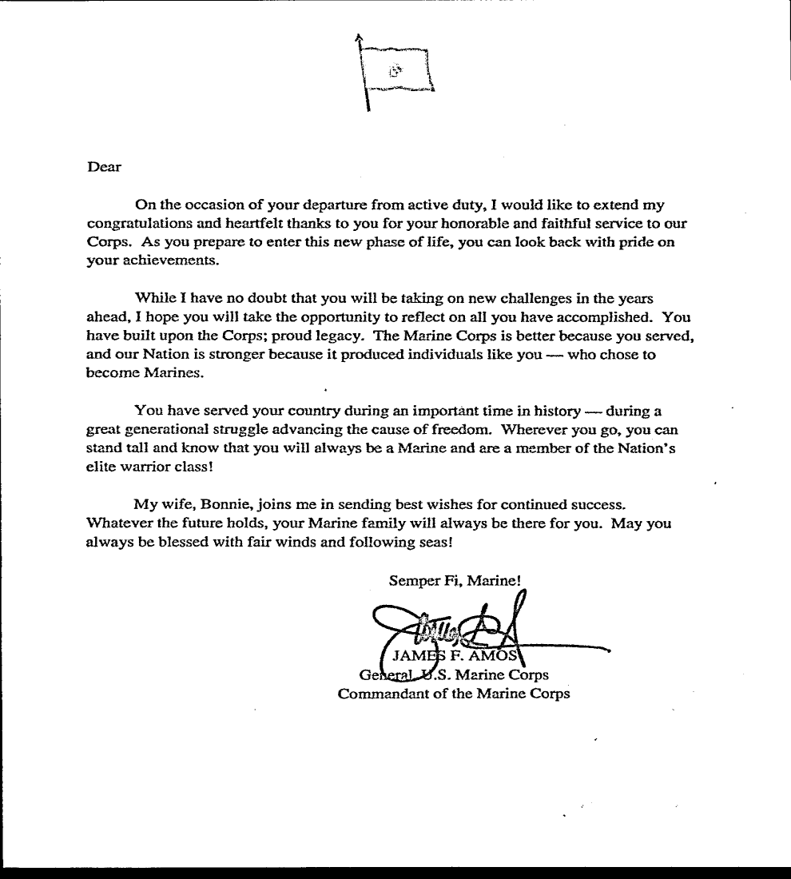
Certificates
CMC Letter
Certificate of Appreciation

Slide 9
Questions?

