Slide 1
Saving and Investing
Lejeune Leadership Institute
Notes:
Slide 1:
THIS CLASS IS FOR INFORMATIONAL PURPOSES ONLY TO GIVE YOUR MARINES A BRIEF OVERVIEW. FOR DETAILED AND EXPERIENCED FINANCIAL INFORMATION REFER TO YOUR UNIT’S COMMAND FINANCIAL SPECIALIST (CFS) AND YOUR BASE PROFESSIONAL FINANCIAL MANAGER (PFM); ADHERE TO MARADMIN 061/13 PERSONAL FINANCIAL MANAGEMENT EDUCATION PROVIDED BY NON-FEDERAL ENTITIES” FOR GUIDANCE.

Slide 2
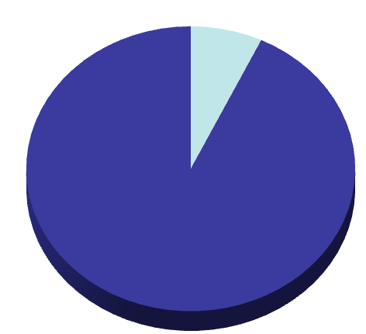
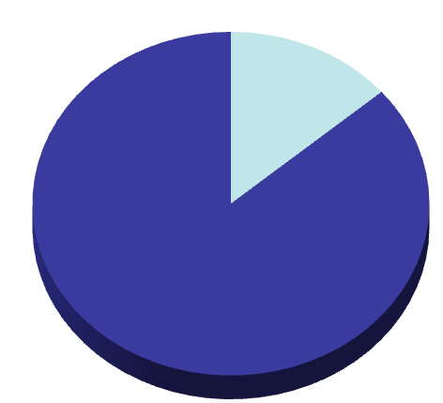
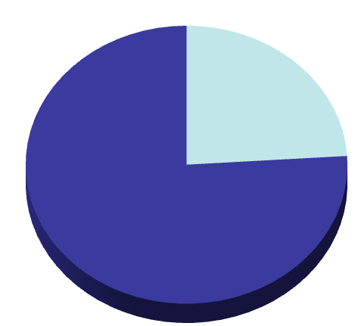
Start Early
What will it take to have ½ million dollars at retirement…starting at age 25? 35? 45?
$37,920
$79,560
$157,920
$79 per month
$37,920 Out of Pocket
$221 per month
$79,560 Out of Pocket
$658 per month
$157,920 Out of Pocket
25
35
45
What is Financially Easier? Paying $79, $221 or $658 a month…
Notes:
Slide 2:
What does this example show? The earlier you start to invest, the less you have to invest each month as you age. This is the “magic” of compound interest and time. The sooner you begin to put money aside, the longer your money will be working for you. In the same way that the key to building wealth is saving and investing, the keys to successful investing are pretty simple: start early in life, be consistent and disciplined, and let compound interest and time work for you.

Slide 3
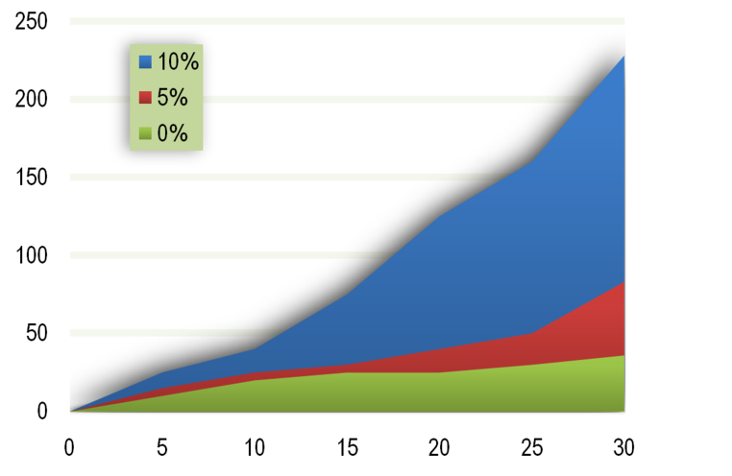
Compounding
$228,033
$228,033
Thousand $
$83,673
$83,673
$36,000
$36,000
Notes:
Slide 3:
The only way to overcome taxes and inflation is to put the power of compound interest and time to work with a long-term, disciplined investment plan. Here is one more example of how money can grow over time. Over 30 years, $100 saved monthly with no interest will equal $36,000.
The same amount accumulating earnings at 5 percent will grow to about $83,673. This amount with a 10 percent rate of return grows to about $228,033. This example, along with earlier examples, shows again that the greater the rate of return and the longer your money works for you, the more you eventually will earn. Compound interest is a powerful force.

Slide 4
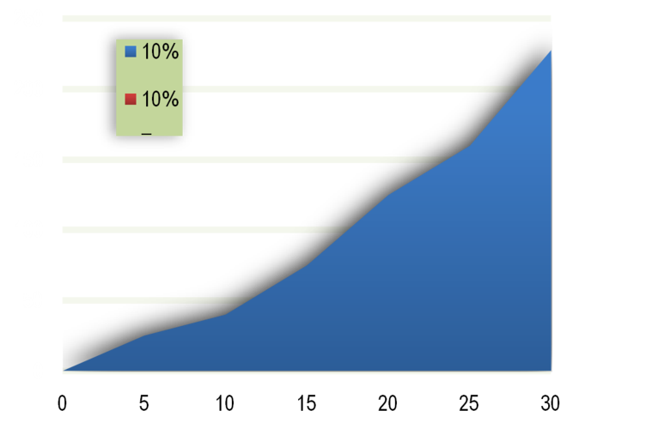
Should I Spend The Nest Egg?
$94,144 LOST!
$228,033
Thousand $
$133,889
Spend $7,800 nest egg on a car
Notes:
Slide 4:
What an investment can do on paper is often different from what investors do in real life. Unfortunately, when some people see their money begin to add up, they feel a temptation to spend. Using the above example, what if, after five years of saving, the investor decided to use the approximately $7,800 that had grown (at 10 percent) to buy a car? Continued investing at the same rate would grow only to $133,889 instead of the $228,033 if all of the money had been left to grow. In other words, you could say that the car did not cost you $7,800 but $94,144 when you account for the lost growth. The message? Save regularly, and leave it alone to grow.

Slide 5
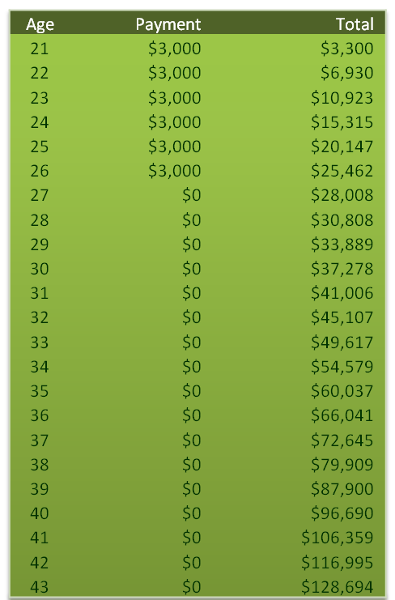
The Effects of Compound Interest and Time: Plan A
(Growth rate of 10%)
$1,047,608
Notes:
Slide 5:
Compound interest, simply defined, is when the earnings on the dollars you save or invest accumulate earnings of their own.
In the first column, Plan A, $3,000 is committed each year for six years (a total of $18,000 out-of-pocket) starting at age 21. Without ever saving another cent, if the money was to grow at 10 percent per year with no withdrawals, the plan would be worth over $1 million by age 65.

Slide 6
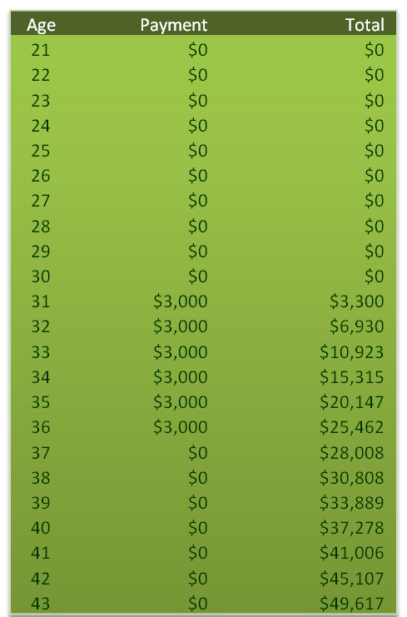
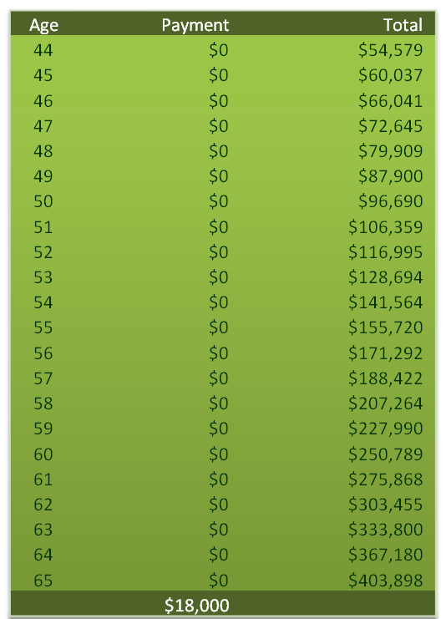
The Effects of Compound Interest and Time: Plan B
(Growth rate of 10%)
$403,898
Notes:
Slide 6:
Rather than starting at age 21, an individual begins at age 31, investing $3,000 for six years (with the same total of $18,000 out-of-pocket). Without any additional contributions, a growth rate of 10 percent per year and no withdrawals, at age 65 that same $18,000 investment would grow to $403,898. That 10-year delay is the equivalent of a loss of 600,000 .

Slide 7
The Financial Planning Pyramid
Factors to consider
Safety
Liquidity
Yield
Options, Commodities, etc.
Real
Estate
Hard
Assets
INVESTMENT LEVELS
Stocks
Bonds
Mutual
Funds
SAVINGS
LEVEL
Reserve
Emergency
Goal-
Getter
MANAGEMENT
LEVEL
Adequate
Income
Controlled Spending
Adequate
Insurance
Notes:
Slide 7:
Safety: When you save and/or invest $1, you want to be certain you at least will get your $1 back. Is the account insured? How safe is the principal? Some products guarantee you’ll get your money back, but others do not. You could lose some or all of what you invested. Another concept that is associated with safety is risk as is relates to level of uncertainty an individual can comfortably manage. Some individuals are somewhat risk-adverse and are looking for saving and investing vehicles with a large measure of safety and a low measure of risk. Others have a higher threshold for uncertainty and are comfortable with a lower measure of safety.
Liquidity: How quickly and easily can you access your money? Some money is available immediately, such as money in a savings or checking account. Other money could take a long time to have in hand, such as equity in a real estate investment.
Yield (or rate of return): The yield is how much money your savings or investments earn. Some financial vehicles, such as a savings account, usually have a low rate of return, while others, like a growth stock, have the potential for high returns. When considering the “S-L-Y” factors, it is important to know that you never can have all three working in your favor — there always will be a trade-off. The trade-off you are willing to accept will depend on your goals and your time frame for the money you have.

Slide 8
Savings Vehicles
Regular Savings Account
Certificates of Deposit
Money Market Accounts
U.S. Savings Bonds (EE and I)
Notes:
Slide 8:
There are four basic options to save: savings accounts, certificates of deposit, money market accounts, and U.S. savings bonds. Each should be evaluated in view of safety, liquidity and yield:
• Regular savings account
• Certificates of deposit
• Money market accounts
• U.S. savings bonds (EE and I)

Slide 9
Regular Savings Accounts
Safety: FDIC Guaranteed up to $250,000
Liquidity: No restrictions on withdrawals
Yield: Generally the lowest interest rate
Bank or Credit Union
Notes:
Slide 9:
Safety: Guaranteed up to $250,000 (per Social Security number) if federally insured.
Liquidity: Restrictions on withdrawals will vary with the institution; some may charge for any withdrawal or for any withdrawal over a certain number. However, federal regulation limits the number of withdrawals and/or transfers that may be made from a savings account by telephone/PC transfer, pre-authorized transfer, debit card. You are limited to six withdrawals and/or transfers from your savings account each monthly statement cycle by pre-authorized transfer, or telephone/PC transfer (including bill payments). And, if the account permits transfers by debit card, no more than three of the six limited transfers may be by check or debit card.
Yield: Generally carry lowest rates of interest.

Slide 10
Certificates of Deposit
Safety: FDIC Guaranteed up to $250,000, if insured
Liquidity: Invested for a fixed period, if liquidated before that - some interest may be forfeited
Yield: Average for 1-year is .90 %
Bank, Credit Union or brokerage
Usually a minimum of $500
Notes:
Slide 10:
A certificate of deposit (CD) is a deposit of a fixed sum of money for a fixed period of time.
Safety: Guaranteed up to $250,000 if federally insured.
Liquidity: Funds are invested for a fixed period, usually six months to five years. CDs may be liquidated at any time, but if it is before the maturity date, some interest may be forfeited.
Yield: Higher than savings deposits; the longer the term, the higher the yield.

Slide 11
Money Market Accounts
Safety: FDIC Guaranteed up to $250,000, if insured
Liquidity: Generally no restriction on withdrawals
Yield: Low but higher than savings account - Average is .71 %
Bank, Credit Union or brokerage
May have a large minimum deposit, required minimum balance, and fees for withdrawals
Notes:
Slide 11:
Money market accounts are interest-earning savings accounts offered by FDIC-insured institutions, with limited transaction privileges.
Safety: Safe but may not be federally insured, depending on where the account is maintained. A money market deposit account at a bank or credit union should be insured up to $250,000 per account. A money market account held at a brokerage or through a mutual fund typically will not be insured.
Liquidity: Money market accounts may have a large minimum deposit required, a required minimum balance, fees for withdrawals, and/or limited check-writing privileges. Restrictions follow the same regulation governing savings account withdrawals, which limits the number of withdrawals and/or transfers that may be made from a savings account by telephone/PC transfer, pre-authorized transfer, or debit card. You are limited to six withdrawals and/or transfers from your savings account each monthly statement cycle by pre-authorized transfer, or telephone/PC transfer (including bill payments). And, if the account permits transfers by debit card, no more than three of the six limited transfers may be by check or debit card.
Yield: Generally low but higher than regular savings. The yield varies with changes in interest rates. Money market accounts may be attractive if rates are rising rapidly.

Slide 12
U.S. Savings Bonds: EE
Safety: FDIC Guaranteed
Liquidity: Can be redeemed after 12 months, subject to a 3 month interest penalty if held for less than 5 years
Yield: Fixed rate of return determined twice a year
Bank, Credit Union or savingsbonds.gov
Minimum investment of $25
No commissions or fees
Notes:
Slide 12:
Safety: Guaranteed by the U.S. Treasury.
Liquidity: Can be redeemed after 12 months but subject to a three-month interest penalty if held for less than five years.
Yield: A fixed rate of return determined twice a year.
Series EE bonds are an easy, convenient and disciplined way to begin your investing. The S-L-Y trade-off is that the yield is relatively low. If you are going to invest in savings bonds, make it a part of your investment plan but not all of it.

Slide 13
U.S. Savings Bonds: I
Safety: FDIC Guaranteed
Liquidity: Can be redeemed after 12 months, subject to a 3 month interest penalty if held for less than 5 years
Yield: Has two parts--a fixed rate of return and a variable, semi-annual inflation rate
Bank, Credit Union or savingsbonds.gov
Minimum investment is $25 (electronic form) or $50 (paper form)
No commissions or fees
Notes:
Slide 13:
Safety: Guaranteed by the U.S. Treasury.
Liquidity: Can be redeemed after 12 months but subject to a three-month interest penalty if held for less than five years.
Yield for Series I Bonds: Yield is indexed for inflation and has two parts: a fixed rate of return and a variable, semi-annual inflation rate.
Like Series EE bonds, Series I bonds are an easy, convenient and disciplined way to begin investing. The S-L-Y trade-off is that the yield is relatively low.

Slide 14
Savings vs. Investing
Different Time Frames
Different Risks
Inflation ($100 in 1984 = $215 in 2007)
Taxes
The Effect of Compound Interest and Time
Notes:
Slide 14:
How does investing differ from savings? They differ in the time frame in which the money is needed; in the higher risk associated with investment vehicles; in the effect of inflation and taxes on investment earnings; and in the significant effect of compound interest and time.
As discussed earlier, it is most appropriate to use savings vehicles for short-term financial goals — money to be used in five years or less. If the money is needed for a goal in five or more years, investment vehicles that offer the potential for a higher yield are the best option. This is because in the short term, money that is placed in investments is subject to market fluctuations, and the investor has a higher risk of losing money. The longer your investment horizon (the distance from making the investment to using the investment), the better your ability to lower some of the risk of market fluctuations.

Slide 15
Taxes on Tax-Advantaged Accounts
Tax-deferred:
Taxes are deferred until you withdraw money
Employer or individually sponsored
TSP, 401(k), SIMPLE IRA, Traditional IRA, SEP-IRA
Tax-advantaged:
Roth IRA
Non-deductible Traditional IRA
Notes:
Slide 15:
Employer sponsored: Tax-deferred accounts can be employer sponsored such as the Thrift Savings Plan and civilian retirement plans such as a 401(k), 403(b), Savings Incentive Match Plan for Employees (SIMPLE) IRA. An immediate benefit of these accounts is that the contributions made to them are deducted from paychecks before income taxes are calculated, so taxable pay is reduced today. Another advantage to employer-sponsored plans can be matching contributions. Matching contributions are essentially free money, if offered, and you should always try to take advantage of the matching maximum.
Individually sponsored: Tax-deferred accounts can also be individually sponsored such as a Traditional IRA, Spousal IRA (same as a Traditional IRA but funded for a spouse who has little or no earned income by the spouse with earned income) and Keogh plan or Simplified Employee Pension-Individual Retirement Account (SEP-IRA) for self-employed individuals. The money earned on these types of accounts is taxed when it is withdrawn at the investor’s ordinary income tax rate at the time of withdrawal. Additionally, the withdrawal may be subject to an additional 10% penalty if you are not yet age 59 ½.
There are two types of tax-advantaged IRA accounts:
Roth IRA account: The Roth IRA is a type of after-tax account. The money put into a Roth IRA cannot be deducted from income before taxes, so the contribution is considered an “after-tax” contribution. Contributions can be withdrawn at any time with no tax consequences. Earning withdrawn from an account less than five years old are subject to taxes like ordinary income and may be subject to an additional 10% penalty if you are less than 59 ½ years of age. All withdrawals (contributions and earnings) made after age 59 ½ are entirely tax exempt.
Non-deductible traditional IRA: This is a Traditional IRA account that consists of non-deductible contributions. If an individual is covered by a retirement plan at work and their modified adjusted gross income exceeds the IRS limitations, they cannot deduct their contributions to a Traditional IRA. Earnings on this type of account are taxed as ordinary income at the time of withdrawal.

Slide 16
Asset Classes and Related Mutual Funds
Stocks
Stock Mutual Funds
Balanced Mutual Funds
Bonds
Balanced Mutual Funds
Bond Mutual Funds
Real Estate
Sector Funds
Hard Assets
Sector Funds
Money Market Instruments
Money Market Funds
*For Detailed Investment Advice consult your PFM or Financial Institution Investment Professional
Notes:
Slide 16:
There are equities (stocks), fixed-income (bonds) and cash equivalents (money market instruments). Everything else is a combination of these three. When you invest in equity — when you buy a stock — you become an owner. When you invest in fixed-income — buy a bond — you become a lender. Often fixed-income securities also are known as debt securities, but this is good debt, the kind where people owe you money. A well-planned financial portfolio will have a combination of equities, fixed-income and cash, depending on investment goals, time frame and risk.
The Financial Planning Pyramid lists some of the better-known forms of equity and debt: stocks (equity); bonds (fixed-income or debt); mutual funds (explained below); real estate; hard assets (things you can touch) such as investment-grade precious metals (gold or silver) and collectible items; and a few others. Several of these are worthy of a more detailed discussion because they are the best investments for Marines and their families. As with any investment you must research these to determine if they are true investments. Not all items sold as “collectible items” are true investments and not all “jewelry” that are gold or silver are true investments.

Slide 17
The TSP Funds
Government-sponsored retirement plan
Defined contribution vs. defined benefit
Similar to a 401(k)
Open to all military service members
Purpose: To provide retirement income
WWW.TSP.GOV
Notes:
Slide 17:
The TSP is a retirement savings and investment plan sponsored by the federal government. It is a qualified defined-contribution plan; therefore, it has the same type of savings and tax benefits as a 401(k). The TSP is open to all members of the uniformed services, active-duty and Ready Reserve. With the TSP, you choose to join; you choose the contribution amount, which comes directly out of your pay; you choose the investments from 10 different options; and you own all of your contributions and any earnings.

Slide 18
TSP Benefits
Contributions are BEFORE TAX
Contributions grow TAX-DEFERRED
Automatic contributions
Low administrative costs
Easy to start and make allocations
You take it with you
You choose the beneficiary
Notes:
Slide 18:
Pre-tax contributions: This means the contribution amount is deducted from gross pay before federal income taxes are calculated, reducing your taxable pay and your annual tax bill.
Contributions grow tax-deferred: You are not taxed on the earnings in the TSP until you make withdrawals.
Contributions are set up to occur automatically: The opportunity for regular, disciplined investing.
The TSP has low administrative costs and expenses: High costs and expenses can reduce the rate of return.
The TSP is easy: It is easy to start and it is easy to allocate and re-allocate money. Most of the transactions can take place over the phone, at the TSP website or via myPay.
You can take the TSP with you: With the military’s regular retirement plan, a member must stay in the military 20 years to get it. With the TSP, the money always belongs to you, and if you leave the service before serving 20 years, the money remains yours.
You can designate beneficiaries: You choose who you would like to receive the funds in the TSP in the event of your death.

Slide 19
TSP Enrollment and Account Access
Enrollment
myPay website
Password and PIN
Account Access
TSP website
Thriftline
WWW.TSP.GOV
Notes:
Slide 19:
You can enroll in the TSP via your myPay account at any time. The TSP has a telephone customer service line (the “Thriftline”) and a website that makes it simple to check on your account and conduct transactions. After you enroll, the TSP will send you a password and a Personal Identification Number (PIN).
Your TSP account number and password are your secure identification for accessing your account at the TSP website and on the Thriftline. The TSP website provides timely account and plan information.
Here you will find rates of return, performance history, daily share prices and fact sheets on each fund. You can view your participant statement online to check on the status of your account and to make changes to your account. However, to enroll in TSP or to start, change or cancel contribution amounts, you must go through your myPay account.
The TSP website provides calculators to help you determine the future value of your investment, estimate loan payments, and determine what monthly payments your account could provide in the future. In addition, the website provides a link to the American Savings Education Council (ASEC) retirement-planning calculator.

Slide 20
Index-Based Fund Options
Fund | Description/Volatility | 2012 Returns
G | Government securities/low | 1.47%
F | Government, corporate and mortgage-backed bonds/low to moderate | 4.29%
C | Stocks of large and medium-sized U.S. companies/moderate | 16.07%
S | Stocks of small to medium-sized U.S. companies not included in the C fund/moderate to high | 18.57%
I | International stocks of 21 developed countries/moderate to high | 18.62%
Notes:
Slide 20:
TSP funds are all index-based investments. TSP investments do not have a fund manager who selects investments based on a changing market. Instead, TSP funds are a selection of a large, widely diversified number of stocks (or bonds) that represent the index chosen to track. Many financial experts maintain that this is one of the best ways to invest for the long term.

Slide 21
Lifecycle (L) Funds
Fund | Description/Volatility | 2012 Returns
L 2050 | Time horizon for use of funds is 2045 or later | 15.85%
L 2040 | Time horizon for use of funds is 2035 or later | 14.27%
L 2030 | Time horizon for use of funds is 2025 – 2034 | 12.61%
L 2020 | Time horizon for use of funds is 2015 – 2024 | 10.42%
L Income | Funds used currently | 4.77%
Notes:
Slide 21:
Lifecycle, or L Funds, consist of five pre-packaged portfolios with professionally determined asset allocation among the G, F, C, S and I Funds. The L Funds are professionally managed to meet your retirement timeline. Assets are rebalanced daily, maintaining your portfolio mix. Assets are reallocated quarterly (redistributed among the available funds), creating a more conservative (less risk) mix with age. When a fund reaches maturity (reaches the year it is named for), it rolls to the next more conservative fund and a new fund is added.

Slide 22
Saving and Investing Take Away
Pay Yourself First
Participate in Military Saves Campaign
Maximize Tax-Deferred Opportunities
Make Regular Monthly Investments
Notes:
Slide 22:
Pay Yourself First
Make sure you have adequate income to pursue a savings and investment plan and that you have adequate insurance. Save from the top of your spending plan versus the bottom (do not save whatever is left after your expenses are paid; make your savings and investments a regular expense, too.) Set up a savings allotment — you will not miss it if you do not see it — or join the TSP.
Participate in the Military Saves Campaign
This program is sponsored by the Consumer Federation of America through an agreement with the Department of Defense. It is designed to encourage you to set your savings goals and provide suggestions and information on how to make that happen. The goal of the program is to help service members and families become financially prepared and put them on the path toward financial freedom. Contact your Command Financial Specialist, Personal Financial Management Specialist (http://www.usmc-mccs.org/finance/), or http://www.militarysaves.com to enroll.
Maximize Any Tax-Deferred Investment Opportunities
When you have all the necessary savings funds in place, decide how much money you can invest regularly and how much of that amount will go into retirement accounts. Put the maximum amount possible into any tax-deferred opportunities. These would include the TSP, a 401(k) and an IRA. However, once money is put into retirement accounts, it cannot be withdrawn without a penalty. Therefore, it is wise to put some of your available dollars into retirement accounts and some into regular, taxable accounts.
Make Regular, Steady Investments
Earlier in this discussion, an example was used that showed the effect of spending money that had accumulated in an investment account. Even if you continue investing at the same rate, you never will catch up to what you could have had if you had not withdrawn your money early. Keep in mind that investment performance is not the same as investor performance. The stock market could be posting a return of 25 percent, but if you are not investing regularly, you will not see your investments grow.
If you have a lump sum of money to invest, research the options, consult a professional and invest it in an appropriate investment vehicle for your goals, time frame and risk tolerance. But if you are like most small investors, you do not have a large sum of money and are investing a smaller amount on a monthly basis. Keep at it, and do not stop the flow of money into your investments.

