Slide 1
Military Pay, Allowances and Benefits
Lejeune Leadership Institute
Notes:
THIS CLASS IS FOR INFORMATIONAL PURPOSES ONLY TO GIVE YOUR MARINES A BRIEF OVERVIEW. FOR DETAILED AND EXPERIENCED FINANCIAL INFORMATION REFER TO YOUR UNIT’S COMMAND FINANCIAL SPECIALIST (CFS) AND YOUR BASE PROFESSIONAL FINANCIAL MANAGER (PFM) ; ADHERE TO MARADMIN 061/13 “PERSONAL FINANCIAL MANAGEMENT EDUCATION PROVIDED BY NON-FEDERAL ENTITES” FOR GUIDANCE.

Slide 2
The Military Pay System
1st and 15th each month
Direct deposit system
Changes in pay
MyPay and Marine Online
Notes:
Slide 2: The Military Pay System
All Marine Corps members are paid on the 1st and 15th of each month. Through direct deposit, net pay amounts are sent to the financial institution you designate. Many events will cause changes in pay.
Allotment changes, starts or stops.
Tax changes, including exemptions, state of legal residence or additional withholding.
Assignment or termination of government quarters for members with dependents.
Marriage, divorce or other change in dependency status.
Relocation

Slide 3
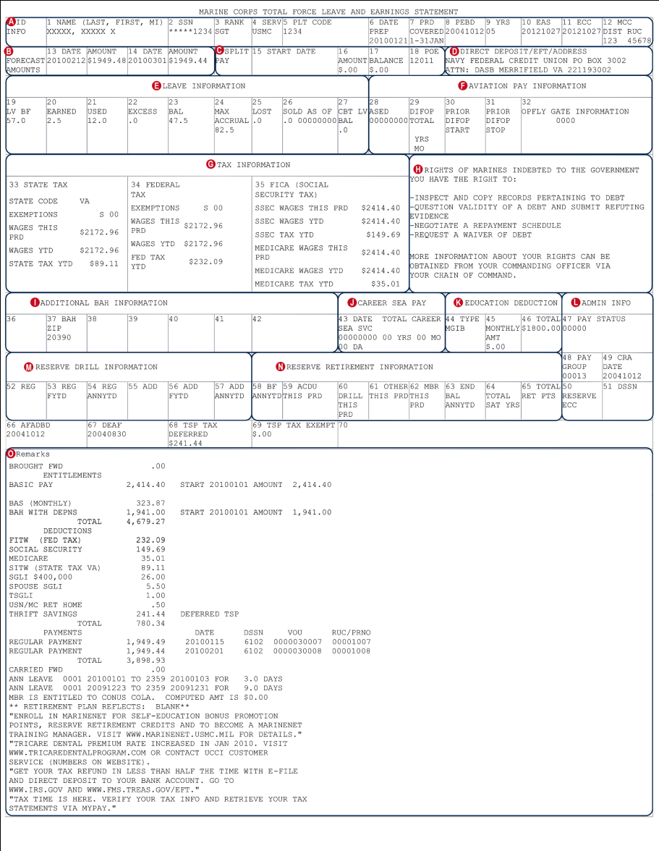
Understanding Your LES
Personal information
Forecast amounts
Split pay
Direct deposit
Leave
Taxes
Other deductions
Notes:
Slide 3: Understanding Your LES
Leave and Earnings Statement (LES): monthly statement showing pay information:
Section B: Forecast Amounts: pay the Marine will receive in the upcoming month.
Section C: Split Pay; allows Marines to receive a portion of their pay at their duty locality.
Section D: Direct deposit/EFT address
Section E: Leave Information
Section F: Aviation Pay Information —information for Marine aviators
Section G: Tax Information/deductions. Some states exempt military from state income tax.
Section H: Rights of Marines indebted to the government.
Section I: ZIP code for BAH entitlement.
Section J: Career Sea Pay; available to Marines in permanent/temporary sea duty assignment.
Section K: Education Deductions: Montgomery GI Bill (MGIB)/Veterans Educational Assistance Program (VEAP), with amount contributed/ paid.
Section L: Administrative Information —pay status and group.
Section M: Marine Corps Reserve Drill Information —number of drills performed
Section O: Remarks — itemizes entitlements, deductions and payments.

Slide 4
Cash Compensation
Base pay
Special pay
Incentive pay
If it says... “PAY,” then it’s taxable
Notes:
Slide 4: Cash Compensation
The three basic types of pay in a military compensation package.
Base pay: determined by rank/years of service. The portion on which military retirement is calculated.
Special pay
Incentive pay

Slide 5
Special and Incentive Pays
Aviation Career Incentive Pay (officers)
Career Sea Pay
Foreign Language Proficiency Pay
Hazardous Duty Incentive Pay
Hardship Duty Pay
Hostile Fire/Imminent Danger Pay
Special Assigned Duty Pay
Wounded Warrior Pay
Notes:
Slide 5: Special and Incentive Pay
Given to qualified members who possess specific or unique skills, or skills determined to have critical shortages.
Aviation Career Incentive Pay (officers): restricted to Marines who hold, or are in training leading to, an aeronautical rating or designation and who engage and remain in aviation service.
Career Enlisted Flier Incentive: Career enlisted flyer must perform operational flying duties for six of the first 10 years, nine of the first 15 years, and 14 of the first 20 years of aviation service to be eligible
Career Sea Pay: If you are an active-duty Marine on sea duty, you are entitled to career sea special pay, at a monthly rate of up to $730.
Foreign Language Proficiency Pay: This incentive pay is earned by an officer or enlisted member of the United States armed forces who is entitled to basic pay, has been certified within to be proficient in a foreign language.
Hazardous Duty Incentive Pay
Non-Air Crewmembers: Marines who perform flying duty as non-crewmembers, parachute jumping, demolition of explosives, handle toxic fuels, engage in flight deck duty or experimental stress duty.
Air Crew members: Marines who perform flight duties as aircrew members and meet their services operational requirements are eligible.
Hardship Duty Pay: paid to Marines assigned to locations where living conditions are substantially below those in the continental U.S.
Hostile Fire Pay/Imminent Danger Pay: Marines may be entitled to Hostile Fire and Imminent Danger Pay.
Special Assigned Duty Pay: If you are an enlisted member who is entitled to basic pay and are performing duties which have been designated as extremely difficult or involving an unusual degree of responsibility in a military skill, you may be paid special duty assignment pay.
Special Pay for Medical and Dental Officers: If you are a health professional officer, you may be entitled to several special pay.
Wounded Warrior Pay: The wounded warriors pay is a comprehensive program of special pays adjustment to normal pay and benefits:www.dfas.mil/militarypay/woundedwarriorpay.html.

Slide 6
Allowance: BAH
Basic Allowance for Housing
Paid if authorized to live off base
Provides for standard quality
Can be used for MHPI
BAH-DIFF
BAH Partial
BAH II (RC/T)
Notes:
Slide 6: Housing Allowance: BAH
Basic Allowance for Housing (BAH): paid to those authorized to live off base. It is based on rental costs by pay grade, location, cost of living in the area and dependency status, and is designed to reflect comparable civilian housing costs for those with similar salary and location. BAH rates: www.defensetravel.dod.mil/site/bah.cfm.
BAH-DIFF: BAH-DIFF is the difference between the with- and without-dependents Basic Allowance for Quarters (BAQ) rates.
BAH PARTIAL: Paid to Marines without dependents that live in government quarters.
BAH II (Reserve Component/Transit): BAH-II (RC/T) is the housing allowance for members in particular circumstances, for example, reservists on active duty less than 30 days.

Slide 7
Other Allowances: BAS
Basic Allowance for Subsistence
Flat monthly rate
Enlisted – meal deduction
Officers pay cash for meals
Notes:
Slide 7: Other Allowances: BAS Basic Allowance for Subsistence (BAS) is designed to offset costs for your meals. All enlisted Marines are paid the full monthly rate, but those required to eat in the mess hall will have most of the allowance automatically withdrawn to cover the cost of meals. Officers collect BAS and then pay cash for meals, including those eaten in government dining facilities.

Slide 8
Housing Allowance: COLA
Cost of Living Allowance
CONUS
OCONUS
Notes:
Slide 8: Housing Allowances: COLA
CONUS COLA - Compensates for a portion of excess non-housing costs, where non-housing costs are at least 8 percent above average.
Overseas COLA - A supplemental allowance to offset the higher prices of non-housing goods and services overseas.

Slide 9
Other Allowances: FSA
Family Separation Allowance
FSA – R (Restricted)
FSA – S (Ship)
FSA – T (Temporary)
Notes:
Slide 9: Other Allowances: FSA
FSA: Family Separation Allowance (FSA) provides compensation for added expenses incurred because of an enforced family separation under certain conditions.
FSA-R (Restricted): Transportation of dependents, including dependents acquired after the effective date of orders, is not authorized at government expense, and the dependents do not live in the vicinity of the member’s homeport/permanent duty station.
FSA-S (Ship): The member is on duty aboard a ship, and the ship is away from the homeport continuously for more than 30 days.
FSA-T (Temporary): The member is on temporary duty (TDY) or temporary additional duty (TAD) away from the permanent station continuously for more than 30 days, and the member’s dependents are not living at or near the TDY station.

Slide 10
Other Allowances: Clothing
Initial clothing allowance
Clothing replacement (enlisted)
Extra clothing allowance
Clothing maintenance
Notes:
Slide 10: Other Allowances: Clothing
Initial Clothing Allowance: Officers and enlisted members are entitled to an initial clothing allowance. Officers, however, are entitled to the allowance only once (with a few exceptions).
Cash Clothing Replacement Allowance: This allowance is payable only to enlisted members annually following initial clothing allowance on the anniversary month.
Extra Clothing Allowance: This allowance is for situations in which Marines may need additional uniforms or are required to have civilian clothing to perform their duties.
Military Clothing Maintenance Allowance: This allowance is for replacement and maintenance of military items during and after three years of active duty.

Slide 11
Travel Allowances
Mileage/Transportation
Per Diem
Miscellaneous
Notes:
Slide 11: Travel Allowances
Moving allowances: Under Permanent Change of Station (PCS) orders which require you to move; you are entitled to moving allowances to cover expenses such as:
Shipment of personal goods.
Temporary lodging.
Vehicle mileage and highway tolls.
Meals during the move.
PCS allowances: For those who are moving their household. Includes:
Temporary Lodging Expenses (TLE): provides for the temporary cost of housing while in transition. It is payable for 10 days in CONUS and five days when going OCONUS.
Temporary Lodging Allowance (TLA): payable up to 60 days OCONUS.
Dislocation Allowance (DLA): varies by pay grade and dependency status. DLA is not an advance and does not have to be repaid.
Advance pay: Up to three months of advance pay/advance BAH (CONUS) and 12 months OHA (OCONUS) when moving into non-government housing.

Slide 12
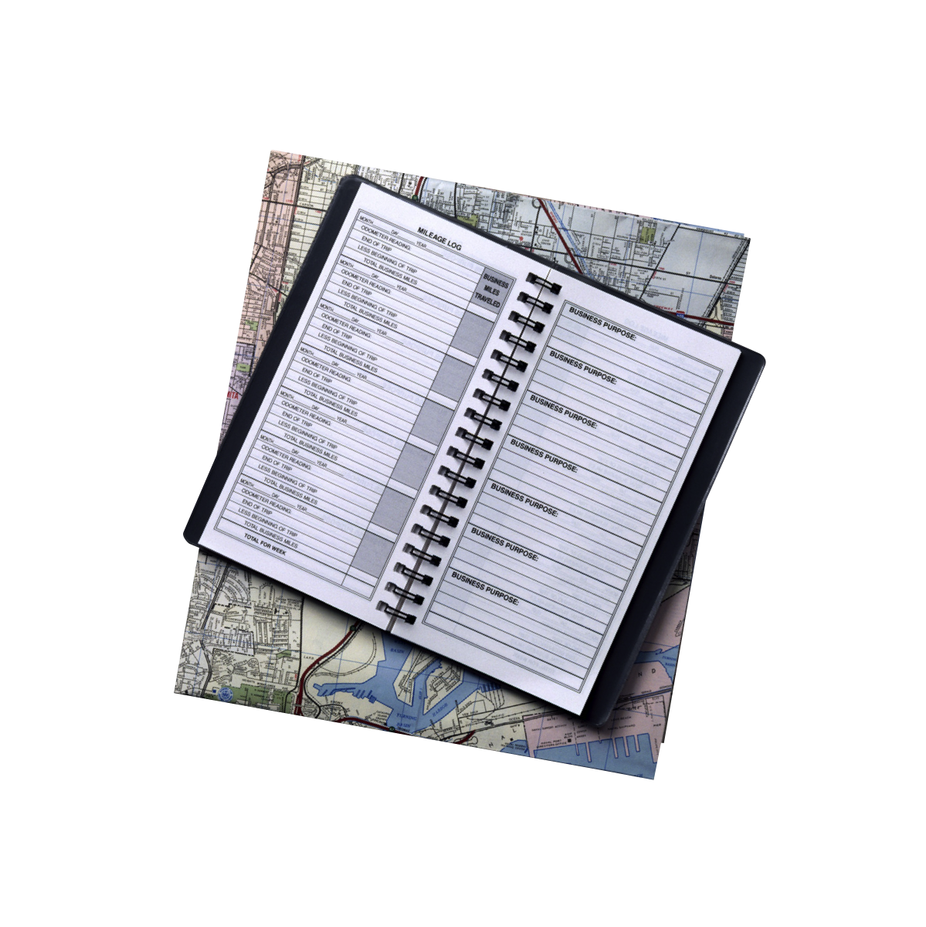
Permanent Change of Station Allowances
Moving allowance
Temporary lodging
Dislocation
Advance pay
Notes:
Slide 12: Permanent Change of Station Allowances
Moving allowances: Under Permanent Change of Station (PCS) orders which require you to move; you are entitled to moving allowances to cover expenses such as:
Shipment of personal goods.
Temporary lodging.
Vehicle mileage and highway tolls.
Meals during the move.
PCS allowances: For those who are moving their household. Includes:
Temporary Lodging Expenses (TLE): provides for the temporary cost of housing while in transition. It is payable for 10 days in CONUS and five days when going OCONUS.
Temporary Lodging Allowance (TLA): payable up to 60 days OCONUS.
Dislocation Allowance (DLA): varies by pay grade and dependency status. DLA is not an advance and does not have to be repaid.
Advance pay: Up to three months of advance pay/advance BAH (CONUS) and 12 months OHA (OCONUS) when moving into non-government housing.

Slide 13
Discretionary Allotments
Dependent payments
Insurance premiums
Investments
Car loans
Mortgage/rent
Loan repayments
Savings
Notes:
Slide 13: Discretionary Allotments
For discretionary allotments, members specify the individual, institution or business to receive the allotment. No more than six discretionary allotments are allowed. Examples of discretionary allotments include:
Voluntary payments to dependents or other relatives. Military members may authorize allotments to dependents, relatives or a divorced spouse.
Payments of premiums for commercial life insurance on the member or the member's spouse or children. Allotments are authorized for all military service members to pay insurance premium. Eligible allotters are: U.S. Government Life Insurance and National Service Life Insurance, commercial insurers and The Navy Mutual Aid Association.
Deposits to financial institutions, mutual fund companies or investments. Members may authorize allotments of pay to financial organizations for credit to the account of the member.
Car-loan payments. Officers and enlisted members may authorize an allotment for payment of car or personal loans.
Mortgage or rent. Members may authorize allotments of pay for mortgage or rent payment to a financial institution, mortgage company, Realtor or landlord.
Payments to repay a loan from a loan or finance company. All enlisted members are authorized to make these types of allotments.
Deposits into the savings deposit program. Active-duty officers and enlisted members may authorize an allotment into the Savings Deposit Program and are processed in accordance with the Marine Corps’ procedural instructions.

Slide 14
Restrictions to Allotments
Minors
Mentally incompetent
Power of attorney
Awaiting trial by court-martial
Returned absentee, deserter or prisoner
Fraudulent enlistment
Reduced pay of alloter
Notes:
Slide 14: Restrictions to Allotments
Minors – Allotments (except bonds) are not made payable to children under 16.
Mentally Incompetent Persons – Appointed guardians or the institution can receive an allotment where the mentally incompetent person is confined.
Power of Attorney – A general power of attorney is not allowed to establish, change or stop an allotment. A member must specifically designate a special power of attorney to make changes to allotments.
Member Awaiting Trial by Court-Martial – Members cannot register allotments between the date that a court-martial is ordered and the date of the approval or disapproval of the sentence.
Returned Absentee, Deserter and Prisoner – Allotments are not registered for a returned absentee or deserter unless DFAS has verified the member’s pay status.
Fraudulent Enlistment – Pay and allowances are not allotted when pay is suspended pending final action on determination of fraudulent enlistment.
Reduced Pay of Allotter – Allotments are discontinued when a reduction in grade or stoppage of pay does not leave sufficient funds for allotments in force.

Slide 15
Non-Discretionary Allotments
U.S. savings bonds
Relief repayments
Government indebtedness
Charitable contributions
Child and spousal support
Debts for non-discretionary allotments
Notes:
Slide 15: Non-discretionary Allotments
Savings bonds. If you wish to start or continue purchasing savings bonds through payroll deduction, you must establish an account through TreasuryDirect.gov. Then you may use myPay to start an allotment to TreasuryDirect by clicking on the allotment option at the Main Menu.
Relief repayments. Repayment of loans to the Army Emergency Relief, Navy-Marine Corps Relief Society, Air Force Aid Society and American Red Cross.
Government indebtedness. Payment of delinquent federal, state or local income or employment taxes; commercial debt; delinquent travel charge card debt.
Charity. Members are authorized to make charitable contributions by allotment to the Army Emergency Relief, Navy-Marine Corps Relief Society, the Combined Federal Campaign or affiliates of the Air Force Assistance Fund.
Child and spousal support. When a member on extended active duty has failed to make support payments, an attentive DFAS site with proper notification will start a statutorily-required child or child and spousal support allotment from the members pay and allowance.
Assistance Funds. The post-Vietnam era Veterans Educational Assistance Program provides assistance on a contributory basis to those who might be unable to obtain higher education.
Debts for Non-Discretionary Allotments. Payment of delinquent federal, state or local income or employment taxes, or other debts.
Commercial Debt: When a member fails to pay debts owed to a commercial creditor, the creditor can make application for recovery of this debt.
Delinquent Travel Charge Card or Military Star Card Debt: When a member fails to pay debts due on their charge card, the heads of agencies have the authority, upon written request of a federal contractor, to collect the debt.

Slide 16
Deductions
Taxes and Insurance
Garnishments
Education and TSP
Advance pay, BAH or OHA paybacks
Meal deductions and AFRH
Notes:
Slide 16: Deductions
Taxes: Includes state and federal income tax and Social Security and Medicare tax (FICA). This based on your home of record.
Insurance: Includes Servicemembers’ Group Life Insurance (SGLI and FS-GLI) and the dental health plan.
Garnishments: An involuntary deduction taken from your pay as a result of legal action against you. When a garnishment is ordered, the government is required to withhold money from your check to pay your debts.
Other pay withholding: You also can choose to have pay withheld from your check for things like educational assistance programs or the Thrift Savings Plan.
Meal deductions: Marines may be charged for meals provided by a government facility. This fee will be deducted from monthly pay.
Armed Forces Retirement Home Assessment: The Armed Forces Retirement Home (AFRH) is an independent establishment in the executive branch.

Slide 17
Taxes
FICA
Social Security
Medicare
Federal Income Tax
State Income Tax
Remember the Volunteer Income Tax Assistance program is available to help you!
Notes:
Slide 17: Taxes
FICA Deductions Social Security taxes, or Federal Insurance Contributions Act (FICA) deductions, are withheld from all military members’ basic pay.
Federal Income Taxes Federal Income Tax Withholding (FITW) is based on all pays (not allowances and not just base pay, like FICA).
Withholding: The goal of paying your federal taxes should be so that when tax returns are due April 15, you do not owe, and are not owed, any money.
W-4 Form: This is for marital status and the number of exemptions you are claiming.
State Income Taxes; Your military compensation may be subject to income-tax withholding for the state you claim as your legal residence.
Volunteer Income Tax Assistance Program available to help you fill out your federal income-tax forms (and possibly state forms) and may even be able to file your taxes electronically.

Slide 18
Non-cash Benefits
Immediate:
MCCS programs (PFM)
Tax advantage
Commissary/Exchange
Chaplain and legal services
Workout facilities
Recreation services
Medical and dental
Education assistance
Deferred:
Retirement
Veteran’s medical, dental and education assistance
Disability
Home mortgage assistance
Life insurance
Survivors Benefits
Notes:
Slide 18: Non-Cash Benefits
Immediate non-cash benefits include:
Marine Corps Community Services (MCCS) educational programs and resources, such as PFM
Tax advantage resulting from the tax-free status of allowances
Commissary and Exchange privileges
Chaplain and Legal services
Leave
Base gym and workout facilities
MCCS/Morale, Welfare and Recreation services and programs
Medical care for members and dependents
Education assistance
Deferred non-cash benefits include:
Retirement
Veteran’s medical and dental
Veteran’s education assistance
Disability compensation
Home mortgage assistance
Life insurance plans
Survivor Benefits

Slide 19
Survivor Benefits
Fallen hero
Burial
Travel and move
BAH
Accumulated leave
Social security
DIC
Education benefits
Limited medical and dental
Notes:
Slide 19: Survivor Benefits
Fallen hero compensation (death gratuity of $100,000)
Burial and funeral benefits
Round-trip travel and household goods move
12 months’ BAH or 12 months of housing
Arrears in pay and accumulated leave
Social Security survivor benefits include a $255 burial benefit. Other benefits for surviving spouses are first payable at age 60; at age 50 if the surviving spouse is completely disabled; or at any age if and as long as there are children under the age of 16. Surviving spouses with dependent children who qualify receive monthly payments.
Dependency and Indemnity Compensation (DIC) are tax-free monthly payments administered by the Department of Veterans Affairs (VA).
Veterans Affairs Dependents’ Educational Assistance (DEA) provides monthly benefits for education and training opportunities up to 45 months for surviving spouses not remarried before age 57 and dependent children ages 18-26.
Continuing medical and dental benefits without cost for three years after the death of the Marine. After three years, the family is eligible for medical and dental coverage at the military retiree rates, if they choose to continue coverage.
To ensure survivors get all entitled benefits, keep your Record of Emergency Data (RED) in the Service Record Book (SRB)/Officer Qualification Record (OQR) up to date.

Slide 20
Medical and Dental
TRICARE and United Concordia
No cost to active duty
DEERS registration
TRICARE
Prime
Standard
Extra
www.tricare.mil
www.tricaredentalprogram.com
Notes:
Slide 20: Medical and Dental
Medical and dental benefits are provided through TRICARE. TRICARE is available to active-duty Marines and retirees of the seven uniformed services, their family members, survivors and others who are registered in the Defense Enrollment Eligibility Reporting System (DEERS). TRICARE is also available to members of the National Guard and Reserves and their families. Confirm or establish your eligibility through the DEERS website: https://www.dmdc.osd.mil/appj/address /login/SelectLogin.do or call (800) 538-9552.

Slide 21
Life Insurance
Service member
SGLI
Family members
FSGLI
Remember to keep beneficiary up to date
Notes:
Slide 21: Life Insurance
Servicemembers’ Group Life Insurance (SGLI) is a term insurance policy with coverage of up to $400,000 per member. You can determine the amount of your coverage by checking your LES in the “deductions” section. If there is no deduction listed for SGLI, then you are not covered.
FSGLI is life insurance coverage for your whole family. Make sure that the beneficiary designated is accurate. Funds will be paid to whoever is listed as your beneficiary, so be certain to update this information.

Slide 22
MyPay Functions
Access your LES
Start or stop allotments
Arrange direct deposits
Change income-tax withholding
Enroll and contribute to TSP
Contribute to SDP
Travel voucher advice of payment
Change e-mail and personal data
Access and print W-2
Notes:
Slide 22: myPay is an automated system that puts you in control of processing certain discretionary pay data items without using paper forms. It has these functions:
Access current and previous LES
Start or stop change allotments.
Start or change direct deposit.
Change income-tax withholding.
Start, stop or change contributions to the Thrift Savings Plan.
Contribute to the Savings Deposit Program.
Get travel voucher Advice of Payment.
Change e-mail address and other personal settings.
Access and print W-2 form.

Slide 23
Common Pay Problems
Overpayments and underpayments
Unexpected repayments
PCS and deployment pay issues
Changes in dependent status
Starting and stopping allotments
Too many allotments
Government travel card or credit card misuse
TA funds repayment
Non-payment of Military Star Card
Notes:
Slide 23: Common Pay Problems
Overpayments and underpayments
Unexpected repays (garnishments, overpayments)
Pay problems related to PCS and deployments
Changes in dependent status (marriages, children, etc.), exemptions incorrect
Allotments not stopping or starting on time
Too many allotments being used at once
Improper use of your government travel card or credit card
Repayment of TA funds is required.
Non-payment of Military Star Card resulting in garnishment of pay.
To avoid pay problems:
Monitor your LES monthly.
Update information on myPay and notify IPAC when there is a change in family status
Keep RED current and update the information on myPay.
Change income-tax withholding (federal and state).
Closely monitor allotment start and stop requests, and keep copies of everything.
Closely monitor budget/spending plan.

Slide 24
Subject Matter Experts
Command Financial Specialist
Marine Corps Community Services
Local Disbursing Office
Base Legal Services Office
TRICARE Health Benefits Advisor
Navy-Marine Corps Relief Society
Notes:
Slide 24: Resources
In addition to the list of websites, you can see these for assistance:
Command Financial Specialist
Marine Corps Community Services
Local disbursing office
Base Legal Services Office
TRICARE health benefits advisor
Navy-Marine Corps Relief Society

