Slide 1
Credit and Debt Management
Notes:
Credit, when used appropriately, can be an excellent tool; but used the wrong way, it can wreak havoc on your financial situation, eventually affecting your ability to make future purchases such as vehicles, household appliances, and even a home. Credit itself is neither good nor bad, but how you use your credit determine whether you have good or bad credit.
THIS CLASS IS FOR INFORMATIONAL PURPOSES ONLY TO GIVE YOUR MARINES A BRIEF OVERVIEW. FOR DETAILED AND EXPERIENCED FINANCIAL INFORMATION REFER TO YOUR UNIT’S COMMAND FINANCIAL SPECIALIST (CFS) AND YOUR BASE PROFESSIONAL FINANCIAL MANAGER (PFM); ADHERE TO MARADMIN 061/13 PERSONAL FINANCIAL MANAGEMENT EDUCATION PROVIDED BY NON-FEDERAL ENTITIES” FOR GUIDANCE

Slide 2
Types of Credit
Installment or closed-end credit
Specific amount
Equal monthly payments
Specific repayment term
Examples: mortgages, car loans, personal loans
Revolving or open-end credit
Credit limit
Variable monthly payments
Open-ended repayment term
Examples: credit cards and lines of credit
Notes:
Installment/ closed-end credit:
-Issued for a specific amount and has equal monthly payments with a specific repayment term.
-Credit products which best represent installment credit are mortgages, car loans and personal loans.
Revolving credit, also called open-end credit:
-Issued up to a specific credit limit, however not all of the credit limit must be used at any given time.
-Has variable monthly payments and the repayment term is open-ended.
-Credit products which best represent revolving credit are credit cards and lines of credit.

Slide 3
Wise Uses for Credit
Planned purchases
Assets: home or education
Pay off each month
Notes:
The best use of credit is for a planned purchase of an asset, something that will grow or increase in value over time, such as a home or an education.
To establish history one only needs to show a responsible payment history. Example: Pay for a single gas purchase, once per month. Pay the purchase off immediately so that interest is not incurred. This will show as positive payment history on your credit however, the purchase is manageable and may be paid off with ease. The best use of credit is trying to avoid using credit as a convenience for everyday purchases.

Slide 4
Unwise Uses of Credit
Impulse buying
Spending for status
Retaliatory spending
Spending to feel good
Purchasing consumables
Everyday living expenses

Slide 5
Qualifying for Credit
Character
WILL you repay the debt?
Capacity
CAN you repay the debt?
Collateral
WHAT IF you don’t repay the debt?
Notes:
When financial institutions make decisions to extend credit to a consumer, they look for both the ability and the willingness to repay debts. The factors they use to evaluate a borrower can be summarized by the three C’s of credit: character, capacity, and collateral.
Character: WILL you repay the debt? Creditors look at your credit history: how much you owe, how often you borrow, whether you pay bills on time, and whether you live within your means.
Capacity: CAN you repay the debt? Creditors ask for employment information: your occupation, how long you have worked, and how much you earn. They also want to know about your expenses: how many dependents you have, whether you pay alimony or child support, and the amount of your other obligations.
Collateral: WHAT IF you don’t repay the debt? Creditors want to know what you have that can be used to back up or secure your loan, any other resources you have for repaying debt besides income, such as saving, investments or property.

Slide 6
Establishing Credit
Maintain checking and savings accounts
Pay bills on time
Savings-secured loan
Co-signed loan
Obtain credit from a retailer
Notes:
It does not take large purchases or large amount of charges to establish credit. Credit can be established just by a small purchase on a card once or a few times a month and then paying it off at the end of the month. Good credit can be achieved by:
-Maintaining a checking and savings account at a financial institution
-Paying bills on time
-Using a savings-secured loan
-Using a co-signed loan
-Getting a charge card from a retailer
-Using a gas card

Slide 7
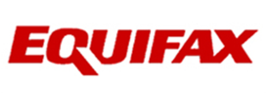
Credit Reports
Detailed information
Check annually
One free report each year at: www.annualcreditreport.com
Credit reporting agencies
Notes:
A credit report is a detailed account of the credit, employment, and residence history of an individual. The report is used by a prospective lender to help determine the person’s creditworthiness. Credit reports also list any judgments, tax liens, bankruptcies or similar matters of public record entered against the individual.
Under current law, every American with a credit history can receive one free credit report each year from each of the big three credit reporting agencies. They are available online at http://www.annualcreditreport.com.

Slide 8
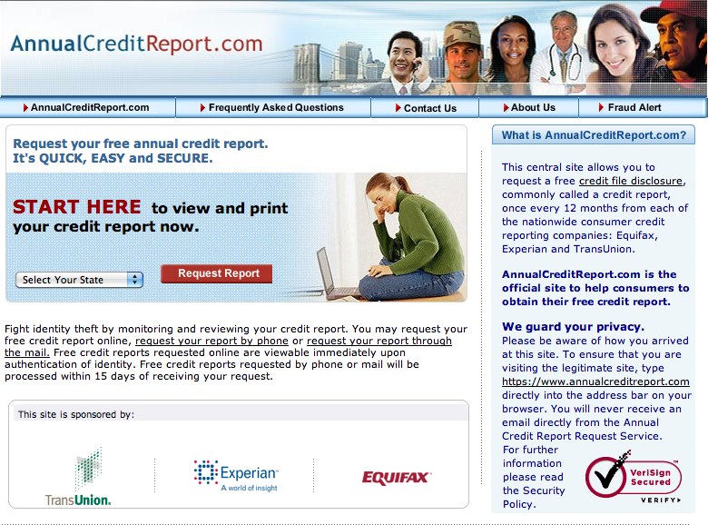
What’s on a Credit Report?
Identification information
Employment information
Residence history
Payment history
Inquiries
Public record information
Accurate negative information
Notes:
-Identification and employment information: Your name, birth date, SSN, current and previous addresses, employer and spouse’s name.
-Credit History: How long you have had credit, past borrowing and repaying habits, if you use more than 25-30% of available funds on your credit card, if you go over your credit limit, how often you open new accounts and any recent requests for new credit.
-Payment history: Shows how much credit has been extended and whether you have paid on time.
-Inquiries: List all creditors who have asked for your credit history within the past year, as well as record of people or businesses requesting your credit history for employment purposes for the past two years. Soft and Hard Inquiries
-Soft Inquiries: When you or a business you already have an account with checks your credit report. Employers can also make a soft inquiry. Generally has no impact on your credit score.
-Hard Inquiries: Hard inquiries appear on your credit report whenever you make an application for a credit card, loan or any other credit based service. Hard inquiries will typically impact your credit score and will account for 10% of your credit score.
-Public record information: Events that are a matter of public record, such as bankruptcies, foreclosures or tax liens, may appear in your report.
-Accurate negative information: An agency can report most accurate negative information for seven years and bankruptcy information for 10 years

Slide 9
What is NOT on a Credit Report?
Checking or savings accounts
Bankruptcies after 10 years
Unpaid debts after 7 years
Medical history
Criminal records
Protected demographic information:
Gender
Ethnicity
Religion
Political affiliation
Actual credit score
Notes:
A credit report does not include information about your checking or savings accounts, bankruptcies that are more than 10 years old, charged-off debts or debts placed for collection that are more than seven years old, medical history or criminal records. Protected demographic information, such as gender, ethnicity, religion or political affiliation- is illegal to include on your credit report. Additionally, your credit score is generated by information on your credit report but is not part of the file itself. Credit reports will only show bills if they are negative and/or past due but typically, payments on bills and living expenses such as insurance or rent will not show on your credit report unless you have been turned in to a collection agency.

Slide 10
Who Can View Your Credit Report?
Legitimate business need
Current creditors
Potential creditors
Insurance companies
Employers
Government agencies
Landlords
Utilities
Cell phone companies
Notes:
A variety of individuals and /or entities with a legitimate business need can view your credit report. Creditors both current and potential, can access your credit report. Insurance companies, employers, government agencies, landlords, utility companies, and cell phone companies can view your credit report as well.

Slide 11
Correcting Your Credit Report
Dispute in writing and keep copies
Credit bureau investigates and sends dispute to information provider
Credit bureau provides results and a free credit report (if changed)
Notices of correction sent
If unresolved, request that it be included in your file
The FCRA says the responsibility to correct is that of both the credit bureau and the provider of the incorrect information.
Notes:
Under the Fair Credit Reporting Act (FCRA), both the credit reporting agency and the information provider (the person, company or organization that provides information about you to an agency) are responsible for correcting inaccurate or incomplete information in your report. To take advantage of your rights under the FCRA, contact the credit reporting agency and the information provider if you see inaccurate or incomplete information.

Slide 12
What is a Good Credit Score?
FICO Score | Category | % of U.S. Population | Meaning
700 and up | Excellent | 60% | Qualify for very best interest rates and terms
600-699 | Good | 27% | May not qualify for very best interest rates and terms
500-599 | Risky | 12% | May have to pay at least 2 percentage points more than those in “Excellent” category
400-499 | Very Risky | 1% | Will probably have to pay maximum rate allowed by law
Notes:
Credit scoring is a system creditors use to help determine whether to give you credit and at what interest rate. Using a statistical formula, creditors compare your credit history to the credit performance of other people with similar profiles. The score helps predict how creditworthy you are; that is, how likely it is that you will repay a loan and make the payments on time. You can get your credit score from the three nationwide credit reporting agencies, but you will have to pay a fee for it.
Generally a credit score of 700 and higher is considered excellent where individuals would normally qualify for the best interest rates and terms, where as a credit score between 400 and 499 is considered very risky. Individuals with these low credit scores usually are involved with foreclosures, liens and /or credit judgments in their reports.

Slide 13
Common Places to Borrow
Credit union
Commercial bank
Savings and loan associations
Consumer finance company
Retail merchant
Predatory lenders
Notes:
-Credit unions tend to lend to members only and normally offers the most attractive rates.
-Commercial banks offer a wide variety of products and average rates for lower-risk people.
-Savings banks and savings and loan associations focus on mortgages and often offer other services similar to banks.
-Consumer finance companies accept higher credit risks and often offer high rates.
-Usually the most expensive place to finance any consumer purchase is the place you are buying it, being the retail merchant.
-Just say no to predatory lenders that offer advance-fee loans, payday loans, subprime mortgages, title pawn lenders, rent-to-own, and refund-anticipation loans. These types of lenders charge excessive interest rates and fees, include unnecessary insurance and often have pre-payment penalties. This is the most expensive money to borrow.

Slide 14
Rule of 78s
Month | Start Balance | Interest | Monthly Rate | Principal | End Balance | Cum. Int. Paid | Interest Left to Pay
1 | $1,000.00 | $30.77 | 36.9231% | $69.23 | $930.77 | $30.77 | $169.23
2 | 930.77 | 28.21 | 36.3636% | 71.79 | 858.98 | 58.98 | 141.02
3 | 858.98 | 25.64 | 35.8207% | 74.36 | 784.62 | 84.62 | 115.38
4 | 784.62 | 23.08 | 35.2939% | 76.92 | 707.70 | 107.70 | 92.30
5 | 707.70 | 20.51 | 34.7822% | 79.47 | 628.21 | 128.21 | 71.79
6 | 628.21 | 17.95 | 34.2854% | 82.05 | 546.16 | 146.16 | 53.84
7 | 546.16 | 15.38 | 33.8024% | 84.62 | 461.54 | 161.54 | 38.46
8 | 461.54 | 12.82 | 33.3332% | 87.18 | 374.36 | 174.36 | 25.64
9 | 374.36 | 10.26 | 32.8766% | 89.74 | 284.62 | 184.62 | 15.38
10 | 284.62 | 7.69 | 32.4319% | 92.31 | 192.31 | 192.31 | 7.69
11 | 192.31 | 5.13 | 31.9996% | 94.87 | 97.44 | 197.44 | 2.56
12 | 97.44 | 2.56 | 31.5776% | 97.44 | 0.00 | 200.00 | 0
Most interest is paid before making substantial repayment of principal
Notes:
-The rule of 78s is a method used to calculate interest.
-The interest payments decrease disproportionately during the course of the loan period.
-The method favors the lender and means the borrower will be penalized for early repayment.
-The rule of 78s becomes noticeable when the borrower wants to pay off the loan early. This is because they will have already paid a disproportionate share of the total interest, which will not be refunded.
-Most interest is paid before making substantial repayment of principal.

Slide 15
Minimum Monthly Payment
$1,000 Balance at 18% APR
2% minimum payment
19 years to pay off
Total interest $1,931
5% minimum payment
2 years to pay off
Total interest $382
Notes:
Beware of making only minimum payments. Base your payment on what you can afford, but always try to pay as much as possible. The Credit Card Accountability, Responsibility and Disclosure Act requires that your monthly credit card bill includes information on how long it will take you to pay off your balance if you only make minimum payments. It will tell you how much you would need to pay each month to pay off your balance in three years. This makes it more important than ever that you read your bill each month.

Slide 16
Amortization Schedules
Chart
How much to principal
How much to interest
Use to compare different types of financing
Notes:
An amortization schedule is a chart that shows how much of each monthly payment is allocated to paying down the principal balance and how much is the interest. Whether for a credit card, a vehicle loan or a mortgage, an amortization chart can be a good tool when comparing different financing terms or models such as fixed interest, variable interest or interest-only financing.

Slide 17
Amortization Schedule
Interest-Only Loan or Mortgage
Month | Beginning Balance | Interest Rate | Payment | Principal | Interest | Ending Balance
Jan | $5,000.00 | 8% | $33.33 | $0.00 | $33.33 | $5,000.00
Feb | $5,000.00 | 8% | $33.33 | $0.00 | $33.33 | $5,000.00
Mar | $5,000.00 | 8% | $33.33 | $0.00 | $33.33 | $5,000.00
Apr | $5,000.00 | 8% | $33.33 | $0.00 | $33.33 | $5,000.00
May | $5,000.00 | 8% | $33.33 | $0.00 | $33.33 | $5,000.00
June | $5,000.00 | 8% | $33.33 | $0.00 | $33.33 | $5,000.00
July | $5,000.00 | 8% | $33.33 | $0.00 | $33.33 | $5,000.00
Aug | $5,000.00 | 8% | $33.33 | $0.00 | $33.33 | $5,000.00
Sept | $5,000.00 | 8% | $33.33 | $0.00 | $33.33 | $5,000.00
Oct | $5,000.00 | 8% | $33.33 | $0.00 | $33.33 | $5,000.00
Nov | $5,000.00 | 8% | $33.33 | $0.00 | $33.33 | $5,000.00
Dec | $5,000.00 | 8% | $33.33 | $0.00 | $33.33 | $5,000.00
Notes:
An interest-only loan or mortgage is one in which the borrower is required to pay off the interest that arises from the principal that is borrowed over a fixed term such as 5-7 years. Because only the interest is being paid, the interest payments remain fairly constant throughout the term of the mortgage and they are usually lower than a conventional loan payment. However, interest-only mortgages do not last indefinitely. At the end of the mortgage interest-only term you either need to refinance the principal, pay the balance (lump sum), or start paying the principal which can jump your payments. An additional consideration is that no equity is being built by the borrower.

Slide 18
Amortization Schedule
Traditional Mortgage or Vehicle Loan with Simple Interest
Month | Beginning Balance | Interest Rate | Payment | Principal | Interest | Ending Balance
Jan | $5,000.00 | 8% | $156.68 | $123.35 | $33.33 | $4,876.65
Feb | $4,876.65 | 8% | $156.68 | $124.17 | $32.51 | $4,752.48
Mar | $4,752.48 | 8% | $156.68 | $125.00 | $31.68 | $4,627.48
Apr | $4,627.48 | 8% | $156.68 | $125.83 | $30.85 | $4,501.65
May | $4,501.65 | 8% | $156.68 | $126.67 | $30.01 | $4,374.98
June | $4,374.98 | 8% | $156.68 | $127.51 | $29.17 | $4,247.47
July | $4,247.47 | 8% | $156.68 | $128.36 | $28.32 | $4,119.11
Aug | $4,119.11 | 8% | $156.68 | $129.22 | $27.46 | $3,989.89
Sept | $3,989.89 | 8% | $156.68 | $130.08 | $26.60 | $3,859.81
Oct | $3,859.81 | 8% | $156.68 | $130.95 | $25.73 | $3,728.86
Nov | $3,728.86 | 8% | $156.68 | $131.82 | $24.86 | $2,597.04
Dec | $2,597.04 | 8% | $156.68 | $132.70 | $23.98 | $3,464.34
Notes:
For these types of loans, the payment is fixed for the term of the loan, at the end of which the principal and interest have both been paid off.

Slide 19
Amortization Schedule
ARM or Credit Card with Variable Interest
Month | Beginning Balance | Interest Rate | Payment | Principal | Interest | Ending Balance
Jan | $5,000.00 | 8% | $156.68 | $123.35 | $33.33 | $4,876.65
Feb | $4,876.65 | 9% | $155.06 | $118.49 | $36.57 | $4,758.16
Mar | $4,758.16 | 10% | $153.50 | $113.88 | $39.65 | $4,644.28
Apr | $4,644.28 | 12% | $154.25 | $107.81 | $46.44 | $4,536.47
May | $4,536.47 | 10% | $146.36 | $108.56 | $37.80 | $4,427.91
June | $4,427.91 | 12% | $147.07 | $102.79 | $44.28 | $4,325.12
July | $4,325.12 | 10% | $139.56 | $103.52 | $36.04 | $4,221.60
Aug | $4,221.60 | 9% | $134.26 | $102.59 | $31.67 | $4,119.01
Sept | $4,119.01 | 8% | $129.07 | $101.61 | $27.46 | $4,017.40
Oct | $4,017.40 | 8% | $129.07 | $102.29 | $26.78 | $3,915.11
Nov | $3,915.11 | 10% | $126.33 | $93.70 | $32.63 | $3,821.41
Dec | $3,821.41 | 9% | $121.51 | $92.85 | $28.66 | $3,728.56
Notes:
An adjustable rate mortgage (ARM) is a loan that has an interest rate that will be reset in periodic intervals. These intervals can vary from months to years and will cause payments to fluctuate more than a traditional mortgage. This is comparable to a variable rate credit card, where the interest rate can fluctuate monthly.

Slide 20
Credit Card Terminology
Credit Card Terminology
APR
Grace Period
Fees
Finance Charges

Slide 21
Annual Percentage Rate
Cost of credit as a yearly rate
Must be disclosed
Periodic rate – the rate used for each billing period
Variable rates
Fixed rates
%
Notes:
The annual percentage rate is a measure of the cost of credit, expressed as a yearly rate. The APR must be disclosed before you become obligated on the account and it must be shown on your account statements. You must also be given your credit limit and information about whether your rate will change and how often. Additionally, the card issuer must disclose the periodic rate, which is the rate applied to your outstanding balance to figure the finance charge for each billing period.

Slide 22
Grace Period
Avoid finance charges if paid by due date
Bills must be provided 21 days before due
Same due date each month
Notes:
The grace period lets you avoid finance charges by paying your balance in full before the due date. Paying by the due date shows financial responsibility. Without a grace period, the card issuer may impose a finance charge from the date you use your card or from the date each transaction is posted to your account.

Slide 23
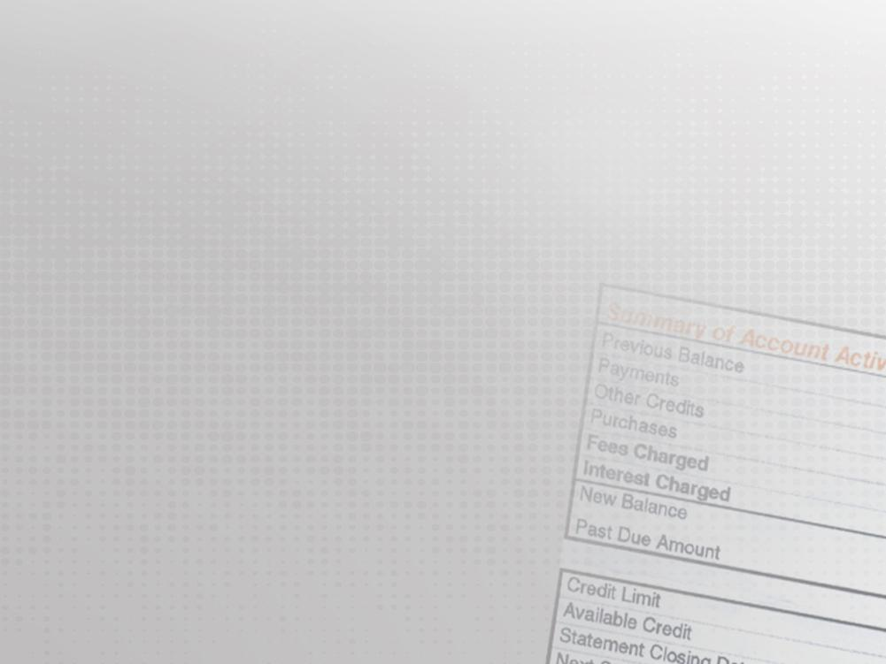
Credit Card Fees
Membership/participation
Monthly, annually or one-time
Reduce your available credit
25% of credit limit maximum
Cash advance fees
Late payment penalties
Over credit limit fee
International transaction fees
Notes:
Many credit cards charge membership or participation fees. These fees may be called such things as “annual,” “activation,” “acceptance,” “participation” or “monthly maintenance” fees.

Slide 24
Finance Charges
Previous balance
Average daily balance
Adjusted balance
Notes:
-Previous balance is the amount owed at the end of the previous billing period. Payments, credits, and new purchases during the current billing period are not included.
-Average daily balance credits your account from the day payment is received by the issuer. To figure the balance due, the issuer totals the beginning balance for each day in the billing period and subtracts any credits made to your account that day.
-Adjusted balance is determined by subtracting payments or credits received during the current billing period from the balance at the end of the previous billing period. Purchases made during the billing period are not included.

Slide 25
Finance Charge Example
APR = 18%, monthly rate = 1.5%
Previous balance = $400
Payment = $300 on 15th day
Purchase = $50 on 18th day
Finance charge
Previous balance method = $4.05
Average daily balance method = $3.75
Adjusted balance method = $1.50
Notes:
-Suppose your APR is 18 percent, your monthly interest rate is 1.5 percent and your previous balance is $400.
-On the 15th day of your billing cycle, the card issuer receives and posts your payment of $300.
-On the 18th day, you make a $50 purchase.
Previous balance method: Including new purchases, your finance charge would be $4.05.
Average daily balance method: Excluding new purchases, your finance charge would b $3.75.
Adjusted balance method: Your finance charge would be $1.50.

Slide 26
Balance Transfer Offers
Balance transfer fees
Low introductory rate
Retroactive interest charges or rate increase if late payment
If pay more than minimum, excess must apply to highest interest rate amount
Deferred interest plan
Notes:
If Card Issuer B charges 4 percent to transfer $5,000 from Card Issuer A, your fee would be $200. In addition, if you make a late payment or fail to pay off your transferred balance before the introductory period ends, Card Issuer B may raise the introductory rate and/or charge you interest retroactively. Credit reports watch the number of credit cards opened and transfers of balances, these numbers can affect your credit score.

Slide 27
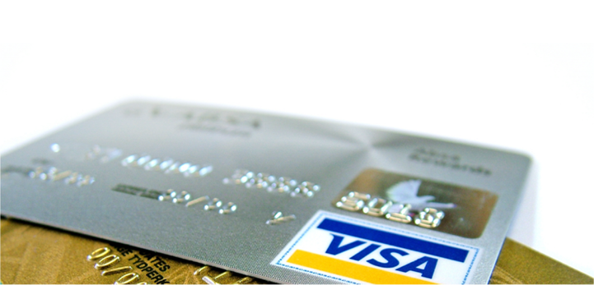
Other Costs and Features
Credit terms vary among issuers
Credit limit
Affinity cards
Over the limit transactions
Default
Special delinquency rates
Notes:
If you pay off your balance each month, get an account with a low or no annual fee. If you carry a balance, look for low APR and low or no fees. Avoid high-priced add-ons such as credit life, credit disability or credit unemployment insurance.
You will want to consider whether the credit limit is a realistic amount needed where you do not potentially have the ability to overextend yourself, how widely the card is accepted, and the plan’s services and features.
An affinity card issuer will often advertise that they will donate a portion of the annual fees or charges to the sponsoring organization or you can qualify for free travel or other bonuses/rewards. To recapture the costs of offering a group’s affinity credit card, issuers often prefer working with large organizations that allow direct access to members.
You must “opt in” to allow your credit card company to charge you over the limit fees. If you allow your credit card company to issue this additional fee, they will approve your purchase. When you are at your credit limit, this has a negative impact on your credit score.
Your credit card agreement explains what may happen if you default on your account.
Some cards with low rates for on-time payments apply a very high APR if you are late on a certain number of times in any specified time period.

Slide 28
Military Star Card
Regular credit card
Variable interest rate
Debt owed to government
Uniform purchases – no interest
Deferred options during deployment
6% interest, no payment and continued usage
0% interest, no payment and no usage
Shows on your credit report
If don’t pay balance in full, will incur interest charges
Notes:
The Military Star Card allows you to make purchases and defer payment over time just like any other credit card. The application and screening process is similar to other credit cards, and finance charges will be assessed if the bill is not paid in full each month. The interest rate is variable, which means it will change with changes in overall interest rates.

Slide 29
Government Credit Cards
Official government travel
Reimbursable expenses
Payment in full by due date
Delinquent after 60 days
Credit check
Inquiry will show to credit bureaus
Account and limit does not show
Misuse
Personal household expenses
Cash withdrawal not related
Intentional failure to pay in a timely manner
Split disbursement
Reimbursement to card contractor
Remainder sent to traveler
Dispute charges
Use form
Salary offset
Delinquent funds can be taken from salary
Notes:
Official government travel: Unless otherwise exempted in accordance with the provisions of the relevant sections of the Financial Management Regulation (FMR), all DoD personnel are required to use the government-sponsored, contractor-issued travel charge cards for all expenses arising from official government travel.
Credit checks: Title 10 U.S.C. 2764a requires the evaluation of creditworthiness before issuing a government travel charge card to an individual. Applicants who refuse to permit a credit check may be asked to self-certify to their creditworthiness to obtain a restricted travel card.
Misuse of government travel cards: Government travel cards are issued only for official travel-related expenses. Cardholders who misuse their DoD travel cards shall be subject to administrative or disciplinary action, as appropriate. While these cards generally shall be used only for reimbursable expenses associated with official travel, certain expenses that are not reimbursable are still considered related to official travel.
Split disbursement: To help travelers with card payments, DD Form 1351-2 (Travel Voucher or Sub-voucher) has been modified to permit reimbursement to the card contractor with the remainder of any entitlement sent to the traveler. All military personnel are required to split-disburse the total outstanding charges against the travel charge card.
Dispute charges: Should there be a dispute about charges, the traveler can obtain a dispute form or use the dispute form included with monthly account statements sent to each cardholder. The cardholder should complete and send the form to the travel card contractor.
Salary offset: Under regulations published in Volumes 7A and 8 of the FMR, and upon written request of the government travel charge card contractor, the department will use salary offset to deduct from a cardholder’s pay any delinquent funds owed to the contractor as long as they are not disputed.

Slide 30
Card Security
Keep record of card in a safe place
Carry only the cards you need
Write, “Ask for ID”
Use PIN whenever possible
Check statements regularly
Report missing card ASAP
Notes:
-Keep a record of card numbers, issuer and company contact number for lost or stolen cards
-Carry only the cards you need. This will protect you in two ways- from yourself and from others.
-Write, “Ask for ID” on the card using permanent ink.
-Use PIN-based transactions when possible, but do not carry your PIN number in your wallet.
-Check your bank account and card statements at least monthly. Balance the transactions on record with your receipts.
-If your credit or debit card is lost or stolen, report this to the issuer as soon as possible.

Slide 31
Identity Theft
Place fraud alert on credit report
Close suspicious accounts
File a police report
Contact the FTC
Notes:
-Call the three credit reporting agencies and place a fraud alert on your credit report. Then ask for the free credit report to which you are entitled.
-Close any accounts that you suspect have been tampered with or opened fraudulently. Start by calling the security or fraud department of each company. Follow up in writing, and include copies of supporting documents.
-File a police report.
-Contact the Federal Trade Commission (FTC). Your information also helps law enforcement officials across the country track down and stop identity thieves.

Slide 32
Cash vs. Plastic
Cash:
Accepted everywhere
No fees
May help you control your spending
No PIN to remember or credit check to pass
Card:
Allows flexibility for unplanned purchases
May earn you rewards
Does not require trips to ATM or bank
Some protection against theft and fraud
Can incur debt
Notes:
Cash:
-Accepted everywhere
-No fees
-May help you control your spending and stay on your budget plan as you will see exactly how much money you are spending as you spend it.
-No PIN to remember or credit check to pass. You don’t have to worry about a credit card thief stealing your card and racking up debt.
Card:
-Allows flexibility for unplanned purchases.
-May earn you rewards.
-Does not require trips to ATM or bank.
-The Negative impact of using credit cards is you can get yourself in debt with unplanned spending and you can incur even more debt if you do not pay off your balance at the end of the month. You may also over spend as you may not realize exactly how much money you are spending each time you pull out your credit card for wants rather than needs.

Slide 33
Warning Signs of Too Much Debt
Moderate
Trouble paying for seasonal or unexpected expenses
No savings
Anxiety and arguments
Rising balances
Using credit to pay credit
Serious
Difficulty paying for essentials
Money runs out
Making minimum payments
Late notices
Using cash advances
Denied additional credit
Severe
Rotating unpaid bills
Threat of losing housing or utilities
Creditors threatening legal action
Negative cash flow
Dishonesty with family
Extreme
Survival endangered
Legal actions
Repossession
Foreclosure or eviction
Bankruptcy
Notes:
Credit cards make spending easy and may encourage you to spend more than you can repay. Be aware of the warning signs of too much debt. Seek financial counseling if you experience any of these indicators; try to rectify the problem early on, rather letting it get to the extreme.

Slide 34
Consequences of Poor Financial Management
Collections
Garnishment
Settlement
Loss of security clearance
Repossession
Bankruptcy
Foreclosure
Career Opportunities
Notes:
Collections:
-Two categories of debt collectors: first-party & third party
First-part debt collectors are agents for the company that owns the debt.
Third-party debt collectors are collecting for someone else.
-First step of dealing with creditors is to validate the debt if there is any question as to whether it is owed and/or if the collector has the legal right to collect.
-Every collector must send you a written “validation notice” telling you how much money you owe within five days after they first contact you.
-This notice must include the name of the creditor to whom you owe the money, and how to proceed if you don’t think you owe the money.
Under the Fair Debt Collection Practice Act (FDCPA), debt collectors cannot:
-Contact you at inconvenient times or places, such as before 0800 or after 2100, unless you agree to it.
-Contact you at work if they are told (orally and in writing) that you are not allowed to get calls there.
-Oppress or abuse you or any third parties they contact.
-Lie when they are trying to collect a debt.
-Declare that you will be arrested if you do not pay your debt.
-State that they will seize, garnish, attach or sell your property or wages unless they are permitted by law and intend to do so.
-Declare that they will take legal action against you if doing so would be illegal or if they do not intend to take legal action.
-Give false credit information about you to anyone.
-Send anything that falsely appears to be an official document from a court or government agency.
-Use a false company name.
-Try to collect any interest, fee or other charge on top of the amount you owe unless the contract that created the debt or your state law allows the charge.
-Deposit a postdated check early.
-Contact you by postcard.
Garnishment:
-Military pay is subject to garnishment for a civilian debt; however, before a garnishment can take place, the creditor must have obtained a judgment from a civilian court in the state where the debt exists. All garnishment orders must be processed through the Defense Finance and Accounting Service (DFAS). Federal law limits the amount that can be garnished from a Marine’s pay at 25 percent of disposable pay or the amount allowed by state law, whichever is less. For garnishment purposes, disposable pay includes basic pay, special pay (including re-enlistment bonuses), incentive pay, accrued leave payments, readjustment pay, severance pay, lump-sum reserve bonuses and inactive-duty training pay. Disposable pay does not include retired pay, retainer pay, separation pay and allowances such as Basic Allowance for Housing (BAH).
Settlement:
Debt settlement includes negotiating a lower payoff to resolve an outstanding debt. If the creditor agrees to accept a settlement amount less than the full balance owed, get this agreement in writing prior to making the payment. Additionally, the collection agency is required to report any savings of $600 or more to the IRS as forgiven debt which is considered a form of income. If you decide to try to settle a debt, do so yourself. Do not engage a debt settlement company because they cannot do anything that you can’t do yourself and they will charge significant fees.
Loss of security clearance:
The Personal Security Appeal Board (PSAB) does not consider what you “plan” on doing as a just cause for not revoking your clearance. They want to see “what you are doing to pay the funds due”. Working with a Personal Financial Management Specialist, showing you have negotiated with the company and are making some sort of payment is looked upon more highly when reviewing the clearance.
Repossession:
Most automobile purchase contracts and many large-ticket item purchase contracts contain a repossession clause. This clause will spell out the conditions for the item to be subject to repossession as well as any fees or penalties. In the short term, having an item repossessed is, at the least, inconvenient. In the long term, repossession can be very costly and affect your credit report and score for up to seven years.
Bankruptcy:
Should be considered as a last resort after other actions have been taken or when there are no other viable alternatives. People who plan to file for bankruptcy protection must get credit counseling from a government-approved organization within 180 days before they file. They also must complete a debtor education course to have their debts discharged. You can find a list of approved credit counseling agencies under the U.S. Trustee Program on the Department of Justice’s website (www.justice.gov). Factors for considering this legal remedy, basic processes, forms, resources, and more can be found at http://www.uscourts.gov/FederalCourts/Bankruptcy/BankruptcyBasics.aspx. Additionally, not all debts can be included in a bankruptcy filing. Some common exceptions are taxes, student loans, child support and alimony.
Foreclosure:
Foreclosure is the legal process in which an owner’s right to a property is ended, usually due to default. This typically involves the forced sale of the property at public auction with the proceeds applied to the mortgage debt. Foreclosure is a lengthy process with long-lasting ramifications in that it stays on your credit report for seven years. If you are facing difficulties with mortgage payments or real estate issues due to relocation, contact your MCCS PFM Specialist or Housing to speak with or get a referral for a Certified Housing Counselor to explore your available options.

Slide 35
Recovering from Debt
Develop a workable budget
Use a power payment plan
Talk to your creditors
Change your behavior
Notes:
Budget:
-Prioritize debts
-Major items should be a top priority
-Evaluate the need for that debt. Ex. Do you need that Acura or can it be sold to pay off the loan and get a less expensive vehicle?
Power payment plan:
-After budgeting to get a positive cash flow, ensure that minimum payments are made on all monthly bills and then apply all remaining available funds to whichever debt has the smallest balance.
-When the smallest balance is paid off, apply the money used for that payment to the next bill on your list and keep the others the same.
Talk to creditors:
-Stay in contact, let them know if there is a problem.
-Approach creditors with a plan once you determine how much you can pay.
Change your behavior:
-Spend time thinking about how you got into debt to begin with… Are you living beyond your means? Are you satisfying all your wants and sacrificing all your needs? Are you an emotional spender or an impulse shopper? Should you not use credit at all?

Slide 36
Debt Recovery Options to Avoid
Credit repair services
Debt consolidation loans
Debt settlement companies
Bankruptcy
‹#›
Notes:
Credit clinics/credit-repair services:
Many of these services charge up-front fees promising to “clean up your credit report” fast and get you out of debt. These services cannot do anything you cannot do for yourself. It is illegal for a company to charge a fee (up front) for this service. Violations should be reported to the FTC at: http://www.ftc.gov.
Debt consolidation loans:
In a consolidation loan, you take out one loan large enough to pay off several or all smaller loans. Consolidation loans may reduce the total amount of dollars expended each month on indebtedness, but the cost of credit (the interest paid) will increase because the repayment time has been extended- possibly at a higher interest rate. If indebtedness can be managed without a consolidation loan, it usually will save money in the long term. Note especially that behavior modification is critical for consolidation loans to work.
Debt settlement companies:
If you decide to try to settle a debt, do so yourself. Do not engage a debt settlement company because they cannot do anything that you can’t do yourself and they will charge significant fees. Your better option is to talk to a professional credit counselor. To locate a reputable company, the U.S. Justice Department has a website which lists approved credit counseling services (http://www.justice.gov/ust/eo/bapcpa/ccde/idex.htm), as does the National Foundation for Credit Counseling (http://www.nfcc.org/).
Bankruptcy:
This often has been the last-resort option for protection from bill collectors, lawsuits and foreclosures, but legislative reforms are making it much harder to use this option to get a fresh start. Bankruptcy does not allow you to walk away from problems. It may severely affect your ability to get credit in the future. It could have a potential negative impact on your career.

Slide 37
Living Debt Free
Manage your income
Track your spending
Budget appropriately
Change your attitude
If you can’t afford it, don’t buy it!
‹#›
Notes:
-You need to know exactly how much money you have coming into your home each month (disposable income).
-Need to know exactly how much money basic living expenses cost you each month (rent or mortgage, utilities, transportation costs, food, medical).
-Find out how much money you spend on non-essential items like cell phone, internet, cable, or dinning out.
-Once you determine what your monthly income and expenses are you can develop a monthly budget.
-This will help determine your discretionary income for each month (income for wants rather than needs).
Some ideas that people with a debt free attitude use to manage their thoughts:
-Live by this powerful rule: if you can’t afford it, don’t buy it.
-Save up for big purchases.
-Pay off existing debt.
-Change your attitude. Don’t think of it as going without. Realize that you are empowering yourself to have what you really want tomorrow.
-Find out if anyone you know lives by this philosophy and get examples and advice from them. Seek out a friend or family member whose money management allows them to live debt free.
-Instant gratification is what gets people into trouble with debt. Patience and persistence is what gets you out.

Slide 38
Resources
MCCS – PFM
CFS
Base Legal Services
Defense credit unions
Non-profit credit counseling and debt management plans

Slide 39
Summary
Stick to a budget
Budget for anticipated expenses
Have and keep an emergency fund
Be thrifty with your food budget
Prioritize your spending
Do your homework
Debt-to-income < 15%
Plan credit purchases
Shop around
Check credit report annually
Use resources to help you
Keep a spending journal
Change behavior
Notes:
Remember, there are practical alternatives to using credit:
-Have a working budget or financial plan, keep it up-to-date and live within your means. Your PFM can assist you with developing a budget.
-Control your spending and don’t spend money before you have it. If it is not on your budget, do not purchase it. Do not make impulse purchases just because something is on sale. Budget for anticipated purchases such as car or home repairs.
-Have realistic expectations of what you can afford. Don’t try to keep up with your neighbors.
-Have and keep an emergency fund.
-Be thrifty with your food budget. Clip coupons and plan your menus. Don’t purchase prepared foods. Cook at home and limit eating out. Pack your lunch.
-Prioritize your spending on what you can afford and what you need. Not what you want. Don’t worry about what others have. Plan for purchases and spend wisely.
-When making major purchases it is especially important to look at what you can afford and not to go over budget as you may have to live with your payment plan for a long time. If you’re purchasing a car, remember to do your homework and buy an affordable car. The same principle applies to purchasing your home.
-Calculate your current debt-to-income ratio and keep monthly payments at 15 percent or less of your net income.
-Evaluate and plan all credit purchases; make sure they fit into your budget if you must make the purchase.
-Shop around for credit; it is just like any other product you would buy. Look for the best deal.
-Check your credit report regularly but at least annually and keep it spotless.
-Use all of your available resources to help you plan and to help you get out of debt.
-Keep a spending journal of what you buy each day. This may seem tedious, but it will track each expenditure and encourage conscious spending.
Remember, financial success is more about behavior than it is about money. If you’re in financial distress, figure out why and change your behavior so you can build wealth, not debt.

