Slide 1
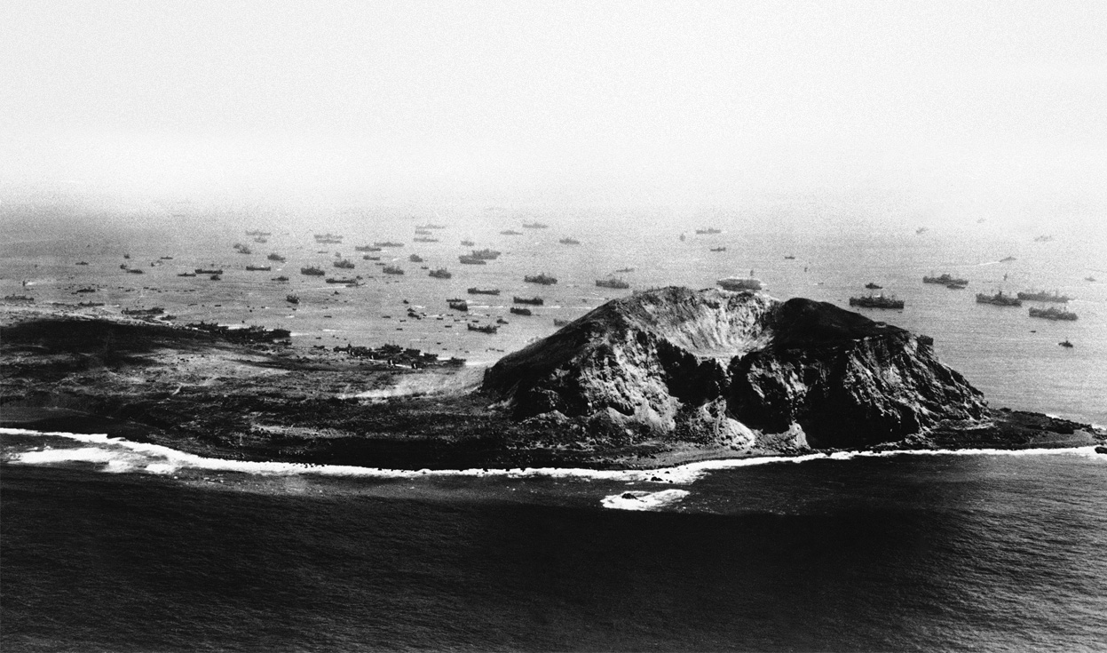
The Battle of Iwo Jima
Operation DETACHMENT
19 February−26 March 1945
Keystone Battle Series
History Division
Marine Corps University

Slide 2
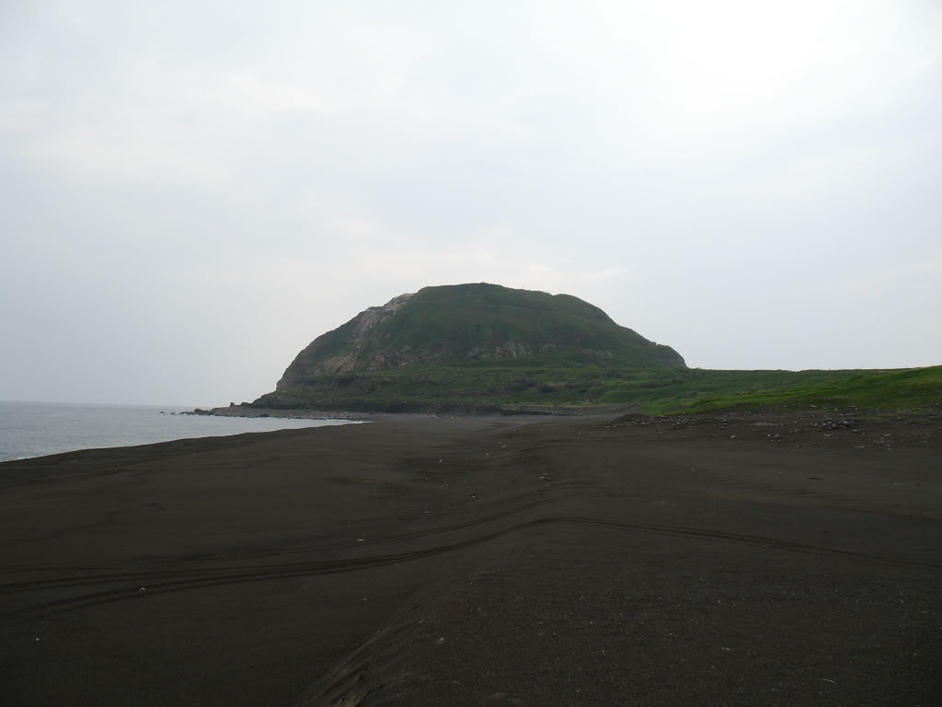
Introduction
The significance of the battle
Three Marine divisions under a single tactical command
American forces sustained more casualties than the Japanese
Classic textbook amphibious assault
Public relations
Mount Suribachi

Slide 3
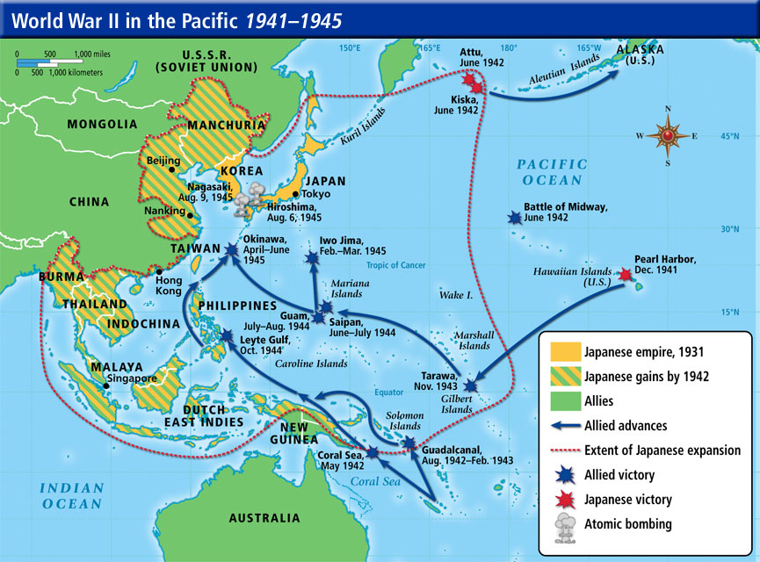
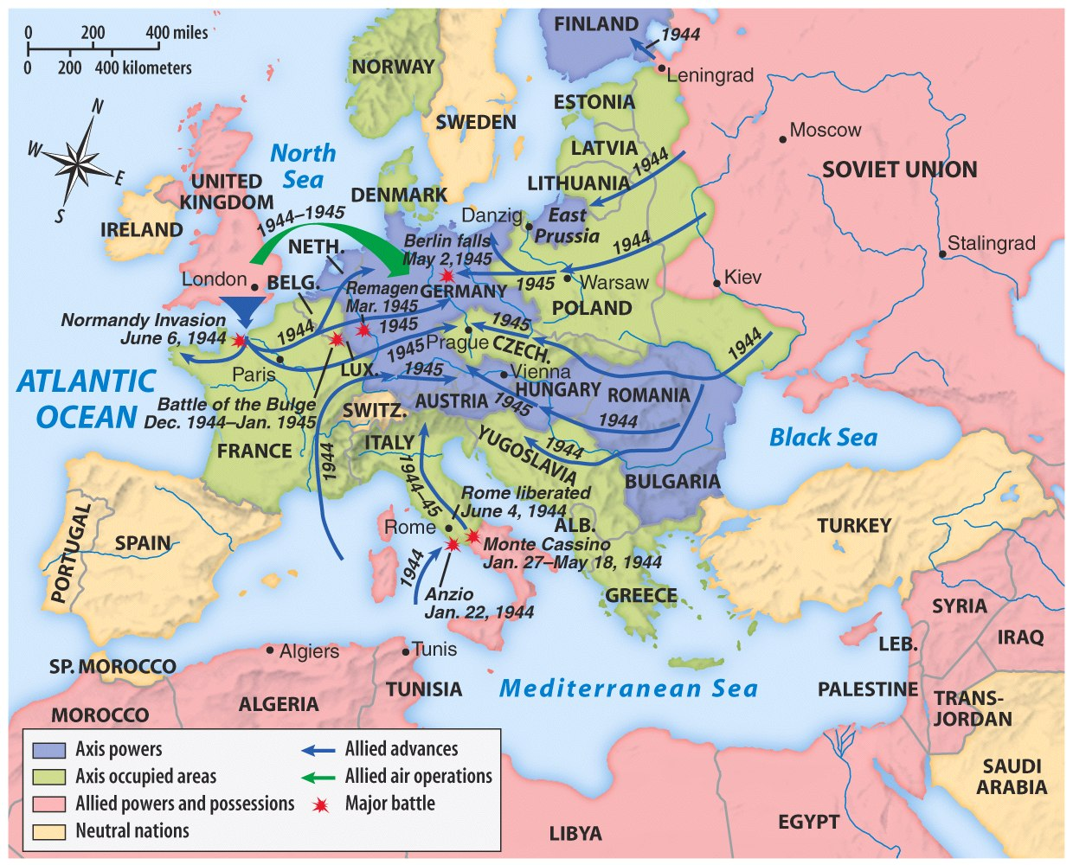
Context: Time, Place and Opposing Forces
Grand Strategy
In 1945 the United States and her allies sought to continue the momentum gained from the successes of 1944 over Japan and Germany.
Central and Southern Pacific Drives
European Theater

Slide 4
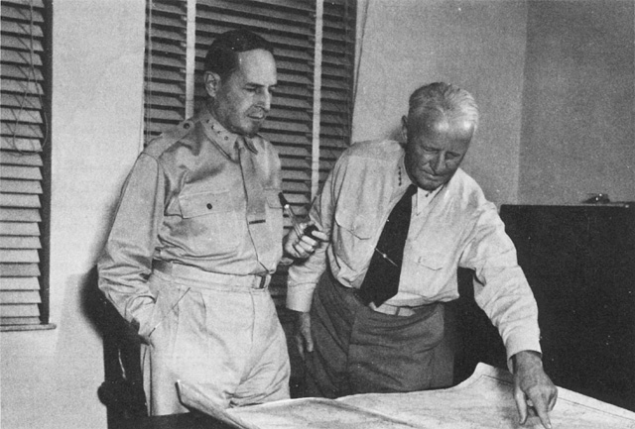
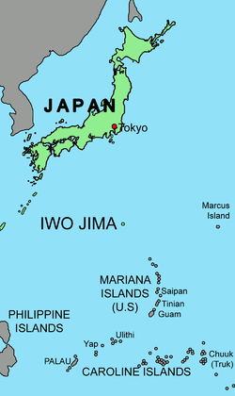
Iwo Jima: Operation DETACHMENT
General Douglas MacArthur (left)
Admiral Chester Nimitz (right)
U.S. military strategists chose Iwo Jima as a target, in part, because of its proximity to the Japanese home islands

Slide 5
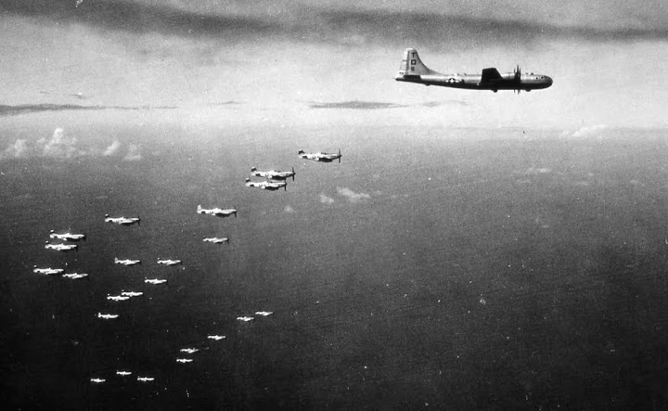
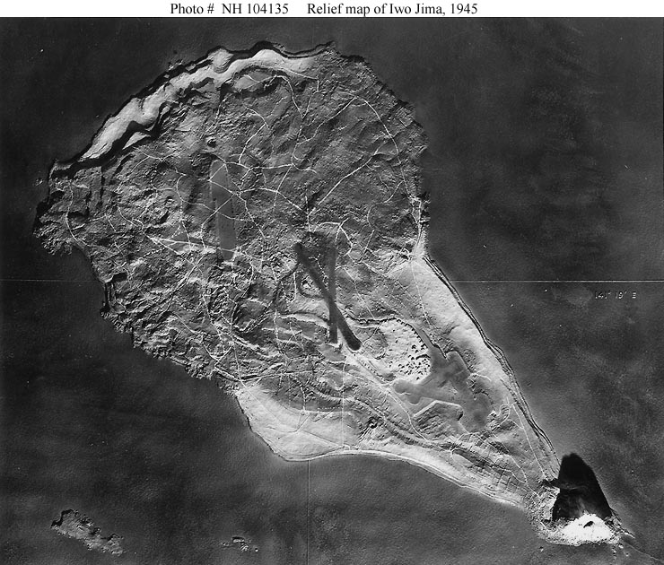
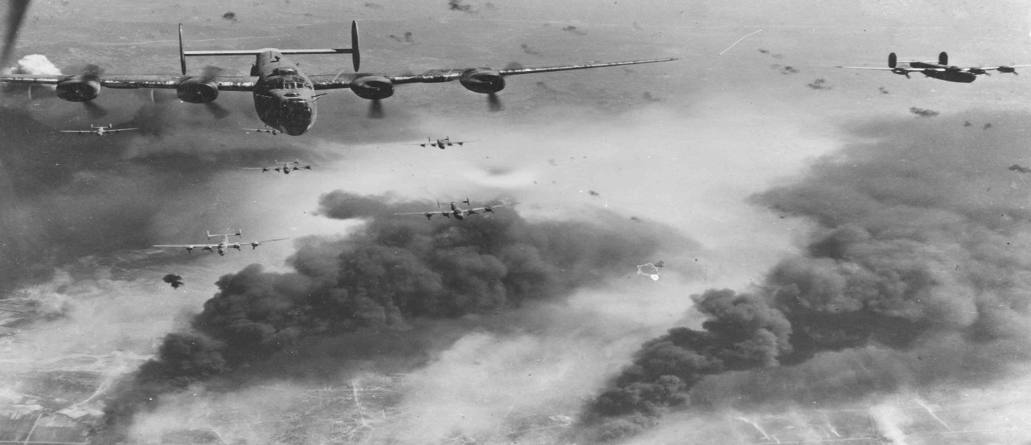
Strategic Importance of Iwo Jima to U.S. Forces
No. 3
No. 2
No. 1
U.S. Navy wanted Iwo for land based support for bombers and escorts
Aerial Photograph of Iwo Jima shows the three air fields and Suribachi in the left-bottom of photo

Slide 6
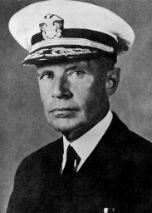
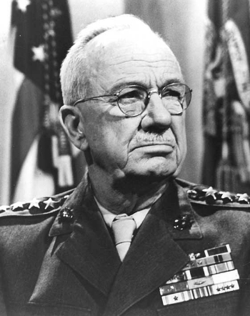
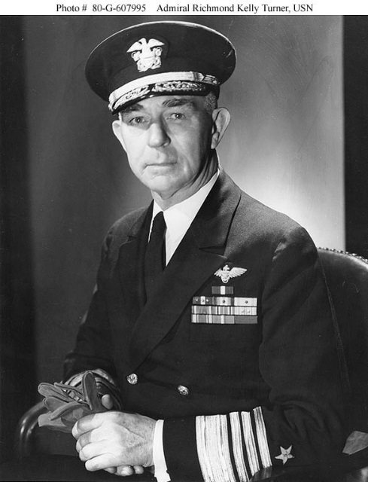
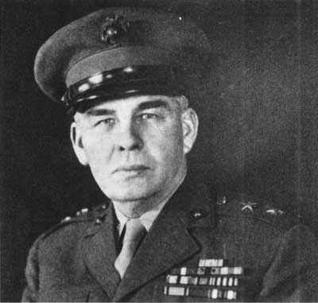
Task Force 56
LtGen Holland M. Smith
V Amphibious Corps
MajGen Harry Schmidt
3d Marine Division
MajGen Graves B. Erskine
4th Marine Division
MajGen Clifton B. Cates
5th Marine Division
MajGen Keller E. Rockey
3d Marines
Col James A. Stuart
9th Marines
Col Howard N. Kenyon
21st Marines
Col Hartnoll J. Withers
12 Marines
LtCol Lowell E. English
Maj George A. Percy
23d Marines
Col Walter W. Wensinger
24th Marines
Col Walter I. Jordan
25th Marines
Col John R. Lanigan
14th Marines
Col Louis G. DeHaven
26th Marines
Col Chester B. Graham
27th Marines
Col Thomas A. Wornham
28th Marines
Col Harry B. Liversedge
13th Marines
Col James E. Waller
American Naval Forces and Leaders
Top Left
Adm Raymond Spruance
Top Right
LtGen
Holland Smith
Bottom Left
Vice Adm Kelly Turner
Bottom Right MGen Harry Schmidt

Slide 7
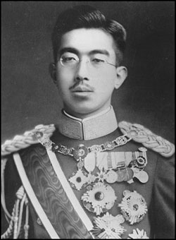
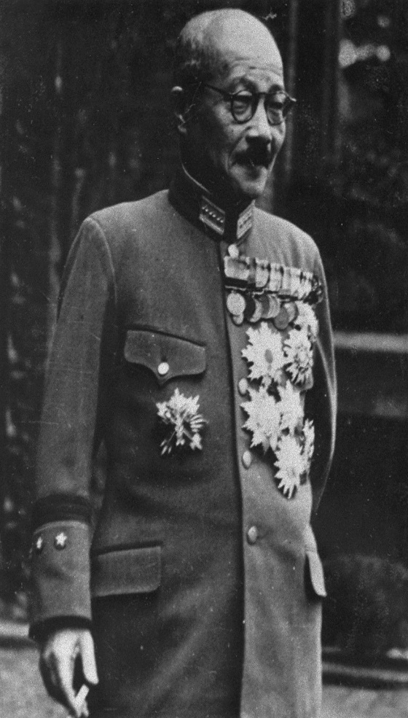
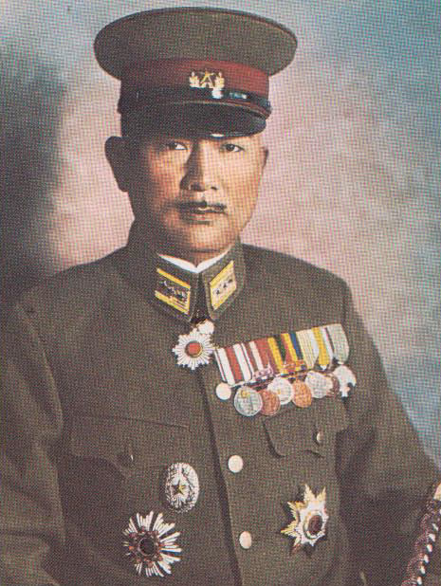
Iwo Jima and the Japanese
For the Japanese, the loss of the Marianas during the summer of 1944 greatly increased Iwo Jima’s strategic and symbolic significance
Emperor Hirohito (left); Prime Minister General Hideki Tojo (center); LtGen Tadamichi Kuribayashi (right)

Slide 8
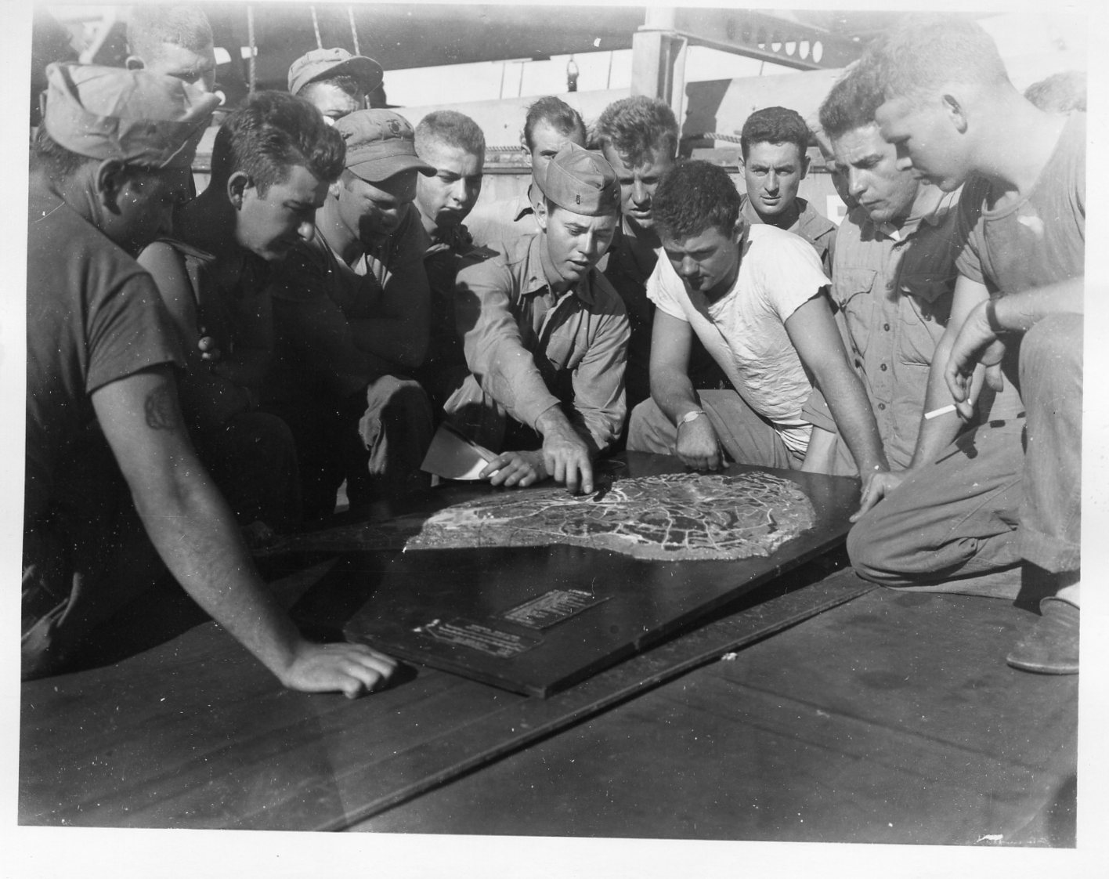
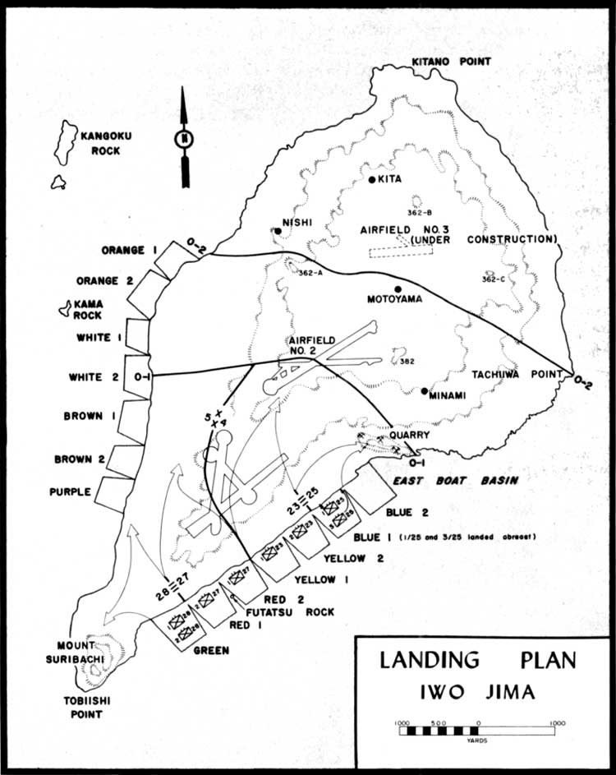
U.S. Assault Plan
Veteran Marine demolition team
studying Iwo before attack
Assault Plan

Slide 9
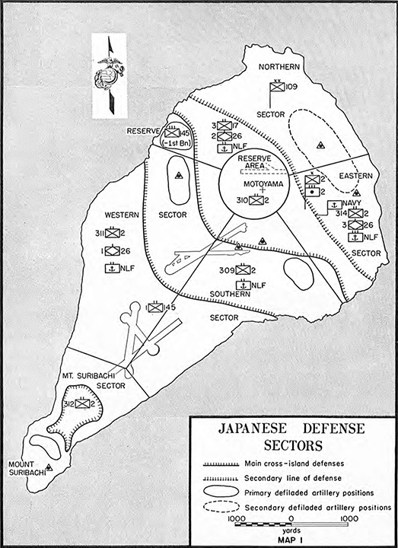
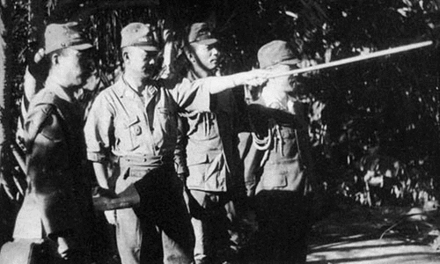
Kuribayashi’s Defense Plan
Kuribayashi broke with previous Japanese defense doctrine and the Marines would pay a heavy price

Slide 10
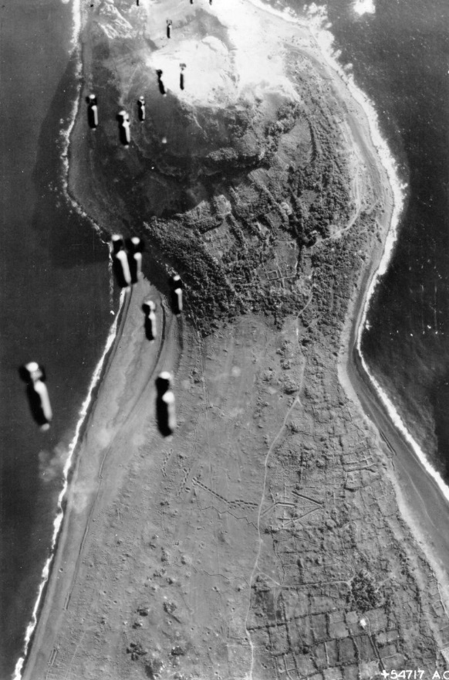
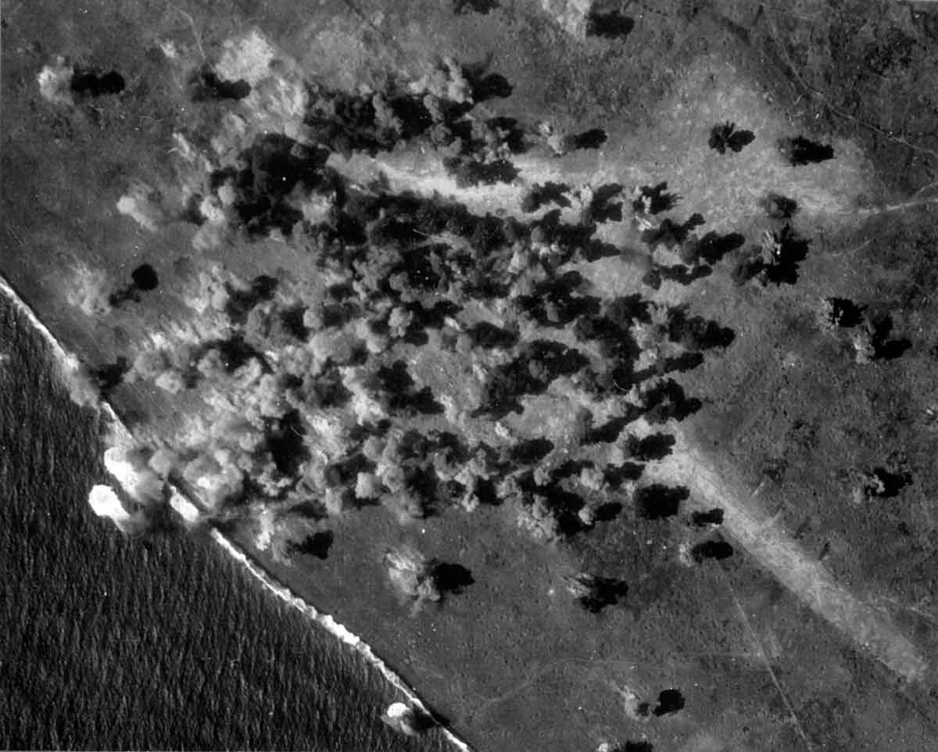
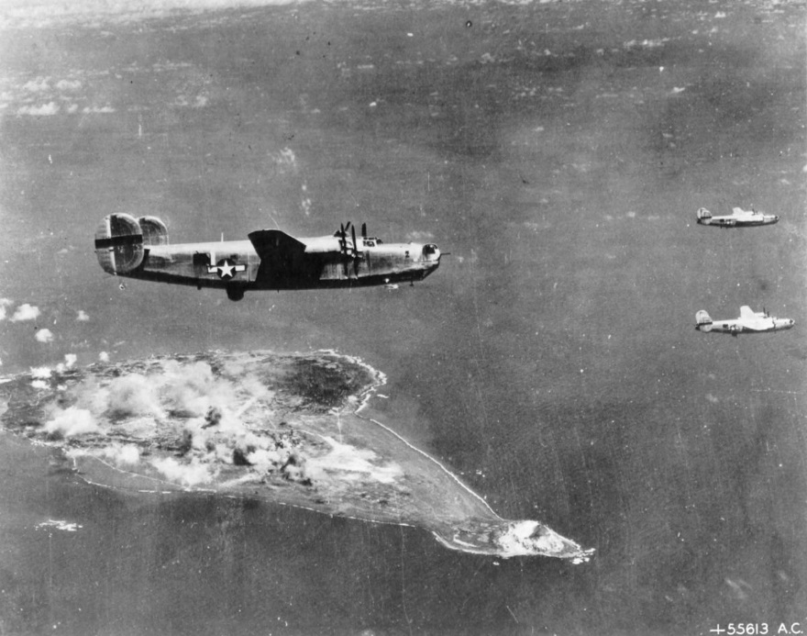
8 December 1944 to 15 February 1945 Bombing Campaign

Slide 11
The Controversial Preliminary Bombardment
Smith and Schmidt vs. Spruance and Turner
LtGen Smith requested ten days preparatory bombardment
Wanted D-Day dependent upon destruction of enemy positions
Argued that a longer bombardment, prior to the landing, would reduce the loss of life and hasten the surrender of the garrison
Focused only on Iwo and the landing
Spruance and Turner authorized a three day bombardment
Fixed D-Day on 19 February because the surface bombardment of Iwo had to commence with the carrier attack on Tokyo
Thought that the prolonged aerial attacks that began on 8 December would be enough
Naval ammunition needed to be conserved
Took a much broader view of the operation

Slide 12
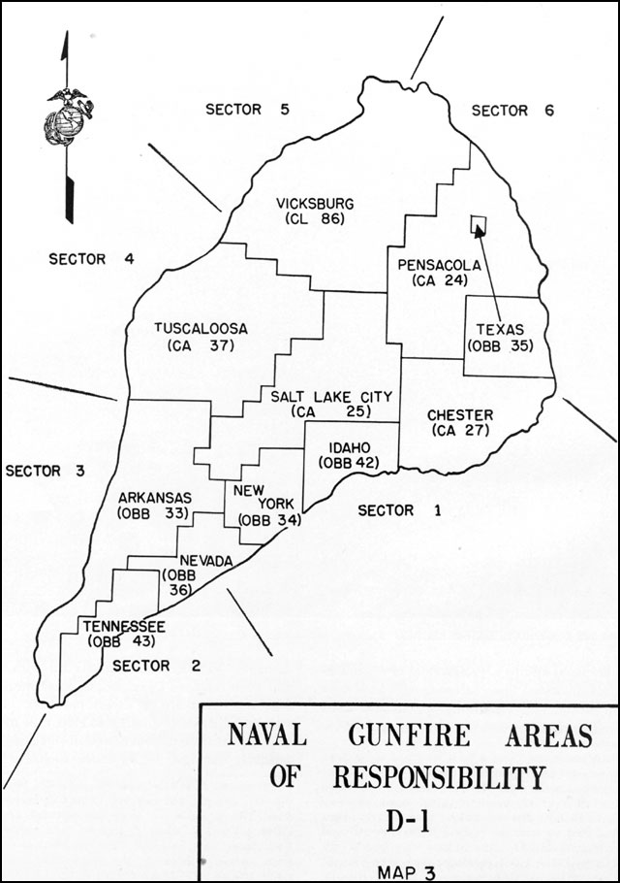
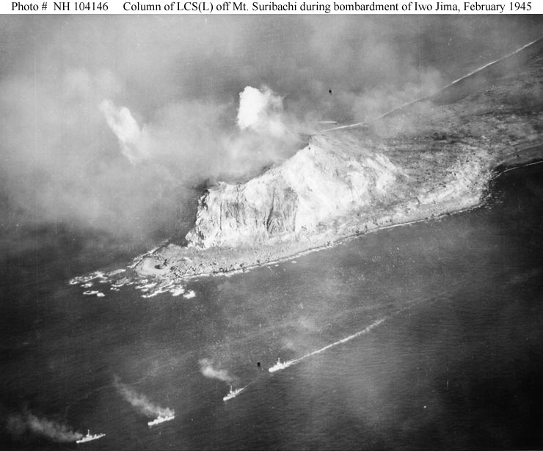
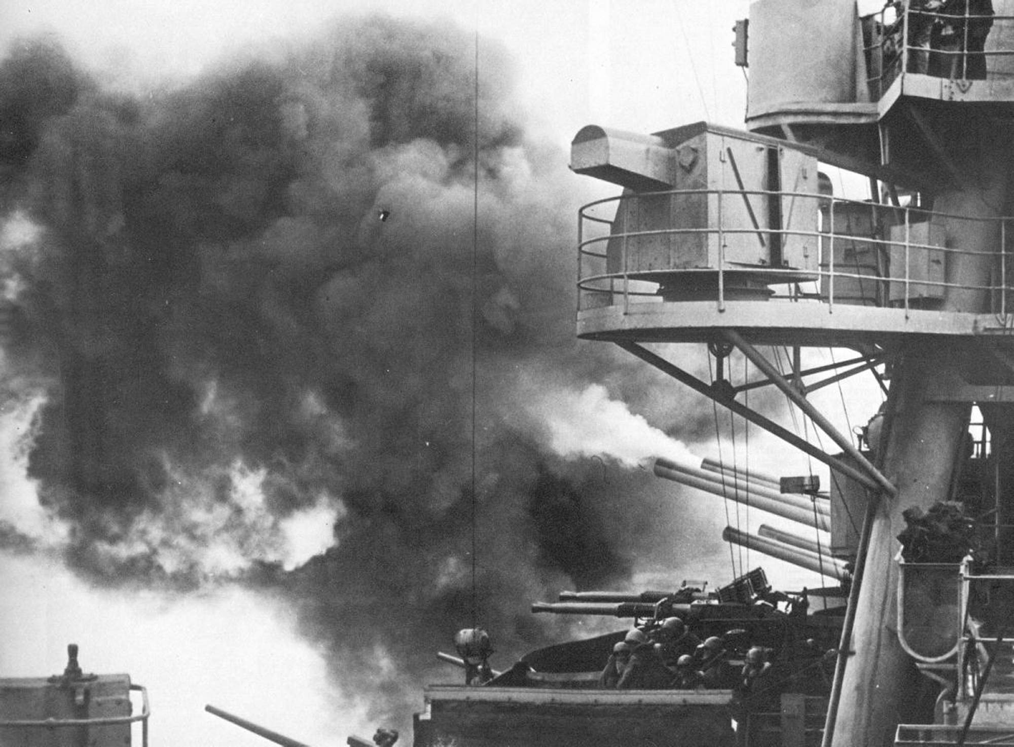
Preparatory Bombardment 16−19 February

Slide 13
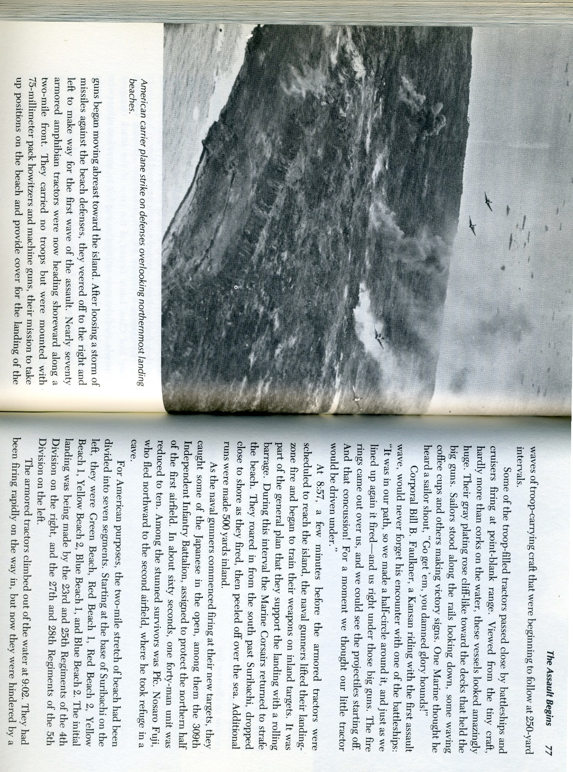
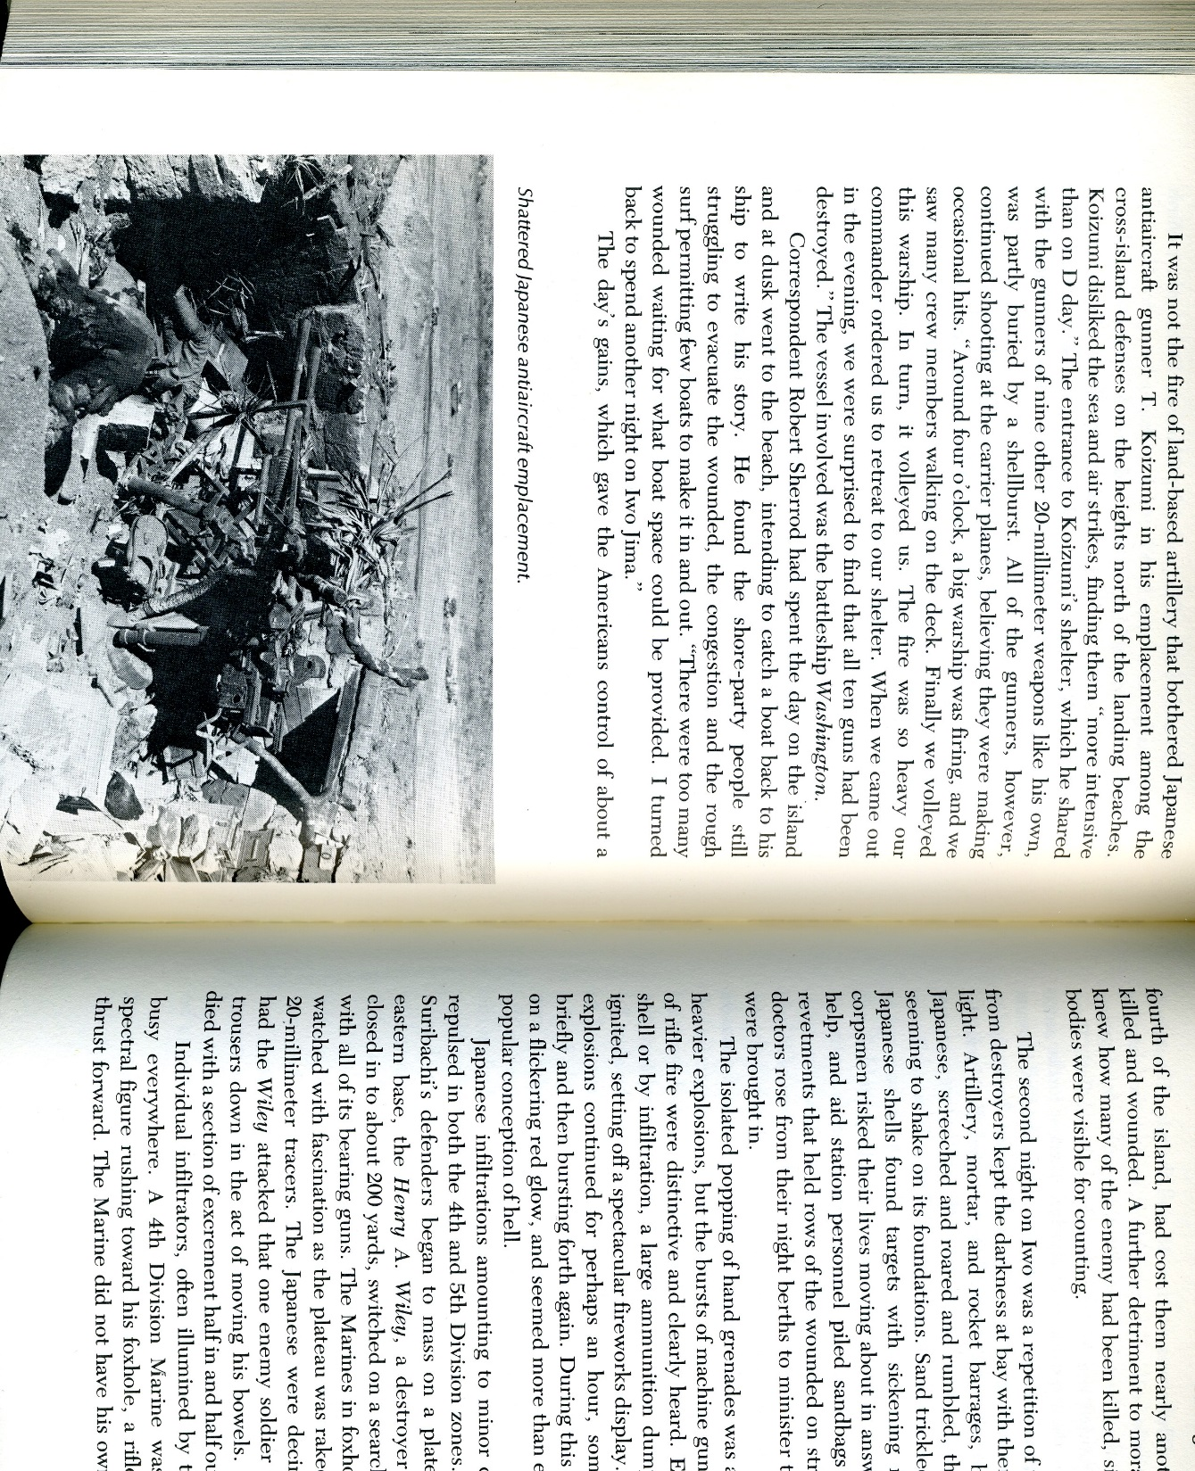
50% of 65 coastal defense guns destroyed
50% of 35 heavy anti-aircraft batteries damaged or destroyed
However, only 25% of small anti-aircraft guns, pill boxes, block houses, and covered tank/artillery positions were damaged or destroyed
More that 80% of garrison survived unscathed
Had enough ammunition for one more day of bombardment but concerns over the weather kept H-hour fixed at 0900, 19 February
Smith and Schmidt would resent this for years
Marine and Navy Aviators during Surface Bombardment
Destroyed Japanese Antiaircraft Emplacement (bottom-left)

Slide 14
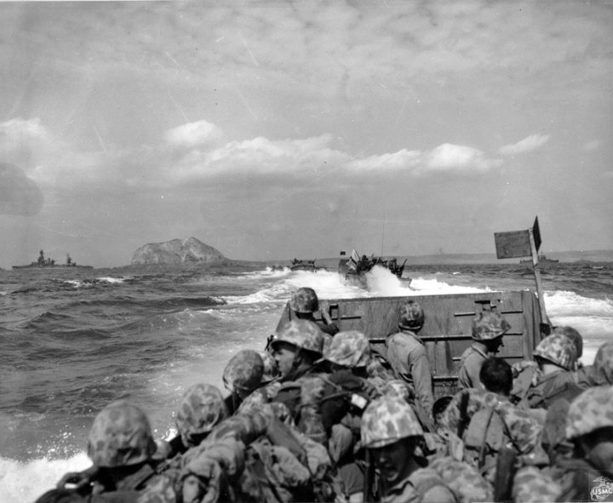
The Beach Assault on 19 February

Slide 15
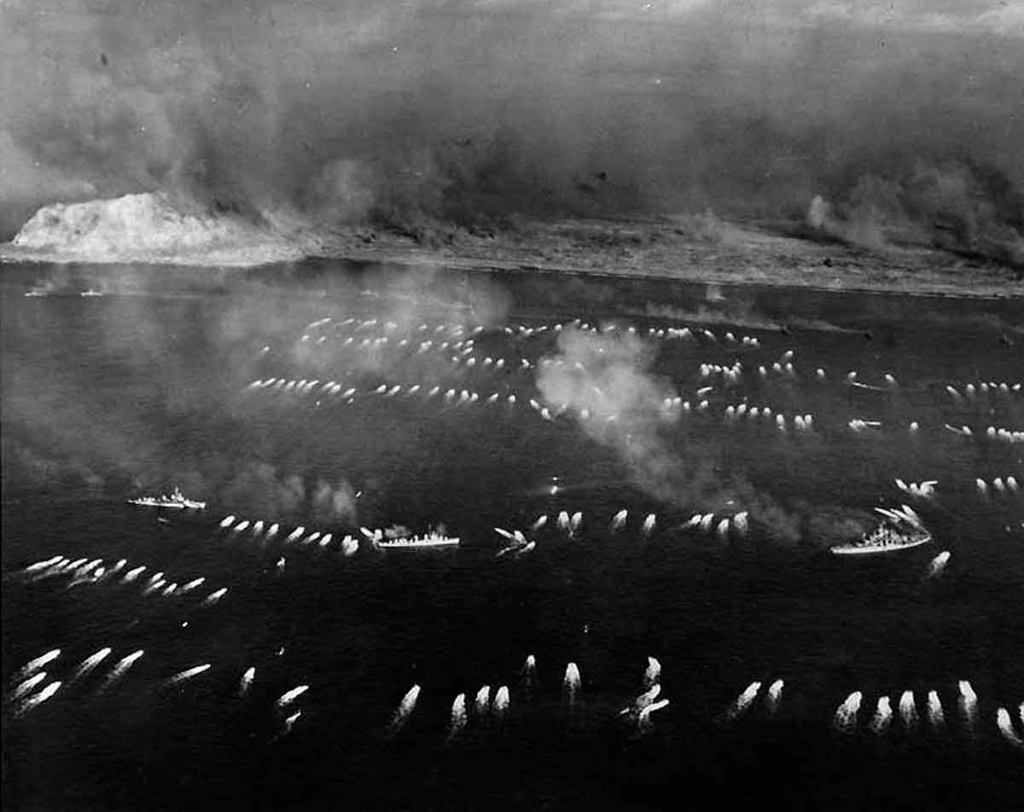

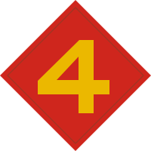

Between 0859 and 0903 Marines from 5th and 4th Marine Divisions land under a naval rolling barrage
5th Marine Division
4th Marine Division
3d Marine Division in reserve

Slide 16
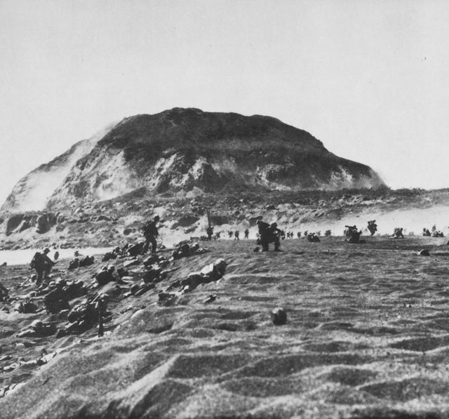
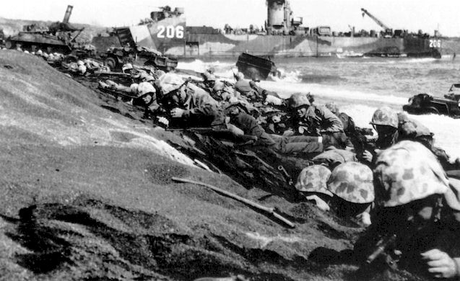
Marines penetrated to a depth of 150 to 300 yards initially
The Japanese waited as men, vehicles, and materiel began to concentrate on the beach

Slide 17
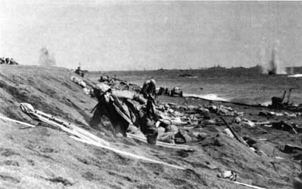
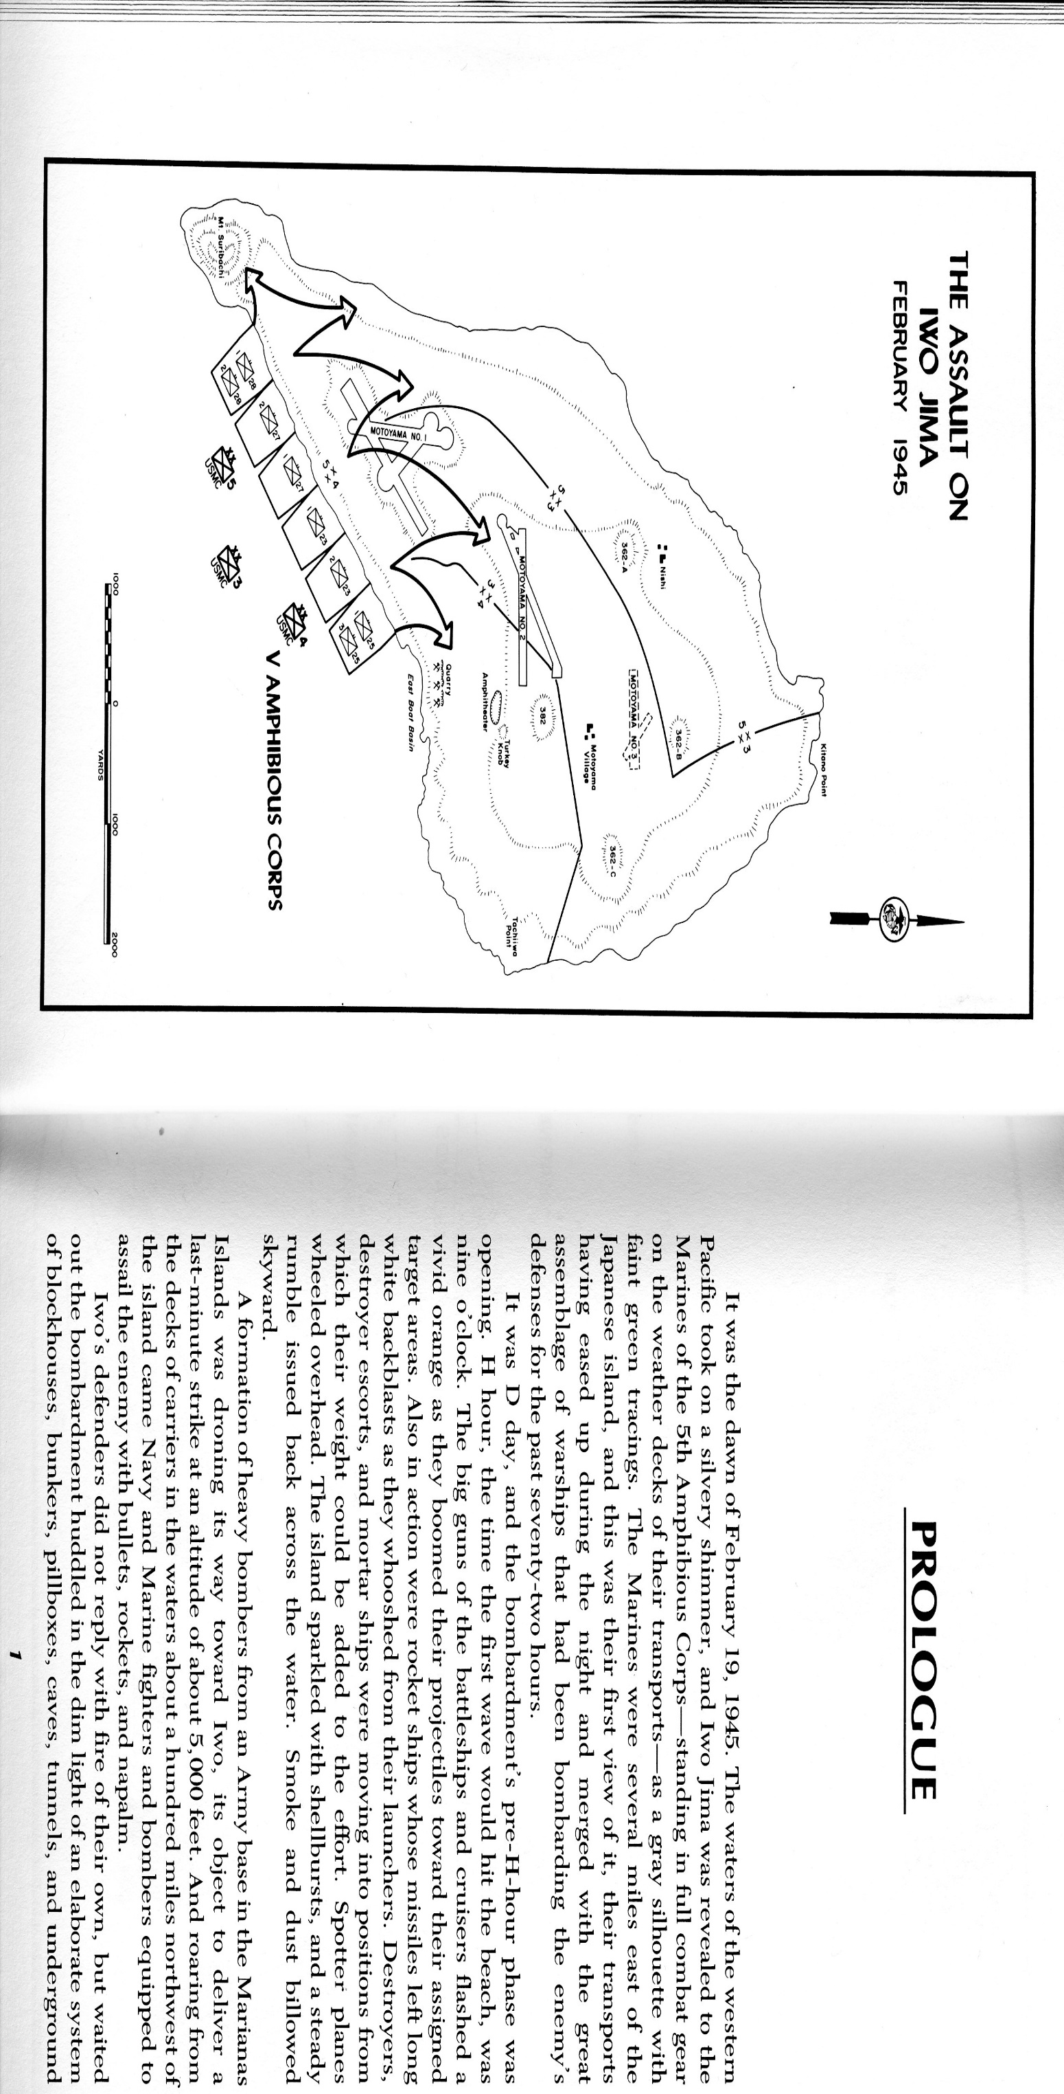
Japanese began to fire, intermittently, on the Marines from 0930−1200
By 1200, Japanese fire became furious and heavy
As elements of 5th and 4th MarDiv came ashore, they began to carry out the assault plan

Slide 18
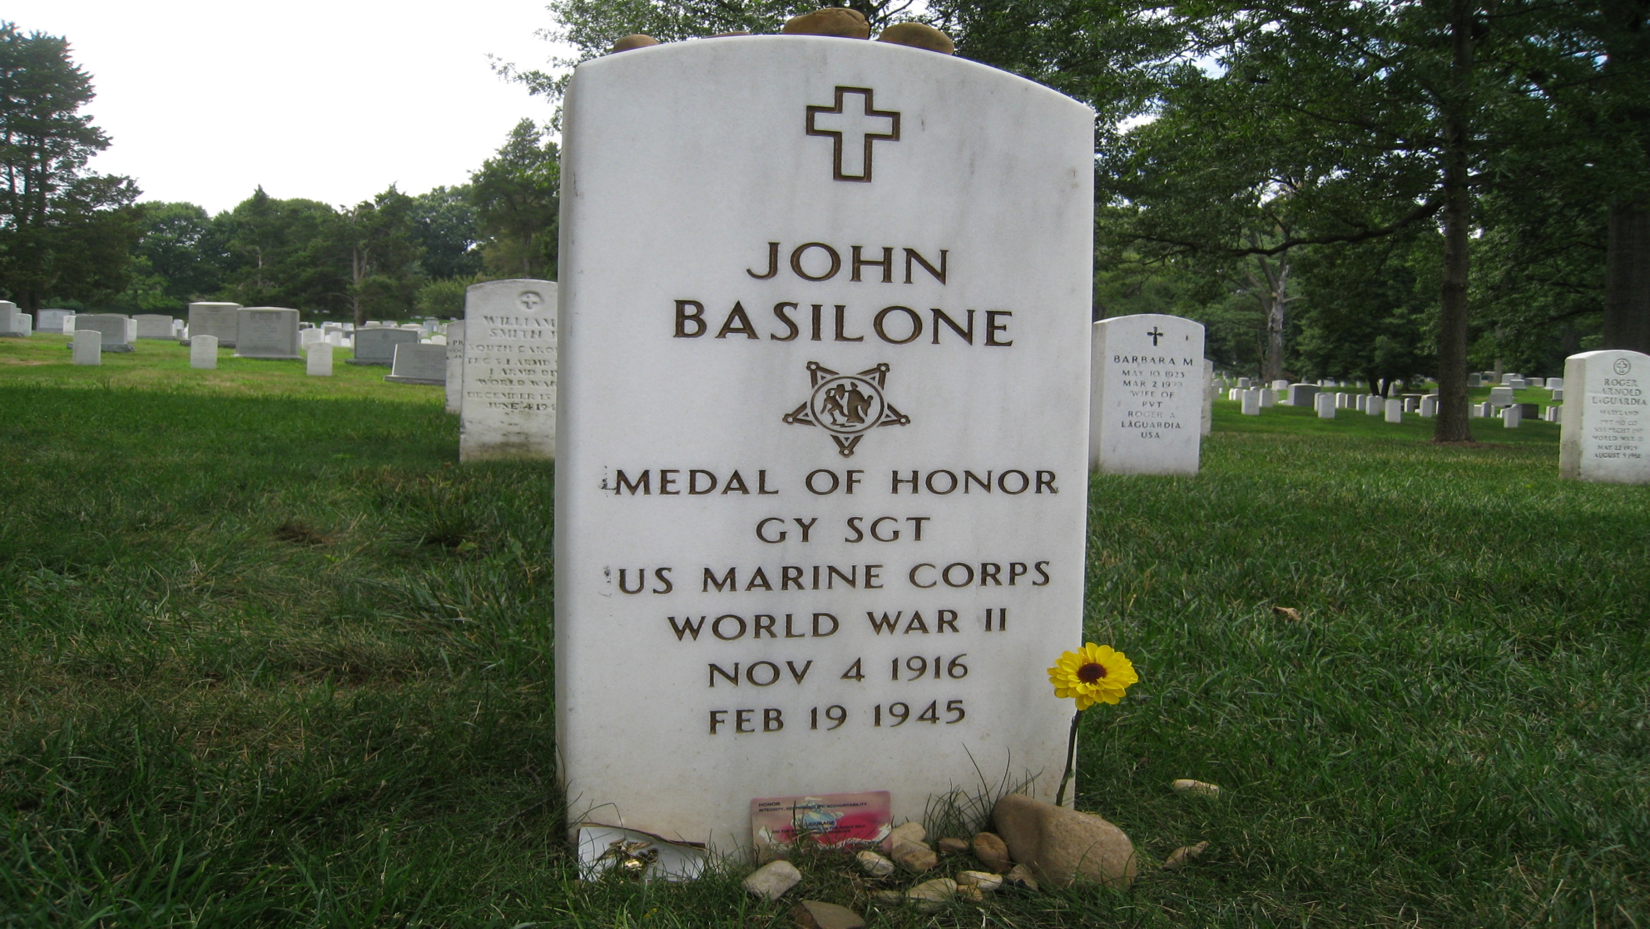
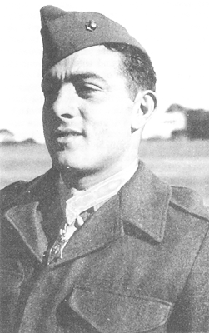
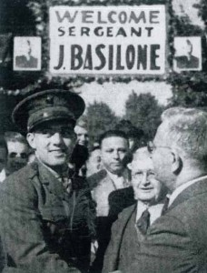
John Basilone

Slide 19
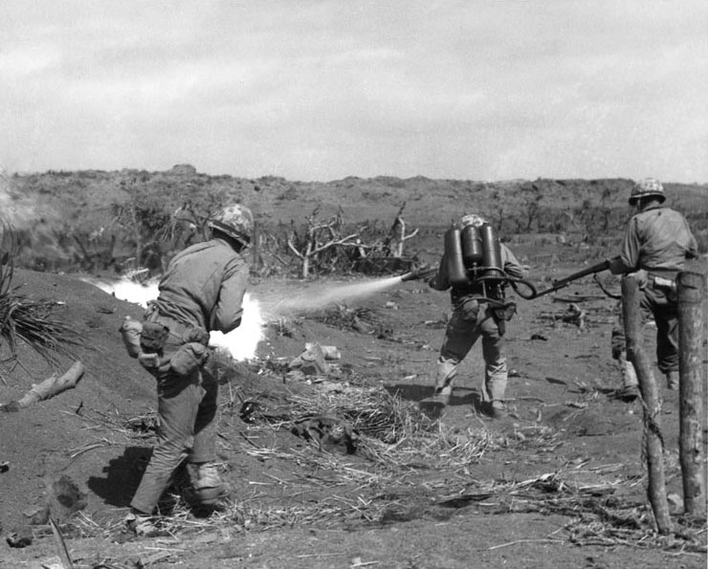
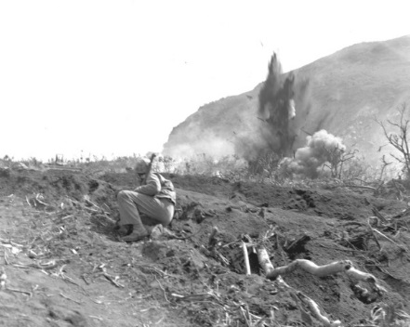
Clearing out each enemy position was tedious and usually involved coordinated use of explosives, flame throwers, and small arms fire. The process cost time and lives.
Marines approach Japanese positions and clear them out with flame and explosives

Slide 20
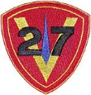
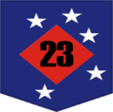

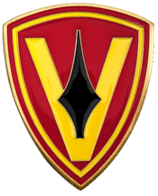
Suribachi and the 28th Marines: 20−23 February
While the rest of 5th MarDiv and all of 4th MarDiv turned northeast to seize the rest of the island, the 28th Marines assaulted Suribachi
1/28
2/28
3/28

Slide 21
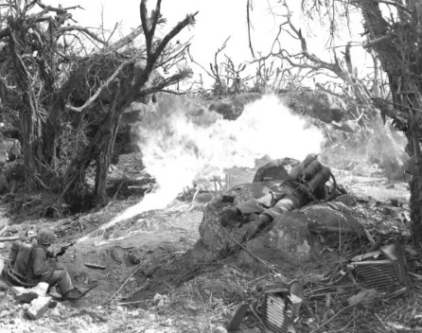
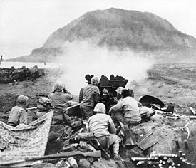
As the 28th Marines advanced, inch by inch, yard by yard, artillery pounded the mountain.

Slide 22
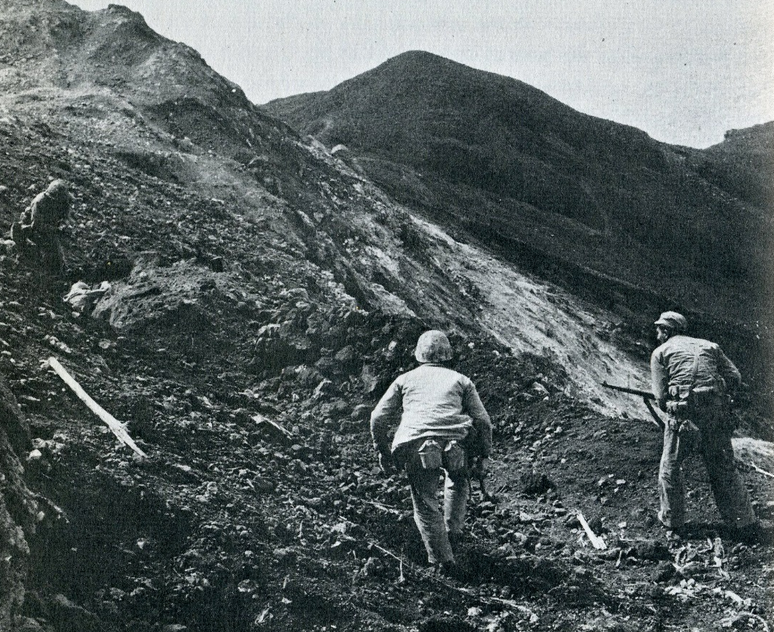
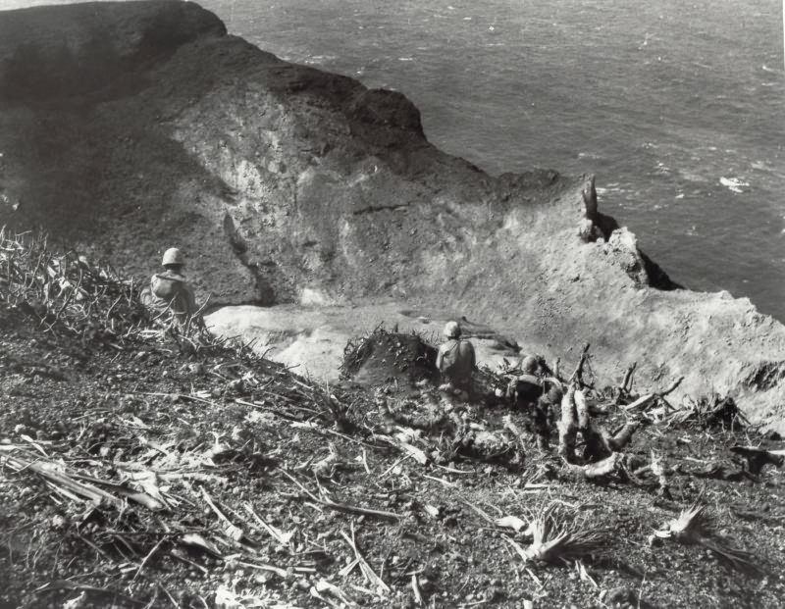
By the end of 22 February, the fight for Suribachi was virtually over
Marines from 2/28 advance cautiously around Suribachi’s rim.
Carefully rooting out resistance close to the summit, a Marine examines a wounded Japanese soldier.

Slide 23
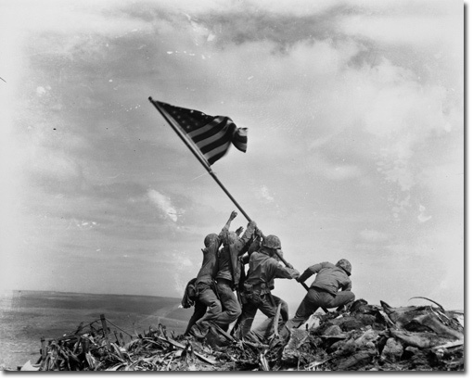
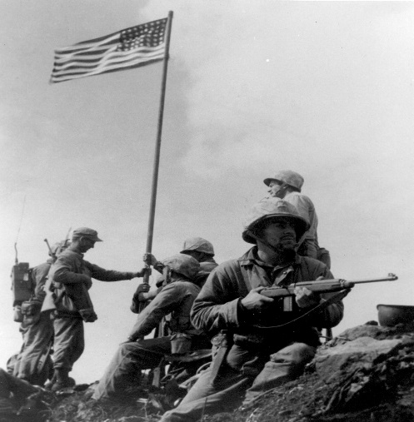
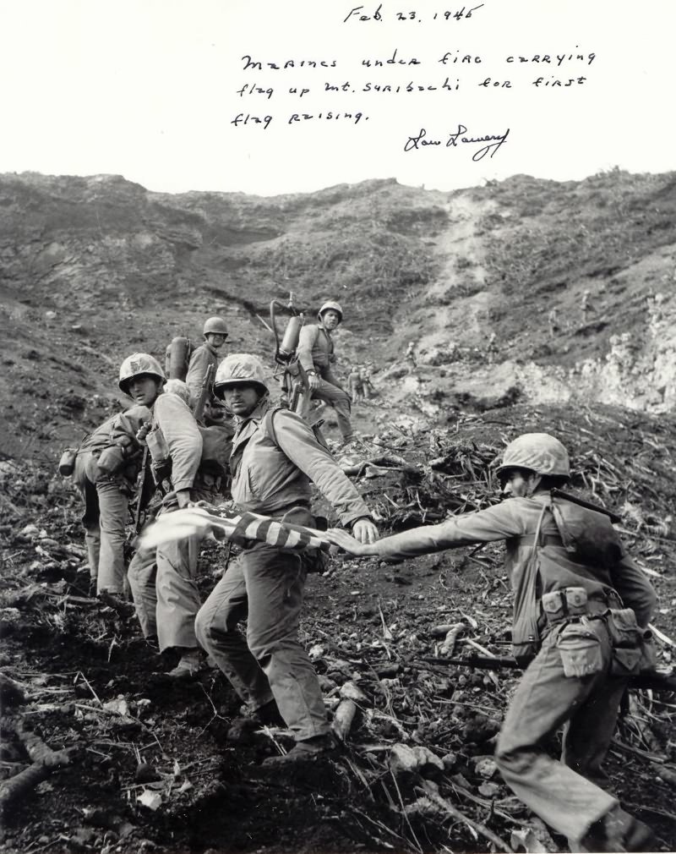
Joe Rosenthal’s Photo of Second Flag Raising
The first flag making its ascent with the 2/28
First flag raising

Slide 24







The Drive North
20 Feb−26 March
MajGen Keller Rockey, CO 5th MarDiv
Kuribayashi’s HQ in this area
Airfield No. 3
MajGen Graves Erskine,
CO 3d MarDiv
Airfield No. 2
Suribachi secured by 23 Feb
MajGen Clifford B. Cates, CO 4th MarDiv
Men and materiel continue to pour onto the beach, including 3d MarDiv and the rest of the artillery

Slide 25












20−27 February saw minor gains
After more concentrated barrage from naval guns, Marine artillery, and airstrikes, all three divisions began to advance at a steady pace by 27 February
Hill 362
Sgt Ross F. Gray Posthumous MOH
21 Feb
Hill 382
HM1 John H. Willis Posthumous MOH 28 Feb

Slide 26

First Week of March
Period of negligible gains due to fierce Japanese resistance
6 March saw a shift in Marine assault tactics
By 10 March 4th MarDiv reached the coast and cut off communication between Japanese in that sector and Kuribayashi's command post

Slide 27


All three divisions had to fight through very tough terrain

Slide 28



Island declared secure on 16 March but Marines continued to clear out caves and suffer casualties until 26 March

Slide 29




Slide 30


Early on 26 March, hundreds of Japanese soldiers executed a well organized attack on Marine and Army units encamped near the western beaches.
5th Pioneer Battalion, an African-American Marine unit, repulsed the attack and killed most of the Japanese.
Left
1stLt Harry Linn, Posthumous MOH
Right
Japanese dead and bullet ridden tents the morning after the Japanese surprise attack

Slide 31

Unit | KIA | DOW | WIA | Total
V Corps | 26 | 14 | 234 | 274
3d MarDiv | 926 | 267 | 3503 | 4,696
4th MarDiv | 1,631 | 375 | 6,211 | 8,217
5th MarDiv | 1,950 | 634 | 7,341 | 9,925
Marine Air and Ship Dets | 25 | 0 | 33 | 58
Navy Units | 363 | 70 | 1,917 | 2,350
Total Casualties | 4,921 | 1,360 | 19,239 | 25,520
Casualties
    These approximate numbers do not include 3 officers and 43 enlisted men still listed as missing, presumed dead, or the 46 officers and 2,602 enlisted men that suffered combat fatigue.

Slide 32

























Navy and Marine Corps Medals of Honor
Twenty-two Marines, four Navy Corpsman, and one naval officer earned Medals of Honor at Iwo Jima (27 Total)
Eleven Marines and two Sailors earned them posthumously

Slide 33




Famous Participants
Belleau Wood to Iwo Jima
Iwo Jima
MajGen Graves B. Erskine, CG 3d MarDiv
Belleau Wood
Lt, 79th Co. 2/6
Iwo Jima
MajGen Clifton B. Cates, CG 4th MarDiv
Belleau Wood
Lt, 96th Co. 2/6
Iwo Jima
MajGen Keller E. Rockey, CG 5th MarDiv
Belleau Wood
Captain, 1/5 (XO)
Iwo Jima
LtGen Holland M. Smith, Commander ATF
Belleau Wood
Major, 4th Brigade Adjutant

Slide 34

First Flag Raisers
Lt Harold Schrier
Sgt Ernest “Boots” Thomas
Sgt Hank Hansen
Cpl Chuck Lindberg
Corpsman John Bradley
PFC Ray Jacobs
PFC Phil Ward
PFC Jim Michaels

Slide 35







Second Flag Raisers
Ira Hayes
Harlon Block
KIA
John Bradley
Frank
Sousley
KIA
Rene Gagnon
Micheal Strank
KIA

Slide 36


Conclusion: Significance of the Battle
The seizure of Iwo Jima deprived Japan of a strong defensive bastion near the home islands
It provided the American military with forward airfields that made bombing Japan much easier
The U.S. presence on Iwo Jima was decisive in neutralizing other fortified Japanese islands in the Bonins
The fall of Iwo served a hard blow to Japanese morale and served as a very important step toward their ultimate defeat

Slide 37



Significance of the Battle to the Marine Corps
Iwo demonstrated that the Navy/Marine Corps team can succeed at their most violent and costly of missions: amphibious assault against a heavily fortified and fanatically defended enemy position
Iwo Jima, like Chapultepec, Belleau Wood, and Guadalcanal, retains a special place in the history and lore of the Marine Corps
Admiral Nimitz’s words “Among the Americans who served on Iwo Island, uncommon valor was a common virtue,” has been associated with Marines since they were recorded
Joe Rosenthal’s photograph of the second flag raising has become one of the most popular, positive, and instantly recognizable public images of the Marine Corps.

Slide 38

Mark R. Folse
PhD Candidate, University of Alabama (Department of History)

