Slide 1
Google Apps Sync for Microsoft Office (GASMO)
Basic installation and setup

Slide 2
General knowledge
GASMO syncs your google .edu email to outlook allowing you to digitally sign and send/ receive encrypted email
GASMO is the primary method to send and receive encrypted emails within .EDU network/Google Apps for Government environment.
Scanning documents from multifunction devices ( printers) causes them to be automatically signed. GASMO must be used to have access to the files if being sent to .edu /GAFG accounts
Encryption/Signature certificates must be set up in outlook once GASMO is installed for the whole process to work
Note: Use of GASMO is also required in order to access archived email files (PST files)– a highly useful feature for personnel transitioning from the MCEN (.MIL) Network to the EDU Network.

Slide 3
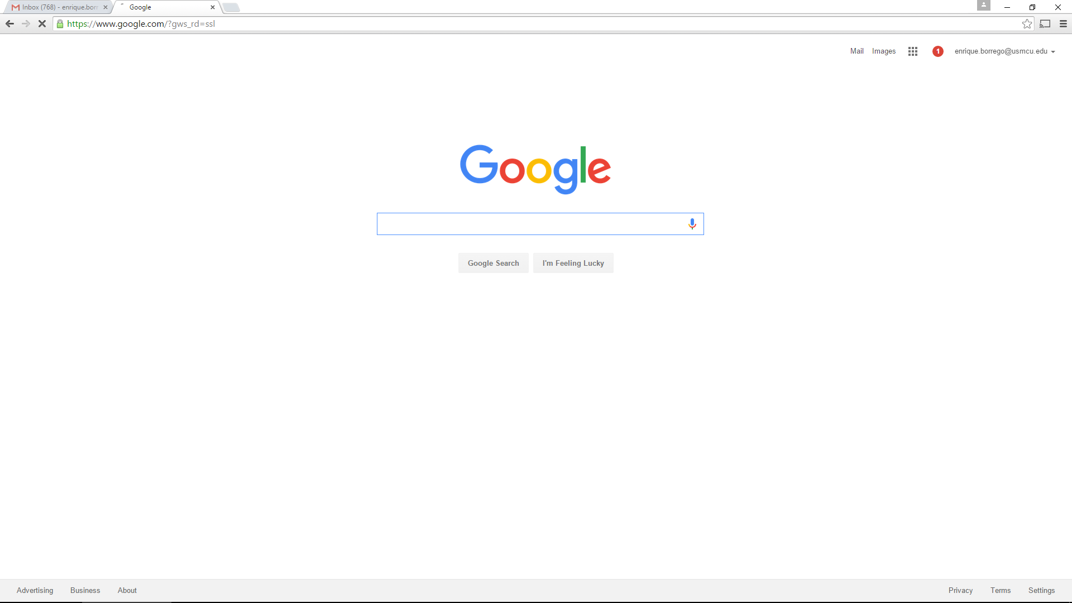
log into your GAFG account
Installing GASMO
(skip to slide 11 if GASMO has already been installed, if not continue here)

Slide 4
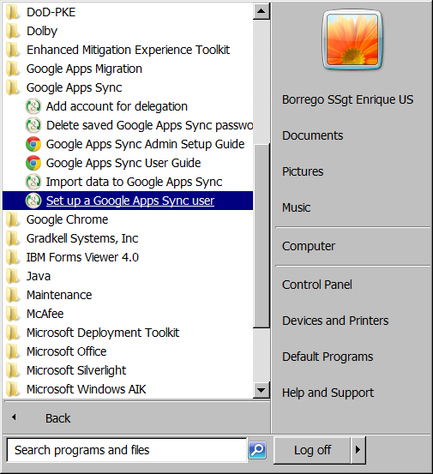
Installing GASMO
While Leaving your browser logged into GAFG, go to G Suite Sync, Setup A G Sync User
Click

Slide 5
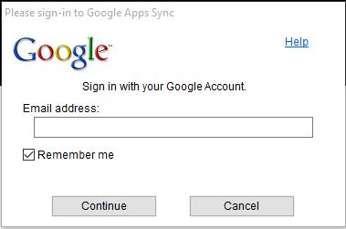
Installing GASMO
Insert your email address ( your.name@usmcu.edu) and click continue

Slide 6
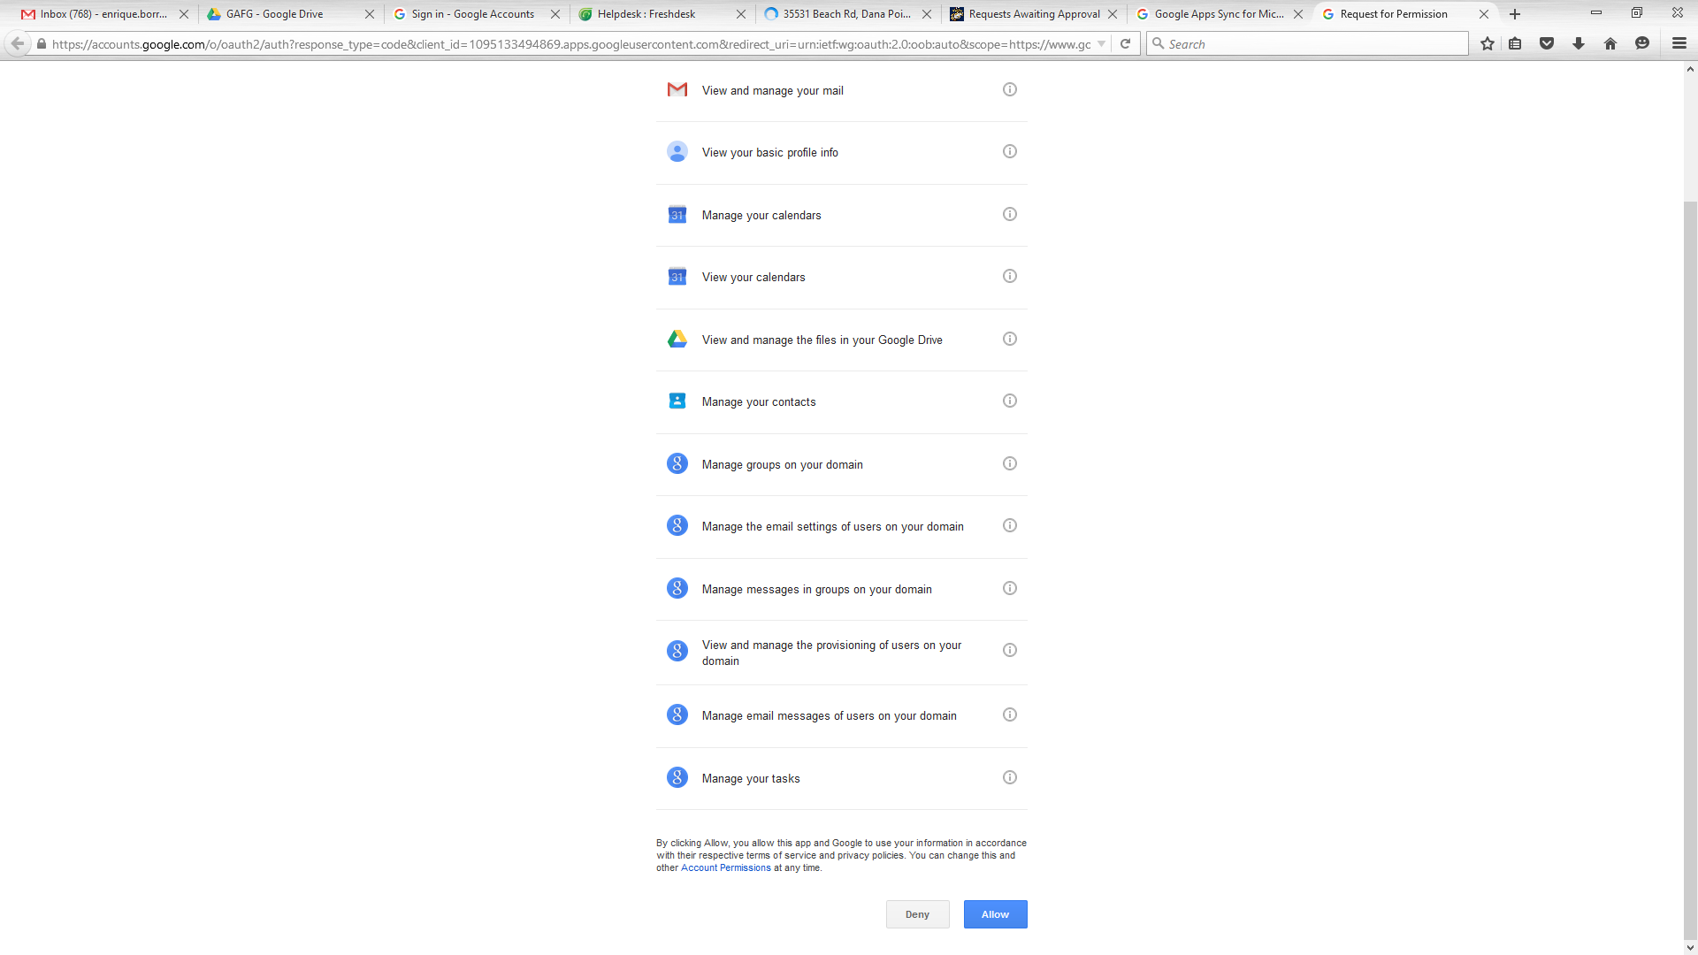
Installing GASMO
Click

Slide 7
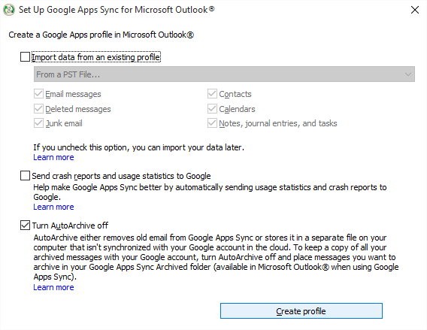
Installing GASMO
Use the below settings and click create profile
Click

Slide 8
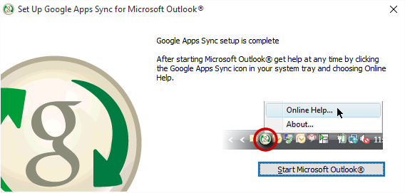
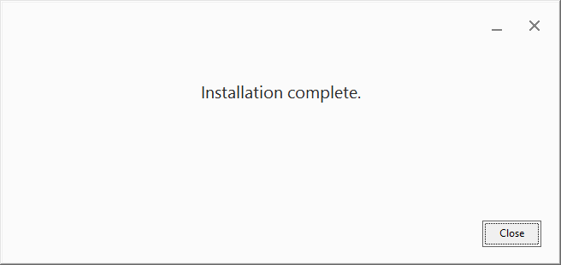
Installing GASMO
These windows should appear, click close

Slide 9
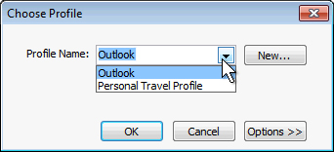
Installing GASMO
outlook should open automatically . Select your profile and click ok

Slide 10
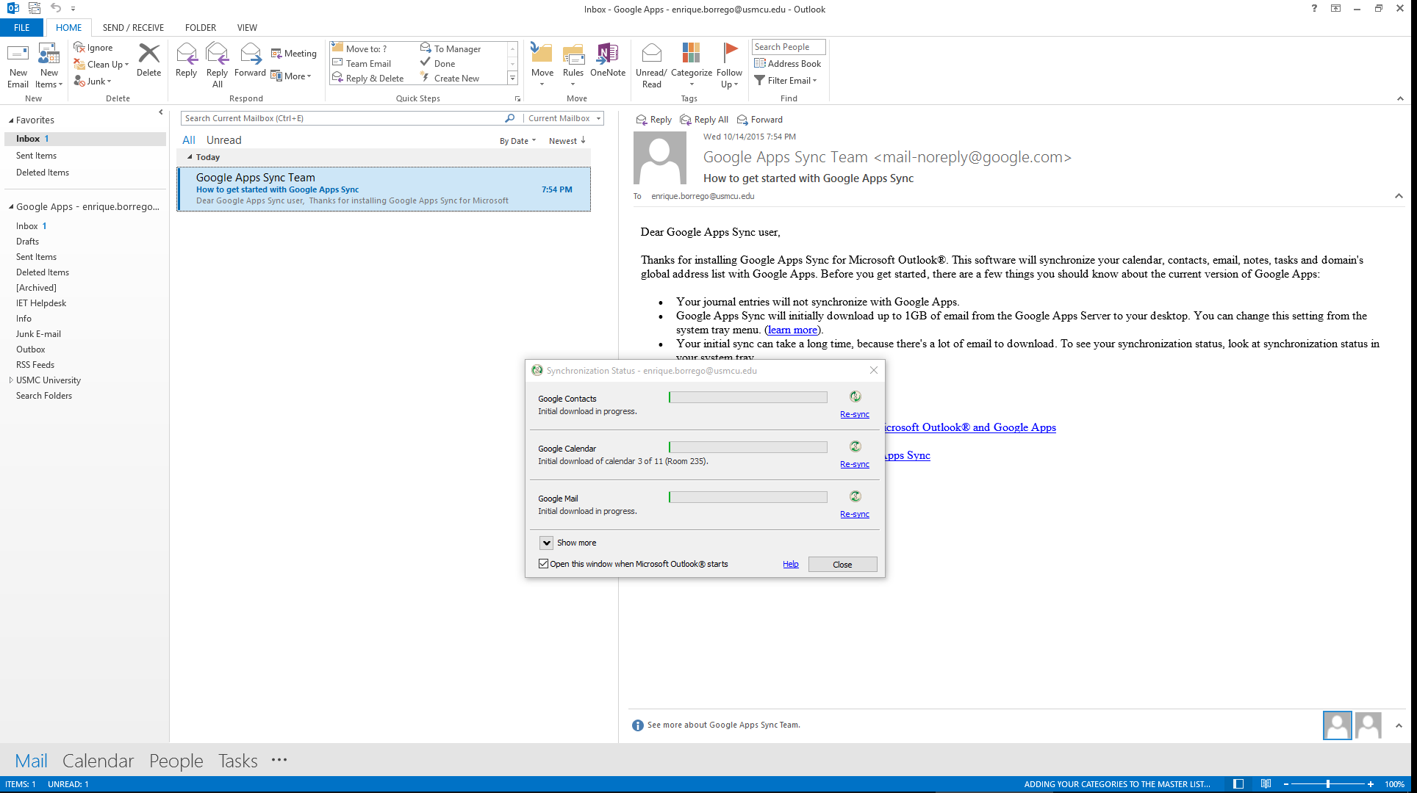
Installing GASMO complete
Continue to next step for certificate set up
Open Outlook, your GAFG email should begin to sync

Slide 11
Installing certificates
(needed for sending/receiving encrypted emails)
Click File

Slide 12
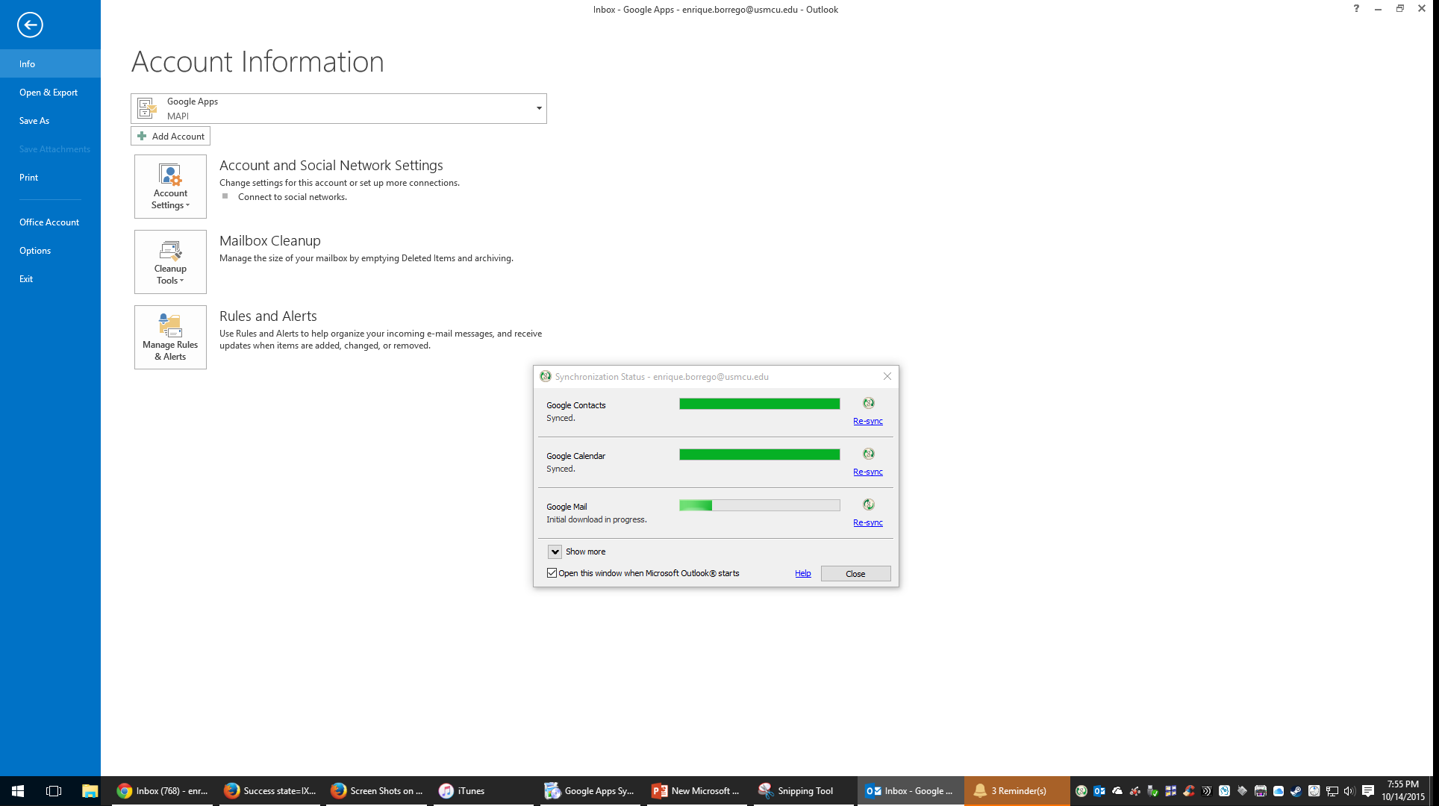
Installing certificates
Click Options

Slide 13
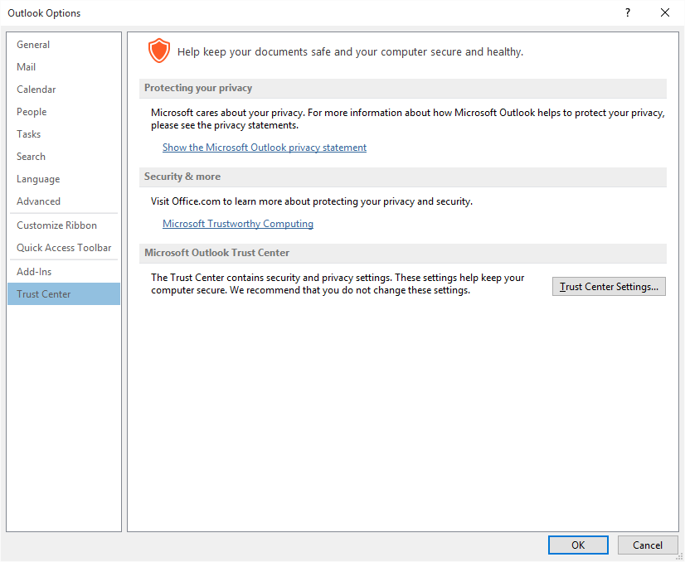
Installing certificates
1
Click Trust Center
Click Trust Center
settings
2

Slide 14
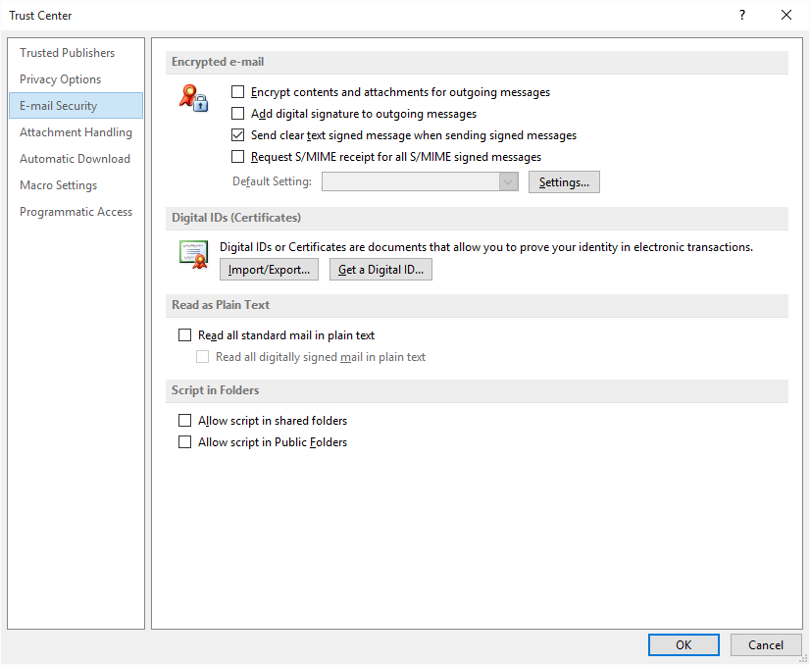
Installing certificates
select Encrypt contents
select Add digital signatures
1
Click Settings
2

Slide 15
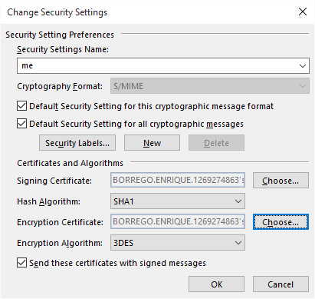
Installing certificates
1
Give your settings a name ( anything)
2
Select both of these options
3
Click button and select your cert
Click button and select your cert
4

Slide 16
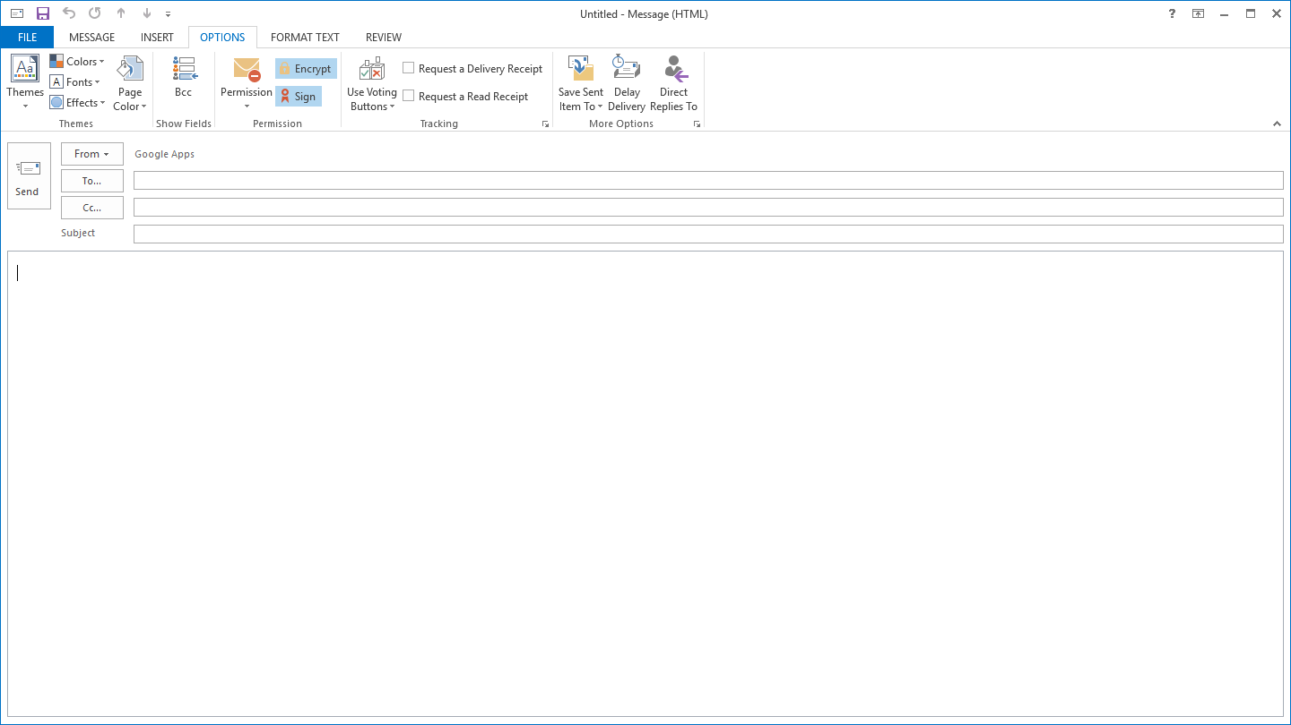
Installing certificates complete
When typing new emails, the Options tab now contains the ability to digitally sign and encrypt.

