Slide 1
Etiquette and Protocol
The rules and conventions governing correct or polite behavior in society in general, or in a particular social or professional group or situation.
Encarta World English Dictionary, St. Martin’s Press

Slide 2
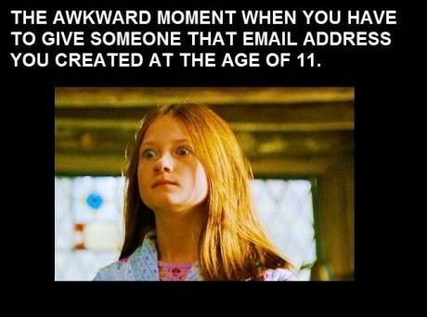

Slide 3
Email
Appropriate email address for professional use.
Use greeting, closing and always complete subject line
Refrain from using all CAPS, emoticons, and patterned backgrounds or fancy fonts that are hard to read.
Only CC when necessary, always CC someone you mention in an email
Acknowledge receipt of an email, even if you don’t have time to respond right away

Slide 4
Email
Use a signature- it is nice to include your email address so others can copy and paste if needed.
Especially military spouses- Try not to use acronyms or abbreviations
Confidential information should NOT be shared via email, Facebook, Twitter etc!
Once you hit send, you can’t take it back.

Slide 5
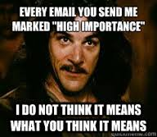

Slide 6
SOCIAL MEDIA ETIQUETTE
Try not to:
Use foul language or offensive images
Use your professional groups to advertise your business or personal ventures
It’s ok to:
Ignore a friend request
Un-tag yourself or ask someone to delete photos of your self
Unfriend someone who makes you uncomfortable
Ignore quizzes, groups and event requests

Slide 7
SOCIAL MEDIA ETIQUETTE
Keep it classy. Once it’s out there, you can’t take it back.
Avoid negative comments and foul language.
Remember- Your social media post ALWAYS represents any organization that you are tied to.
Refer to Social Media Almar 008/17 for more information.

Slide 8
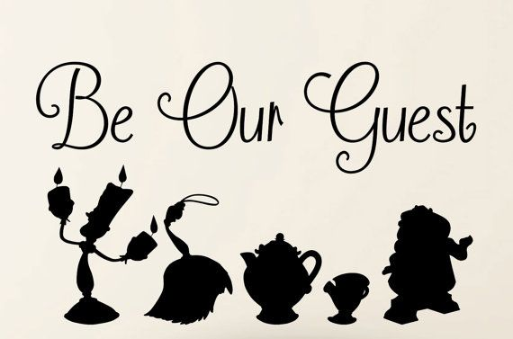
How to behave…anywhere!

Slide 9
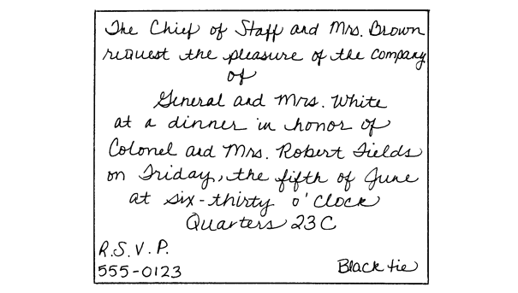
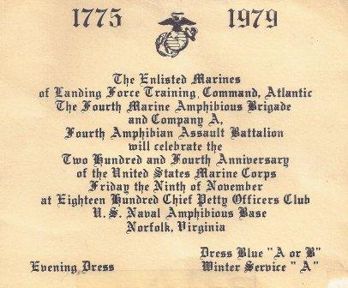
The Invitation!

Slide 10
Invitation Basics
The invitation will establish the tone of the event.
What should an Invitation should include?
Mailing Invitation timelines:
- 4 weeks before a business or social dinner
- 3 weeks before an informal dinner
- 3 weeks before a cocktail party
- 2 to 3 weeks before a business or social
luncheon
* If event is during the Holiday season, allow for longer time. Or send a save the date card.

Slide 11
Invitations
Only those named on the invitation should attend. No children or houseguest should attend unless specifically invited.
When addressing a dual active military couple, the spouse being invited in their official capacity should be listed first. If both are invited in their official capacity, the senior spouse is listed first.
Nametags and handshakes

Slide 12
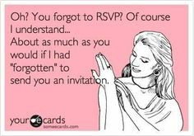

Slide 13
RSVPs
It’s always a compliment to be invited to a function so you should treat each invitation with the respect it deserves.
Proper time to respond to an invitation is within 48-72 hours if possible, but definitely by the deadline.
There is no need for an explanation if you decline.

Slide 14
RSVPs
Respond to the point of contact given on the invitation. Don’t tell the host/hostess in person.
Inform your host if you have any dietary restrictions or special needs when you RSVP.
DO NOT attend the event if you failed to RSVP.
Hostess gifts. When is one appropriate? What are some different ideas?

Slide 15
Thank you notes
Hand written notes are ALWAYS appropriate and shows your appreciation.
An email thank you note may be appropriate if the invitation was extended by email.
Formal receptions do not require a thank you note or call.
What should be included in a Thank you note?

Slide 16
Honors and Ceremonies
The most common ceremonies you will attend are
Change of Command- Unit changes from one CO to another, a formal ceremony is held.
Relief and Appointment- Unit changes from one SgtMaj to another.
Retirements
Marine Corps Birthday Ball- Tradition for Marines. Family members are included. There is a formal ceremony, cake cutting, diner and dancing.

Slide 17
Unit and Social Functions
Mess Night- For Marines only. Promotes camaraderie.
Dining In- Formal event that spouses can attend. Army calls it a Dining Out
Bosses night- For Marines only. Social evening where you get to know each other outside of work.
Hail and Farewell- Can be for just unit or with families.

Slide 18
Music for the ceremonies
The National Anthem
    You should stand and face the flag with your hand over your heart.
    If in uniform, you will salute, only when covered.
    Children
Service songs:
    Stand (military will be at attention)
Taps
    Stand and face the music. If in uniform, you will salute.
    Hand over heart is appropriate, if desired.
Marines Hymn
    Marines will stand at attention and sing (when appropriate)

Slide 19
Music for the Ceremonies and Honors
Personal Honors:
  Ruffles and Flourishes
  Flag Officer’s March
  General Officer’s March
    Stand. If in uniform, you will salute.
If a General, Dignitaries, Senators or Congressmen are presiding, Honors will be played. They all rate Ruffles and Flourishes.

Slide 20
To stand or not to stand?
HONORS AND CEREMONIES
Do stand when
  The flag is passing (6-10 paces before and after)
  For the reading of awards, the narrator will indicate whether to or not.
  Attention to orders, or please rise
  When being introduced to ANYONE!
  Anytime the host indicates it

Slide 21
To stand or not to stand?
Do not stand
  If you can’t see
  To take pictures during a ceremony
  To adjust your gown at table
  If you are not included in the group asked to stand

Slide 22


Slide 23
The Shake
Handshakes are the physical greetings that go along with your words. The handshake developed from greetings in the middle ages. In order to be sure that the person you were meeting was a friend and not an enemy, you checked him for weapons. You held your hand open and so did he; then you shook hands to indicate that you were a friend. Today, we use this same greeting ritual to check whether a new person is open, confident, sincere, and friendly.

Slide 24
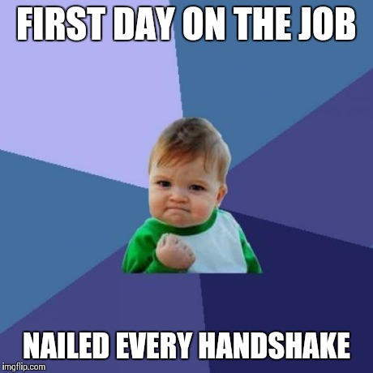
The Shake

Slide 25
In closing
Respect the position your spouse holds. Everyone expects them to do everything perfectly.
Our actions are a direct reflection of them.

