Slide 1


Developing Ethical Leaders
‹#›

Slide 2
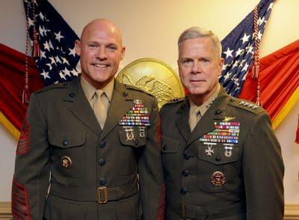
CMC & SGTMAJ Video

Slide 3
Who is an individual of character?
An individual who knows the difference between right and wrong – good and evil - and is committed to do the right thing.
‹#›

Slide 4
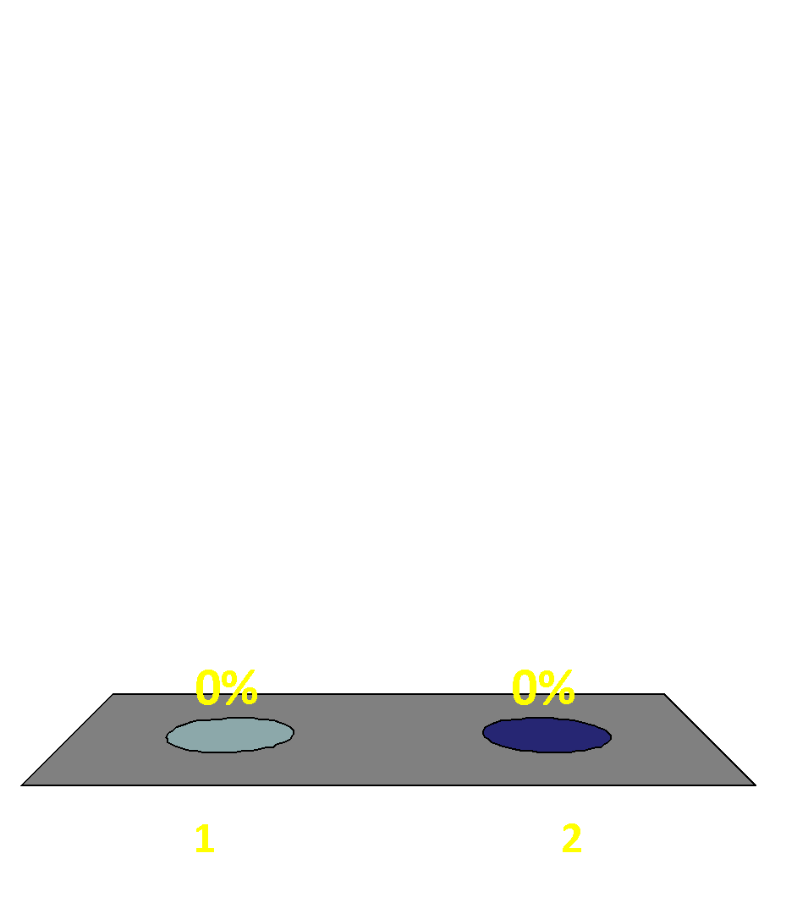
Is ethical leadership all about character?
Yes
No
‹#›

Slide 5
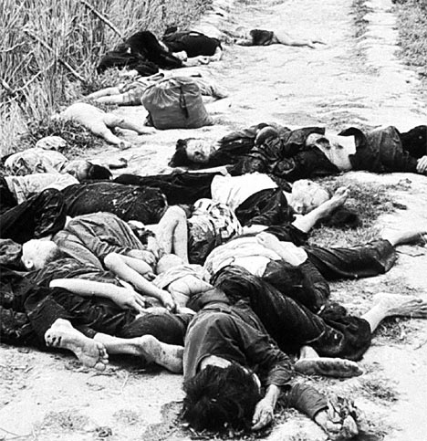
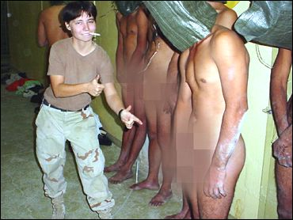
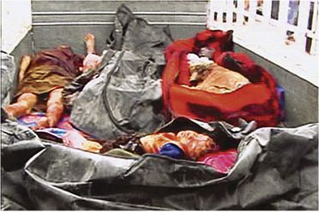
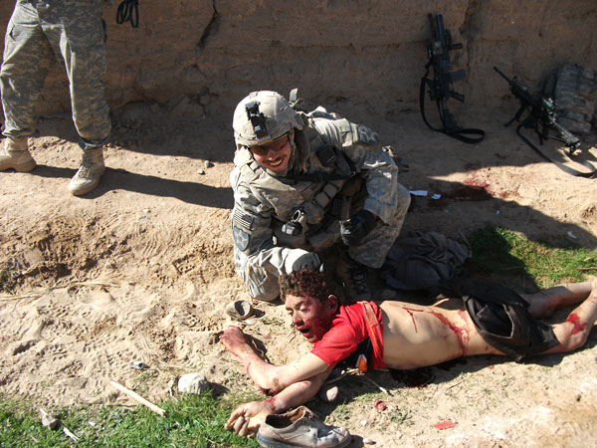
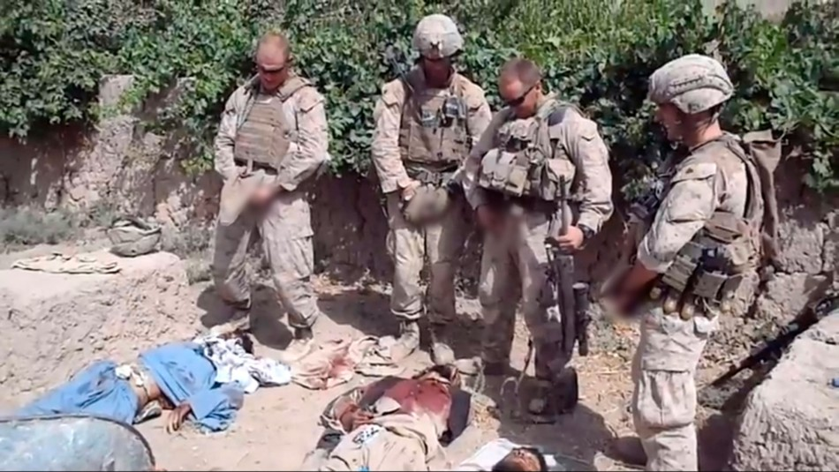
The Spectrum of Unethical Behavior
My Lai, Vietnam
1968
Abu Ghraib, Iraq
2003
Haditha, Iraq
2005
?
Kandahar, Afghanistan
2010
Helmand, Afghanistan
2011
Your Next Deployment?
20??
‹#›

Slide 6
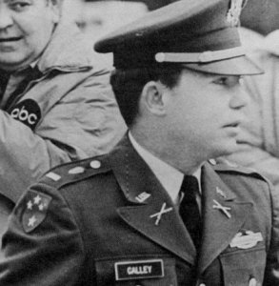
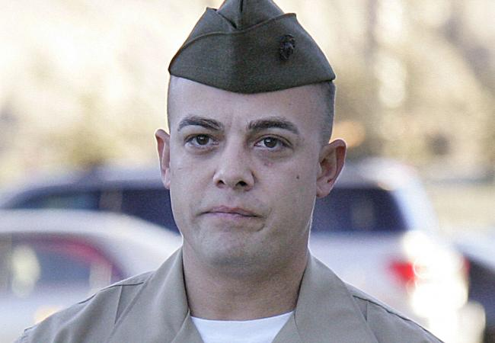
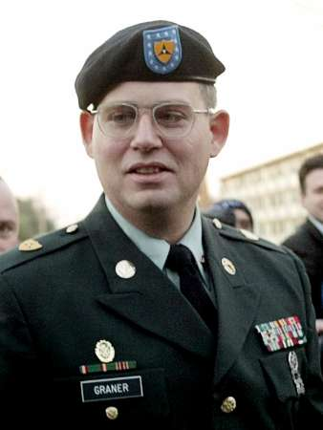
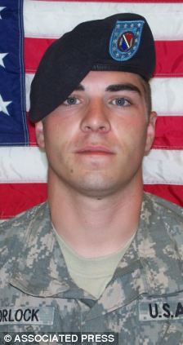
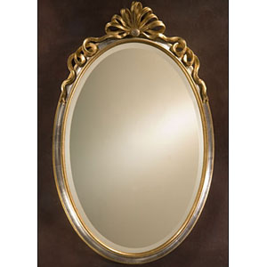
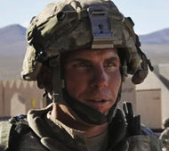
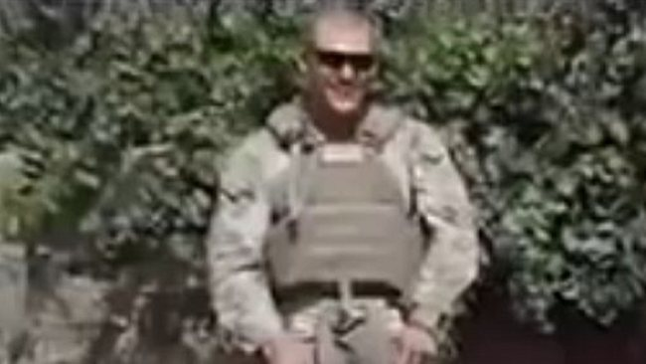
Who Is Responsible?
‹#›

Slide 7
Develop Ethical Leaders.
The Three Levels of Awareness
The Individual
The Situation
The System
‹#›

Slide 8
THE INDIVIDUAL
‹#›

Slide 9
Why do individuals behave unethically?
They might be psychopaths.
They might be people of character who know the difference between right and wrong, but fail to apply their values.
‹#›

Slide 10
How do we make decisions in a simple or simplified moral field?
‹#›

Slide 11
Every day we make ethical decisions in response to societal inputs.
Often we do not even have to think about the ethical dimension of our actions.
How long does it take us to decide to stop at a red traffic light?
How long does it take us to help a child who is the victim of a car accident?
How long does it take us to give back the cashier the money he/she has given us in excess?
‹#›

Slide 12

Healthy societies provide constant input and points of reference for morally sound behavior.
‹#›

Slide 13
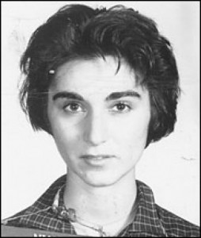
Kitty Genovese
‹#›

Slide 14

Darley and Batson 1973
Good Samaritans at Princeton Theological Seminary?
‹#›

Slide 15
The percentage of organ donors in several European countries is much higher than in the US. 6000 lives could be saved each year if more Americans were donors.
Austria 99.98 %
Belgium 98 %
France 99.91 %
US 44 %
Germany 12 %
Denmark 4.25 %
‹#›

Slide 16
Ethical Leadership and the Vulnerability Gap
‹#›

Slide 17
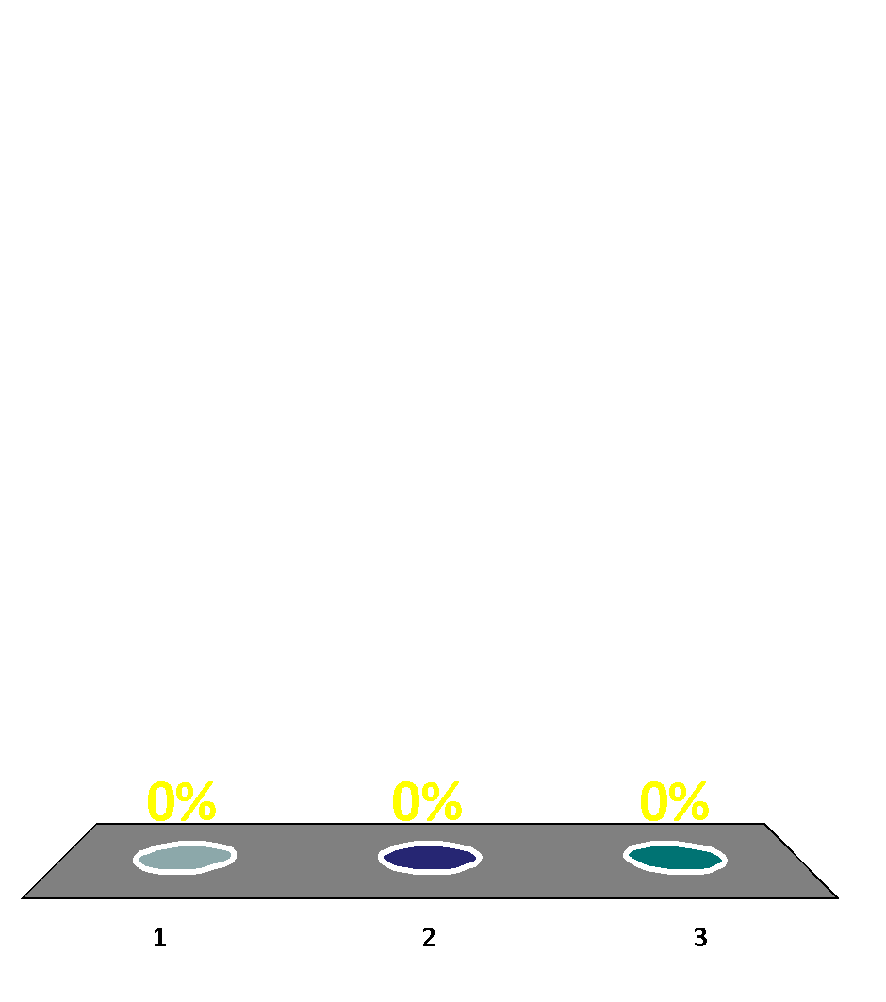
The cashier at the supermarket makes a mistake and gives me back $10 more in change. How long do you think it is going to take me to give the money back?
A few seconds
From a few to several minutes
From a few to several hours
‹#›

Slide 18
The cashier at the supermarket makes a mistake and gives me back $100 more in change. How long do you think it is going to take me to give the money back?
A few seconds
From a few to several minutes
From a few to several hours
‹#›

Slide 19
My neighbor, a wealthy 80 year old man, has crashed into my new car. The repair was $700. He thought that it was $7,000 and gave me a check for that amount. How long do you think it is going to take me to give the money back?
A few seconds
From a few to several minutes
From a few to feveral hours
‹#›

Slide 20
My taxi driver says he is pleased with the nice tip from his last ride, a foreigner he drove to the airport. Next to me, in the back seat, I find an envelope that contains the foreigner’s ID, contact info, and $ 100,000. How long does it take for me to decide to ensure the foreigner gets his money?
A few seconds
From a few to several minutes
From a few to several hours
‹#›

Slide 21

In the same taxi the envelope in the back seat, contains the foreigner ID, contact info and $ 1,000,000. How long does it take me to make sure he gets his money?
A few seconds
From a few to several minutes
From a few to several hours
‹#›

Slide 22
$ 10
Input
Right Course of Action
Reaction time
‹#›

Slide 23
The Vulnerability Gap
$ 1,000,000
Right Course of Action
Input
Reaction time =VG
Emotions can push us into the VG.
Temptation and coercion can push us into the VG.
‹#›
‹#›

Slide 24
THE SITUATION
‹#›

Slide 25
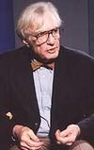

The Power of the Situation
Developed the concept of atrocity-producing situation
Robert Jay Lifton
‹#›

Slide 26
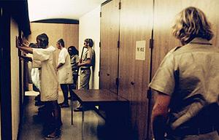
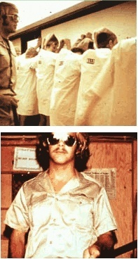
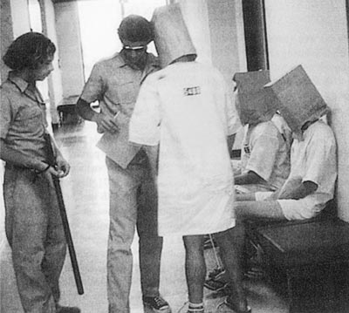
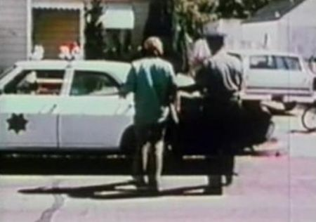
The Stanford Prison Experiment, 1970s
‹#›

Slide 27
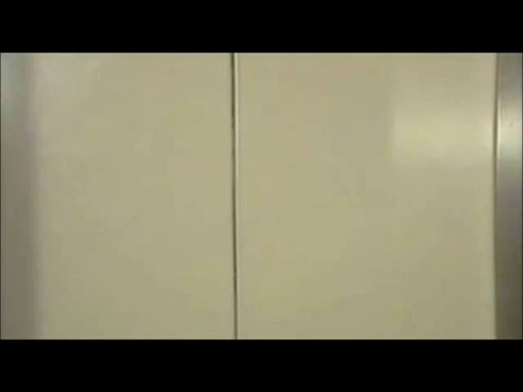
‹#›

Slide 28

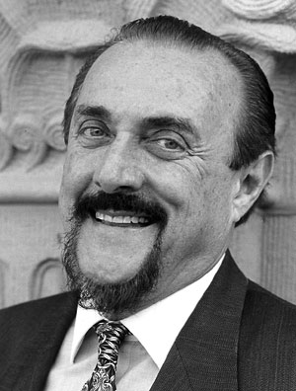
“Good people can be induced, seduced, and initiated into behaving in evil ways.”
“They can also be led to act in irrational, stupid, self-destructive, antisocial and mindless ways when they are immersed in ‘total situations’ that impact human nature.”
Prof. Zimbardo
‹#›

Slide 29
Character
vs
Situation
‹#›

Slide 30
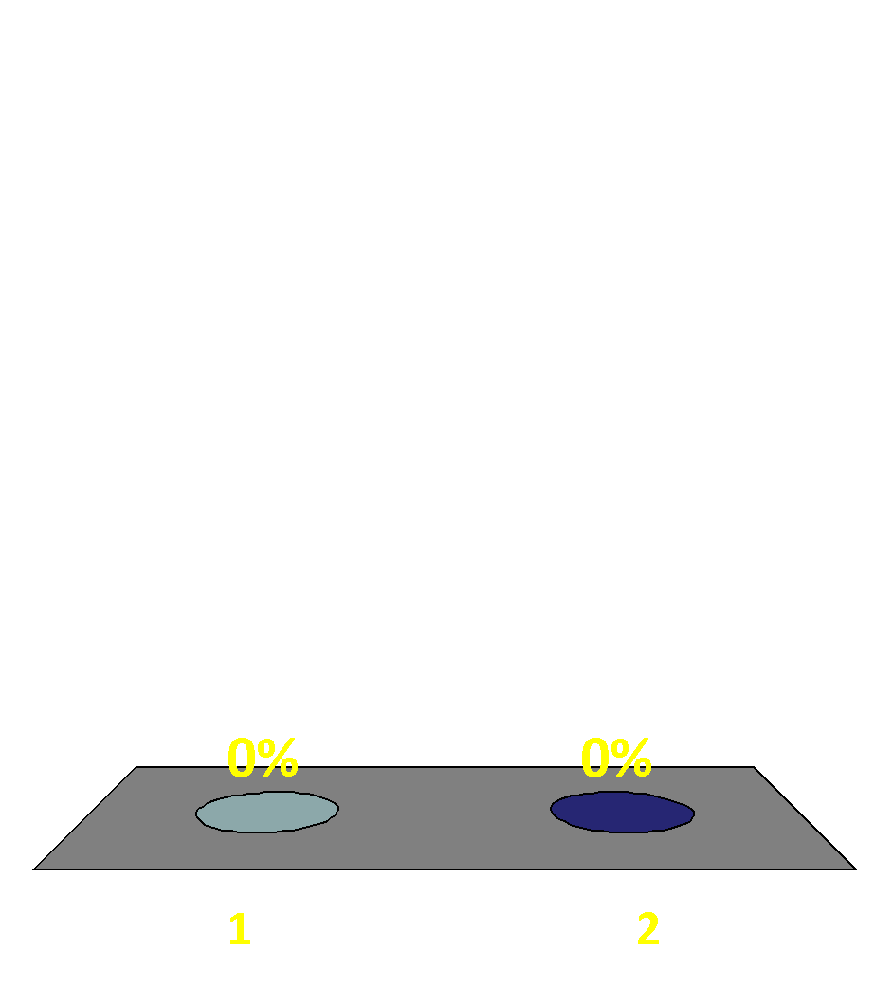
Is it acceptable to steal?
Yes
No
‹#›

Slide 31
Is it acceptable to steal food?
1 Yes
2 No
‹#›

Slide 32
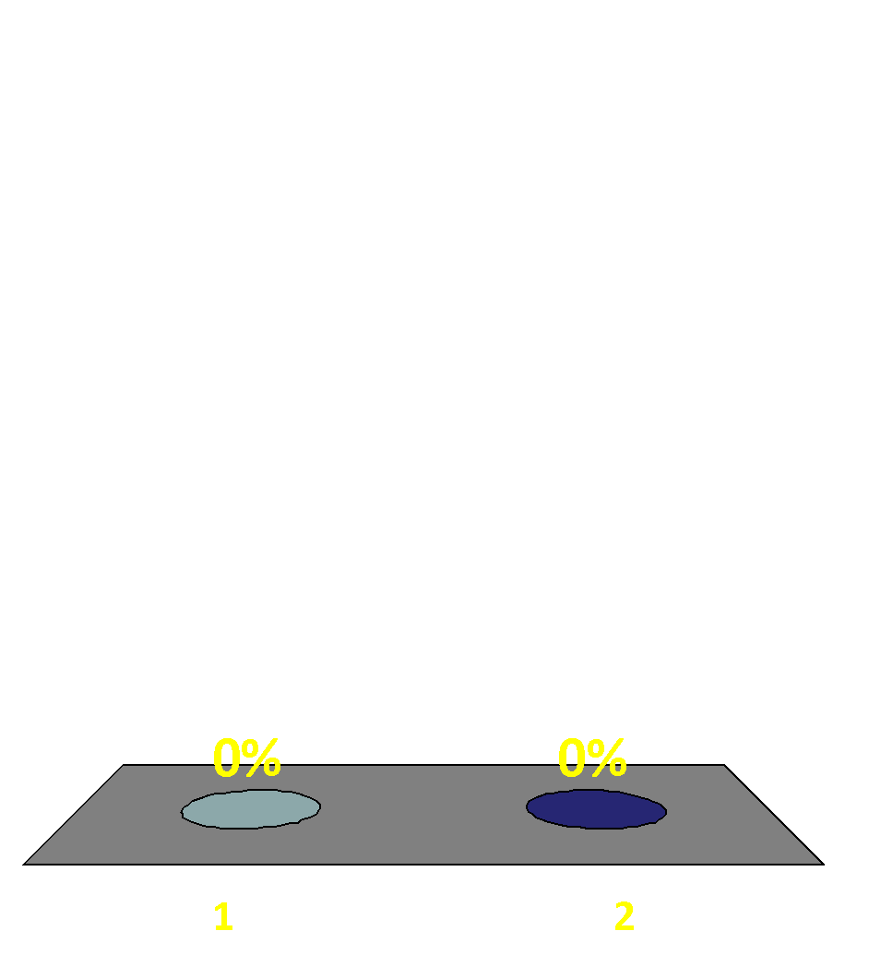
Is it acceptable to steal food if I am hungry?
1 Yes
2 No
‹#›

Slide 33
Is it acceptable to steal food if I am starving?
1 Yes
2 No
‹#›

Slide 34
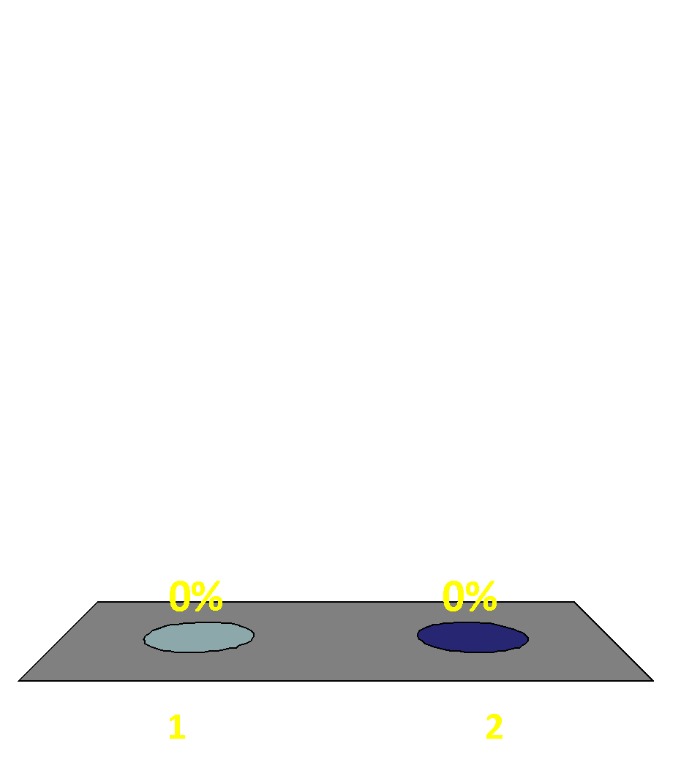
Is it acceptable to steal food if someone I am caring for is starving (My children; my parents)?
1 Yes
2 No
‹#›

Slide 35
Is it acceptable to torture?
Yes
No
‹#›

Slide 36
Is it acceptable to torture an EPW or detainee who might be responsible for the killing of several Marines?
Yes
No
‹#›

Slide 37
Is it acceptable to torture the EPW or detainee who might give us good intelligence?
Yes
No
‹#›

Slide 38
Is it acceptable to torture the EPW or detainee who might know the location of a Marine that was taken prisoner yesterday?
Yes
No
‹#›

Slide 39

Is it acceptable to torture the member of a kidnapping group who has taken your son, and might know where he is being held?
Yes
No
‹#›

Slide 40
At what point does something unethical become acceptable? And why?
Emotions can cause us to abandon rational thought and shift our moral judgment from long-term absolutes to short-term pragmatic “solutions”.
Marines do not do that!
How dangerous is this shift from rational thought to emotional “solutions” for the ethical leader and his/her Marines?
‹#›

Slide 41
THE SYSTEM
‹#›

Slide 42

Rank the importance of the elements below
Cohesion
Culture
Discipline
Leadership
Obedience
Training Education
‹#›

Slide 43
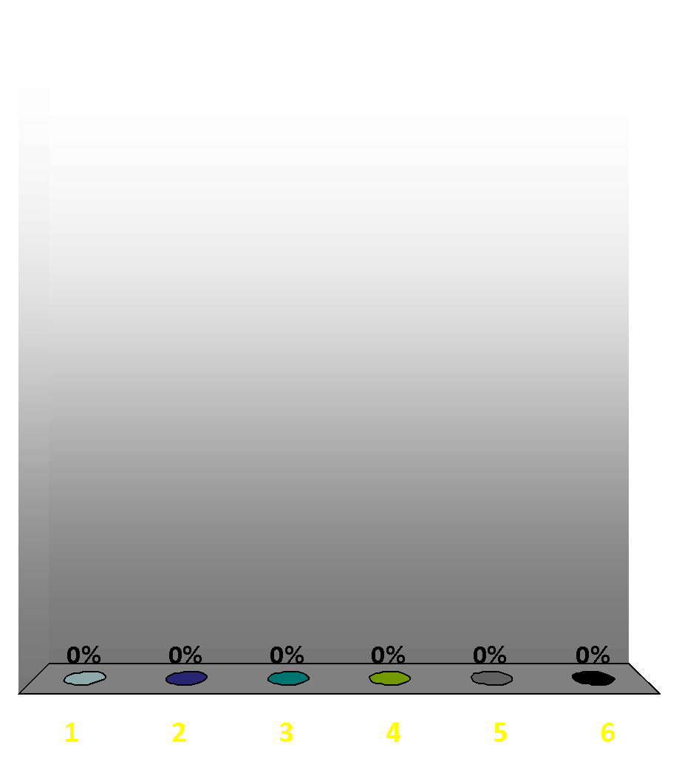
Rank the importance of the elements below
Cohesion
Culture
Discipline
Leadership
Obedience
Training Education
‹#›

Slide 44

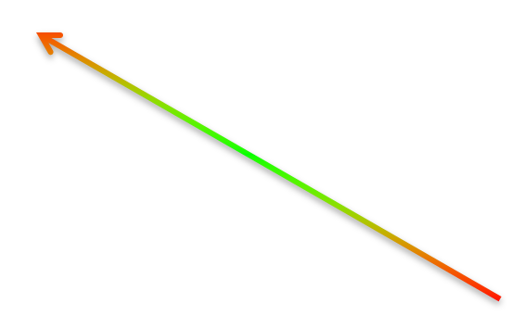



The Military System
Military Culture/values
Regimental Culture
Small Unit Culture
Obedience
Training/
Education
LEADER
Cohesion
Discipline
‹#›

Slide 45
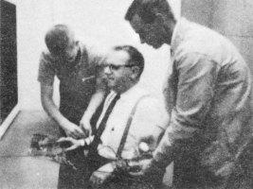
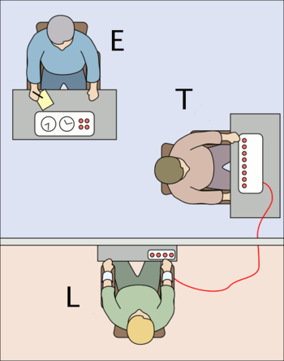
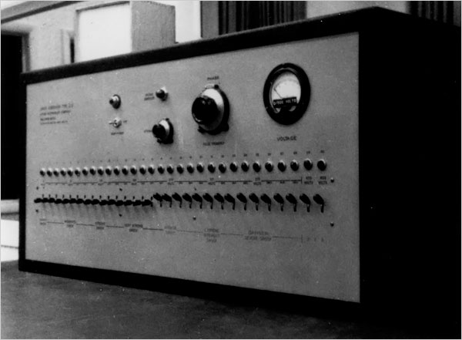
Obedience and Moral Courage
What should leaders learn from the Milgram experiment?
‹#›

Slide 46

‹#›

Slide 47
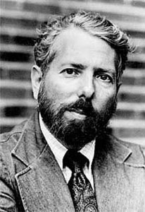
Milgram, morality and leadership
The individual shifts his/her moral concern “to a consideration of how well he is living up to the expectation that the leadership has of him.”
Gradual acceptance of immoral behavior only requires a first step towards immoral behavior!
Distorted understanding of moral responsibility leads to immoral behavior.
Prof. Milgram
‹#›

Slide 48
Cohesion
It is a force multiplier.
Motivates individuals to accept and deal with challenges they might never be able to face alone.
‹#›

Slide 49

Cohesion
Cohesion can turn negative if the core values of the individuals and the unit are significantly eroded.
In a crisis or highly stressful situation such as combat, soldiers will choose loyalty to their close friends over obligation to a higher organization.
LTC Robert Rielly, Military Review 2001
‹#›
‹#›

Slide 50
The negative side of Cohesion: Conformity
‹#›

Slide 51

‹#›

Slide 52
Conformity and Asch Experiment
Y
A
B
‹#›
C

Slide 53
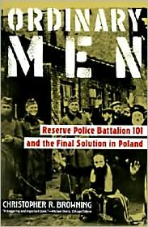

Conformity
and unethical behavior
Jozefow massacre, Poland, July 13, 1942
‹#›

Slide 54
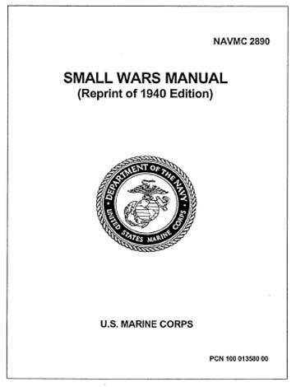
Training/Education: develop the proper mindset
In SWs “the aim is not to develop a belligerent spirit in our men, but rather one of caution and steadiness.”
“In major warfare, hatred of the enemy is developed among troops to arouse courage. In small wars, tolerance, sympathy, and kindness should be the keynote of our relationship with the mass of the people.”
‹#›

Slide 55
Preparing Marines to be strong ethical agents
For Marines, ethics are the standards of our corps. As a result, the individual is obligated to apply judgment to a given set of circumstances.
Judgment and therefore choice, is at the center of ethical conduct.
Leading Marines
‹#›

Slide 56
Our intuition is critical in the moment we have to make a choice.
Sound ethical intuition depends on judgment developed through life experiences.
The development of sound judgment depends primarily on EDUCATION.
Proper education and preparation for those critical moments depend on TRAINING (constant practice).
‹#›

Slide 57
THE BEST RESULTS ARE BASED ON A FOUNDATION OF TRAINING AND EDUCATION
THE
MOMENT
OF CHOICE
FOR THE BEST RESULTS
INTUITION
SOUND JUDGMENT
EDUCATION AND PREPARATION
TRAINING

Slide 58
Discipline
Discipline is learning what to do, when to do it and in what manner it should be done. For the Armed Forces, discipline is the standard of personal deportment, work requirement, courtesy, appearance and ethical conduct that will enable all to perform the mission with optimum efficiency.
- U.S. DEPT. of DEFENSE, The Armed Forces Officer
Character…Physical…Mental
‹#›

Slide 59
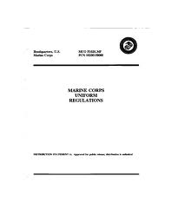
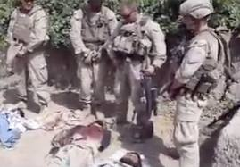
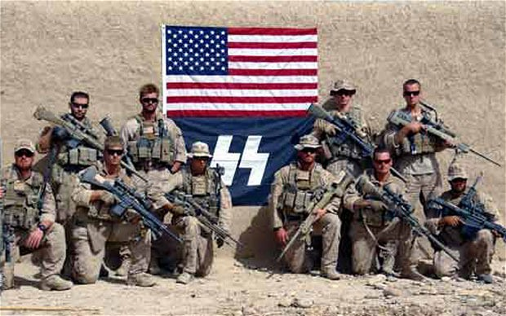
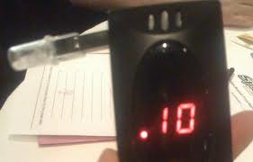
Absence of Discipline
‹#›

Slide 60
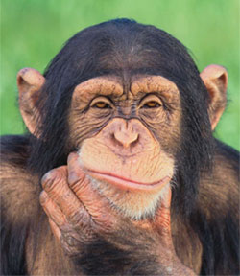
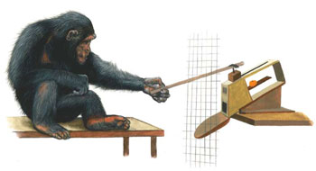
Culture
Water Hazard Parable
Pokers and Pushers
How are we any different?
‹#›

Slide 61
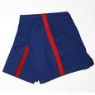
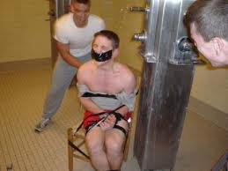
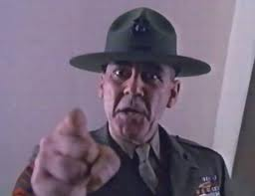
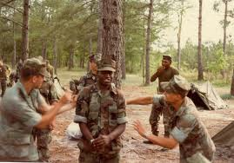
Culture
‹#›

Slide 62
Leadership role in Zimbardo experiment:
Absent/Passive
Did not provide a point of reference
Did not send inputs to the system
Leadership role in Milgram experiment:
Negative
Sent negative inputs to the system
‹#›

Slide 63

A leader’s dangerous mistake
“creating the myth of invulnerability to situational forces, we set ourselves up for a fall by not being sufficiently vigilant to situational forces.”
‹#›

Slide 64

Zimbardo’s experiment ended with:
The leader’s trap
I had not been a participant in the study. I had no socially defined role within that prison context. I was not there every day, being carried along as the situation changed and escalated bit by bit.
The situation I entered at the end of the week was not truly the “same” as it was for everyone else. For them, the situation was constructed as being still within the range of normalcy; for me, it was not – it was a madhouse.
Christina Maslach
‹#›

Slide 65
Leaders will often not be able to change or shape the situation in which they operate. However:
a good understanding of the individual(s)
and
a correct application of the system
will provide them with the best response to the situation and encourage ethical and morally sound behavior in their troops.
‹#›

Slide 66
‹#›

Slide 67
Based on the photo you saw, rank which of the elements of the system failed most
Cohesion
Culture
Discipline
Leadership
Obedience
Training Education
‹#›

Slide 68
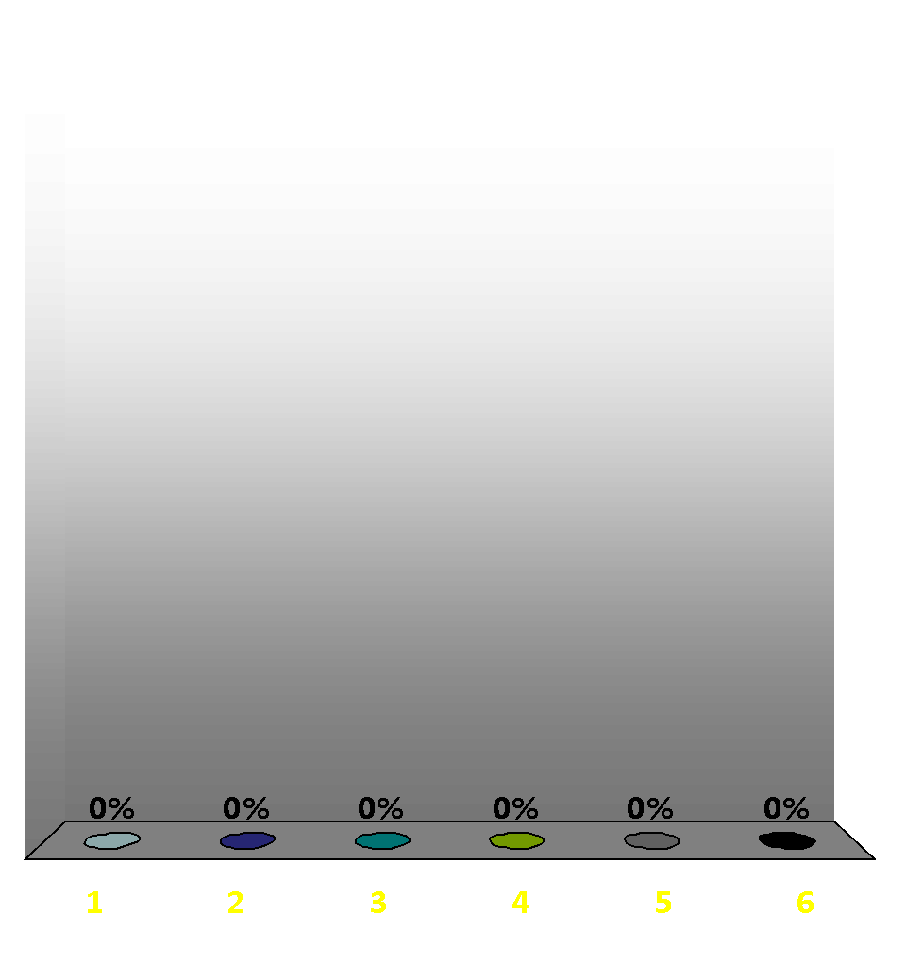
Based on the photo you saw, rank which of the elements of the system failed most
Cohesion
Culture
Discipline
Leadership
Obedience
Training Education
‹#›

Slide 69
Is ethical leadership all about character?
Yes
No
‹#›

Slide 70
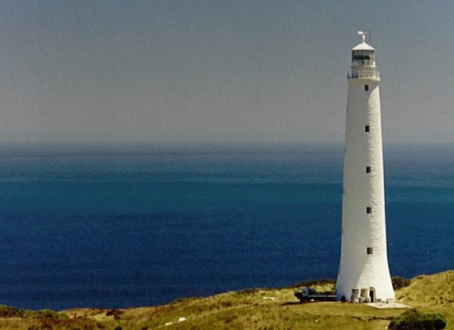
The Most Important Role For Ethical Leaders
Leaders should provide their Marines a strong point of reference and send them positive inputs, ESPECIALLY when operating in a complex moral environment.
‹#›

Slide 71
West Coast
LtCol Brian Christmas brian.christmas@usmc.mil
Dr. Rebecca Johnson rebecca.j.johnson@usmc.mil
Ethics Team POC
National Capital Region
Col Royal Mortenson
royal.mortenson@usmc.mil
Dr. Paula Holmes-Eber
paula.holmes-eber@usmc.mil
East Coast
LtCol Wayne Beyer
wayne.beyer@usmc.mil
Dr Wendy Chambers
wendy.chambers.ctr@usmc.mil
Pacific
SgtMaj William Skiles
william.skiles@usmc.mil
Dr Paolo Tripodi
paolo.tripodi@usmc.mil
‹#›
https://www.mcu.usmc.mil/sitepages/ethics_symposium.aspx

